Slide 1
Vibration issues for SuperKEKB
M. Masuzawa, R. Sugahara and H. Yamaoka (KEK)

Slide 2
Contents
What is SuperKEKB?
See slides that I presented on Monday
Vibration measurements at KEKB
Measurements at various locations &
components since 2003.
Some presented at IWAA2004.
more recent data.
What to do

Slide 3
1. What is SuperKEKB
Y (vertical)
YZ view of the beam at the IP
Z(Beam direction)
KEKB
σy ~ 1 μm
σz ~ 6 mm
SuperKEKB
σy ~ 0.07 μm
σz ~ 6 mm
Will such thin beams collide stably??
We’d better re-evaluate the vibration and take a closer look.

Slide 4
2. Vibration measurements at KEKB tunnel
Especially around the Interaction Region (IR)
where the very small beams collide.

Slide 5
Purpose of the measurements
To characterize the vibrations.
Where is it that vibrates?
Magnets
Supporting table
Floor
At which frequency?
Characteristic frequencies
With what amplitude?
Will it cause a serious degradation in the machine performance?

Slide 6
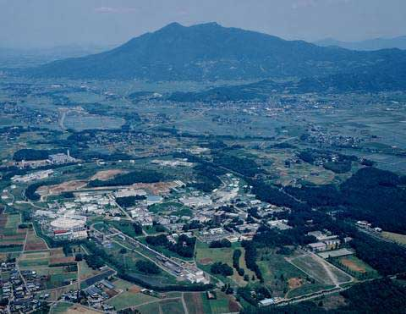
KEK environment
D3
D9

Slide 7
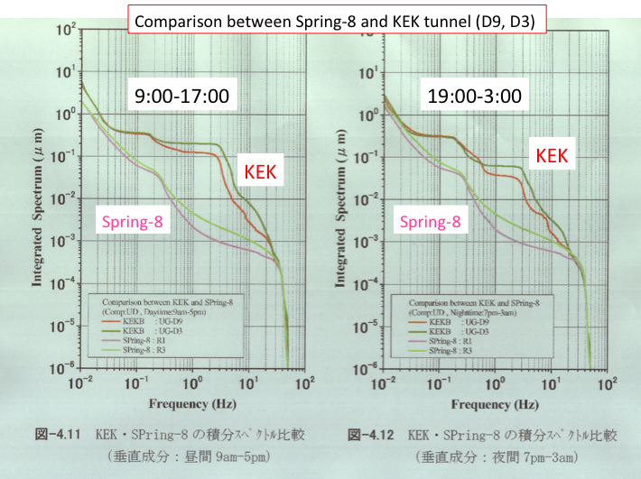
KEK environment Measured by R.Sugahara et.al (KEK Report 2003-12)
D3
D9
D3
KEK >>
Spring-8
D9
D3 (road side)
> D9 (field side)
Clear day & night
effects seen
day > night
3Hz

Slide 8
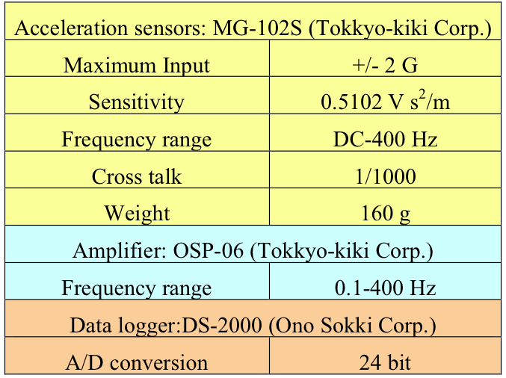
Sensors
We use six acceleration sensors (MG-102S, Tokkyo-kiki Corporation).
Each sensor measures one direction, 3 sensors used to measure (X,Y,Z).
2 sets of sensors, one set usually on the floor and the other on the magnet, for example.
Servo Accelerometer
ＭＧ－１０２
Size
40×40×50mm
Max. input
±２G
Resolution
１／10⁶G
Acc. 0.1～400Hz Acc. 60dB = 1gal/V

Slide 9
Measurements KEKB Interaction Region (IR)
*Power Spectrum Density (PSD) plots
*Integrated amplitude (vs frequency) plots
Data taken in June 2009,
when Belle solenoid, QCS and the ring magnets were
turned off.

Slide 10
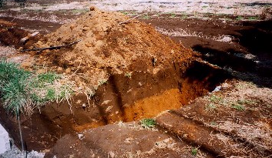
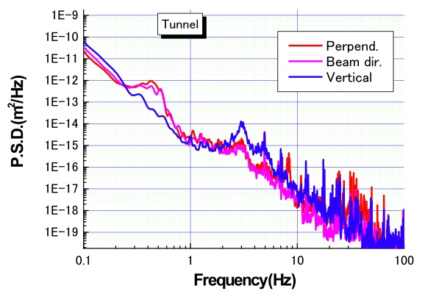
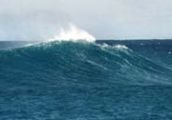
~3Hz : characteristic frequency of the soil,
called “Kanto loam,” around KEK.
Induced by human activities,
mainly vertical vibration.
Day & night effects and weekend effects
have been observed.
3 Hz
0.3 Hz
and 3 Hz
peaks
understood.
0.3 Hz
Tunnel floor
0.2~0.3 Hz: Ocean waves & wind.
Depends on the weather, mainly in horizontal vibration.

Slide 11
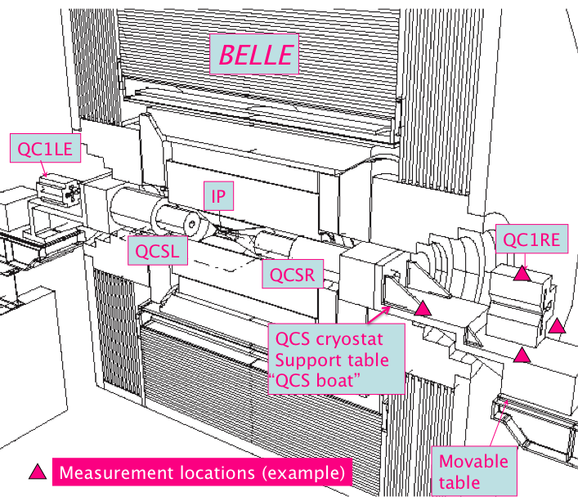
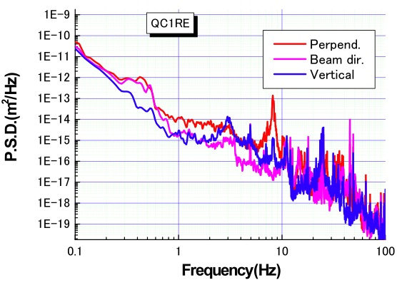
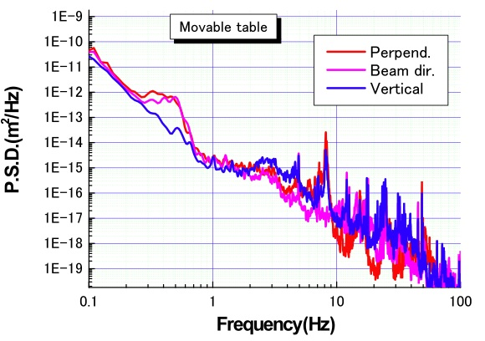
QC2RP
1250kg
PSD
QC1RE
1370kg
500kg
~8Hz peak
Tunnel floor
H.Yamaoka

Slide 12
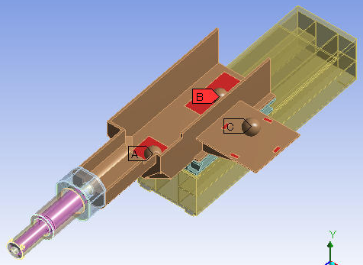
All the IR magnets on the movable table
& the movable table vibrate at 8Hz.
QC2RP
1250kg
Movable table
QC1RE
1370kg
500kg
IR tunnel floor
Cryostat for Final Focusing Superconducting Magnets,
supported by just one end.
Most important final focus Q probable vibrates…

Slide 13
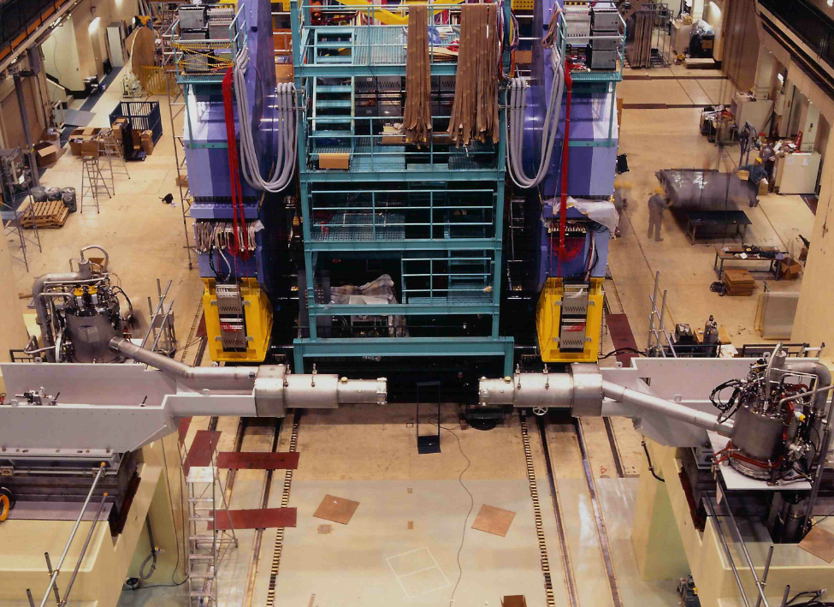
Displacement sensors
To measure the distance
Between cryostat and BELLE
Cryostat for Final Focusing Superconducting magnets (QCS),supported by just one end.
The vibration amplitude is probably larger
Near the IP !!

Slide 14
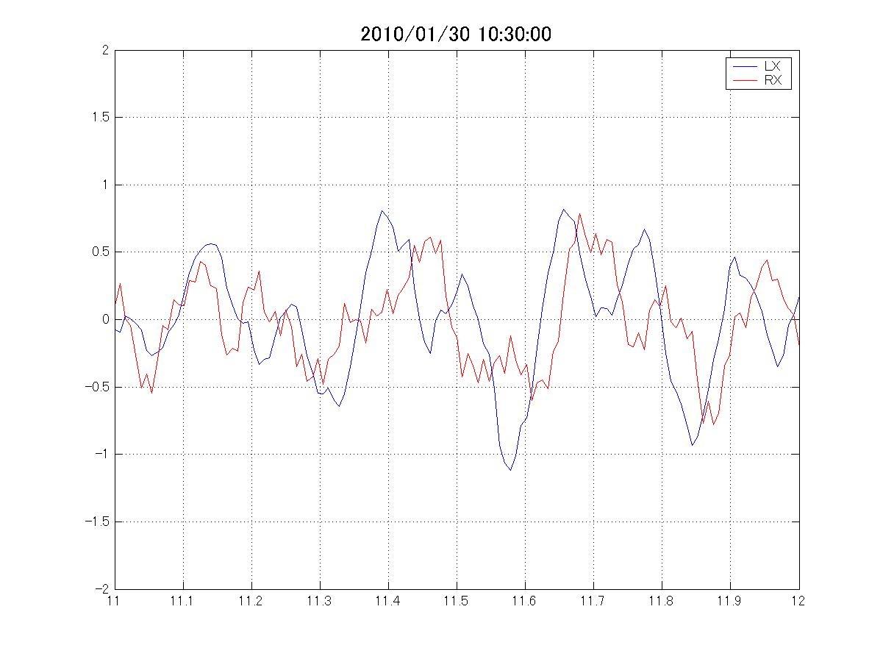
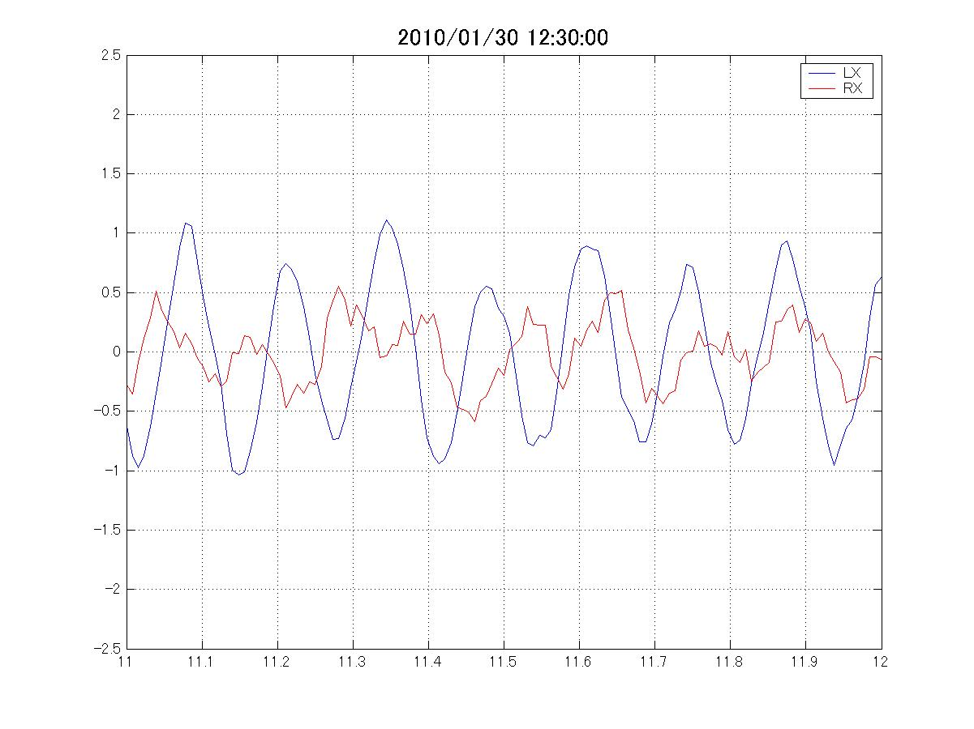
Displacement sensors
To measure the distance
Between cryostat and BELLE
LX
RX
4Hz (R&L in phase)
± 1μm
1 second
Cryostat motion with respect to
BELLE has 4 Hz and 8Hz peaks.
LX
RX
8Hz
The ~4 Hz motion is in phase.
BELLE is the one that is
vibrating, not cryostat.
The ~8 Hz motion is not in phase.
>Cryostat is moving.
± 1μm
1 second

Slide 15
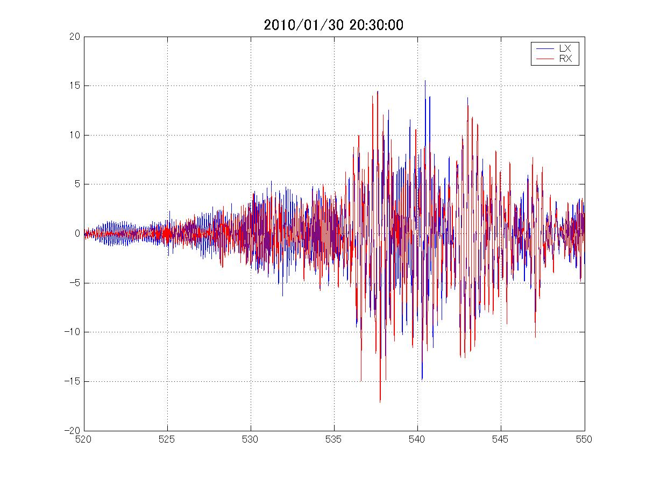
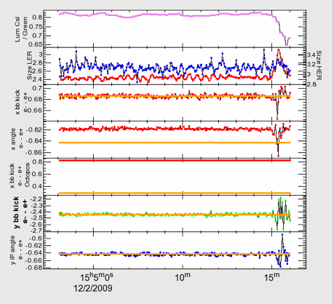
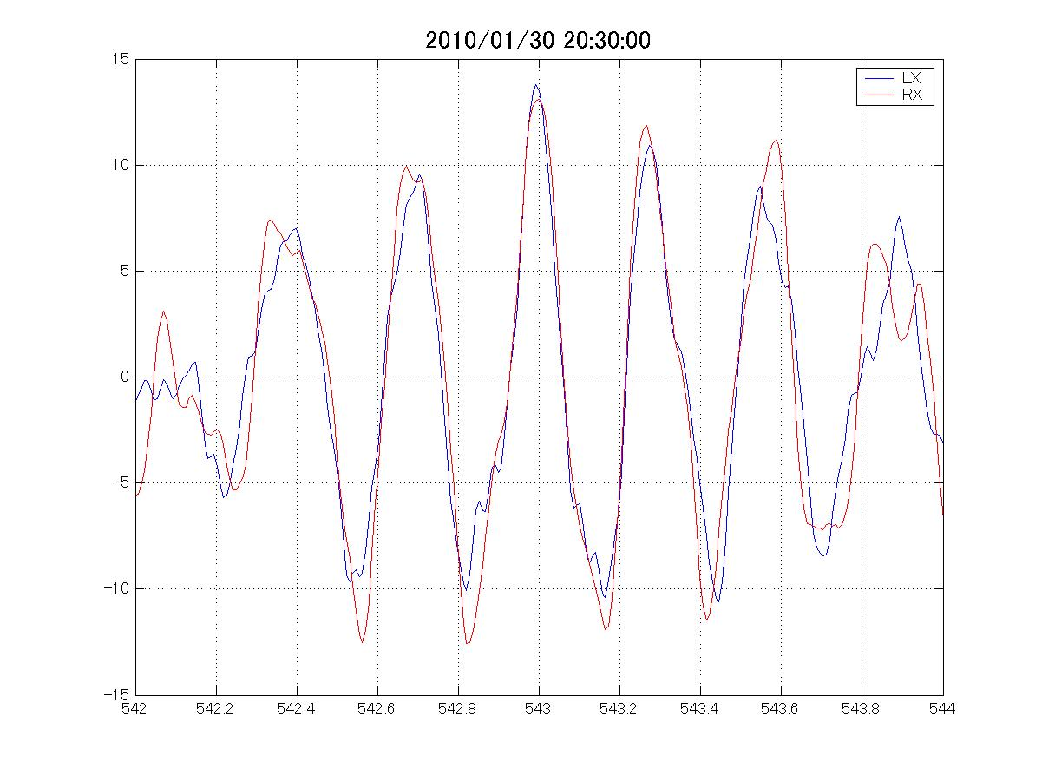
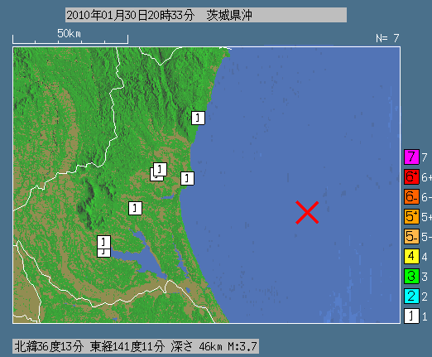
In phase
Out of phase
± 15μm
Earth quake!
A good collision condition maintained by
orbit FB system was lost, resulting in beam loss.
“1” in Japanese seismic
Intensity scale.
I did not feel anything.

Slide 16
Measurements on BELLE (1300 ton!) and indeed BELLE was shaking at 4Hz
Cryostats (& therefore final focusing superconducting quad) vibrate
a lot when earth quake hits the area
at 8Hz
at 4Hz (Left side and right side cryostat modules vibrate in phase)

Slide 17
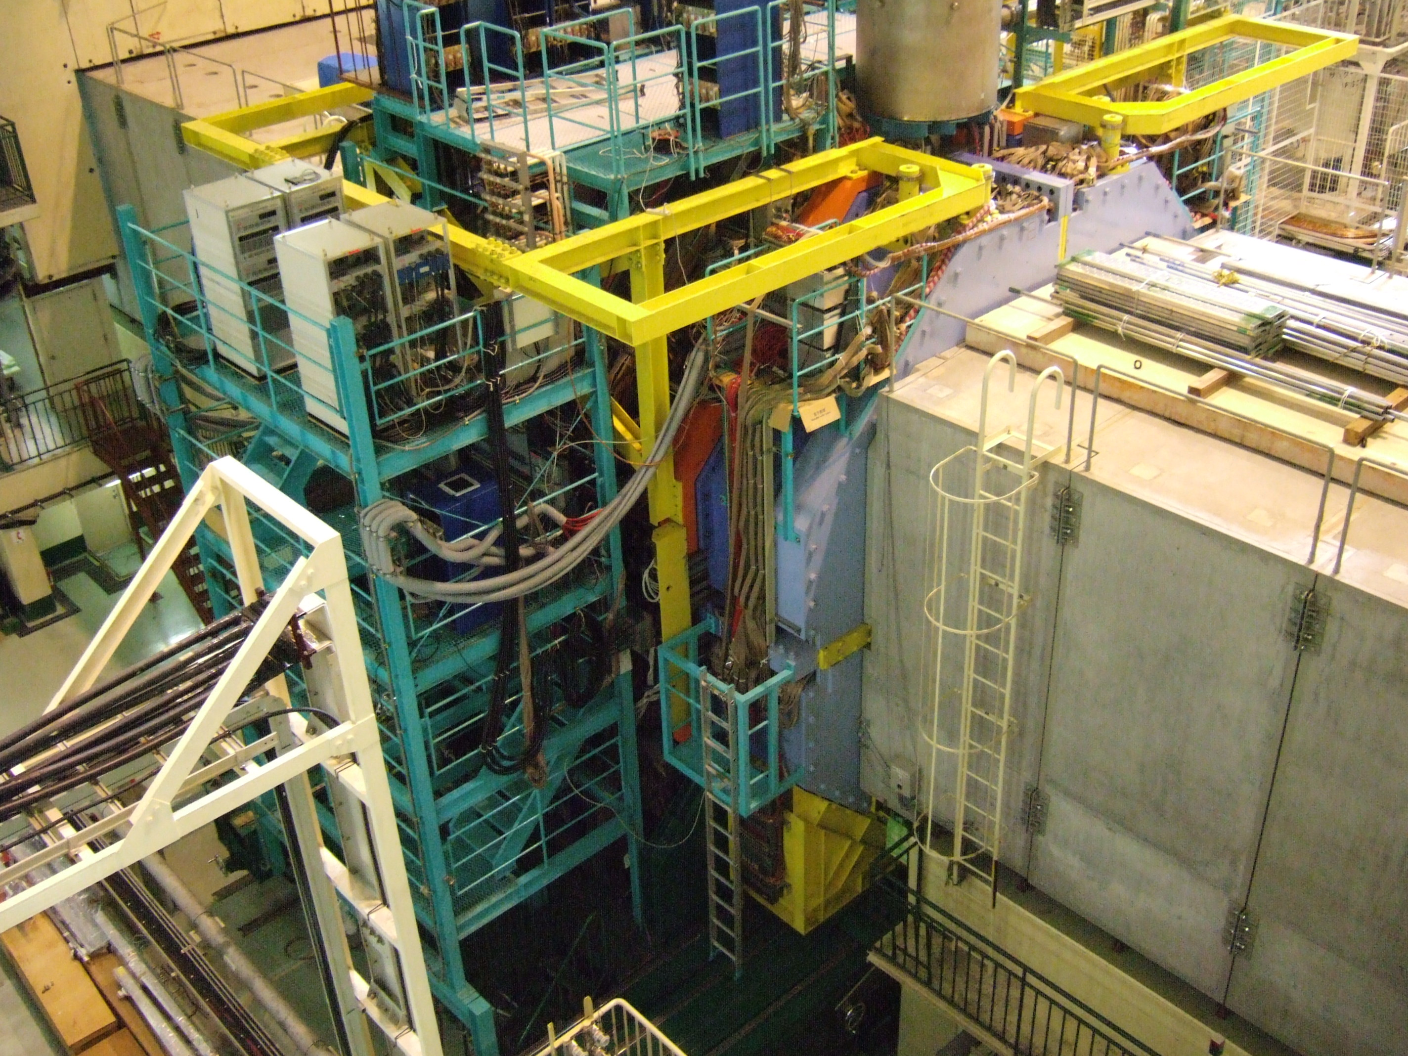
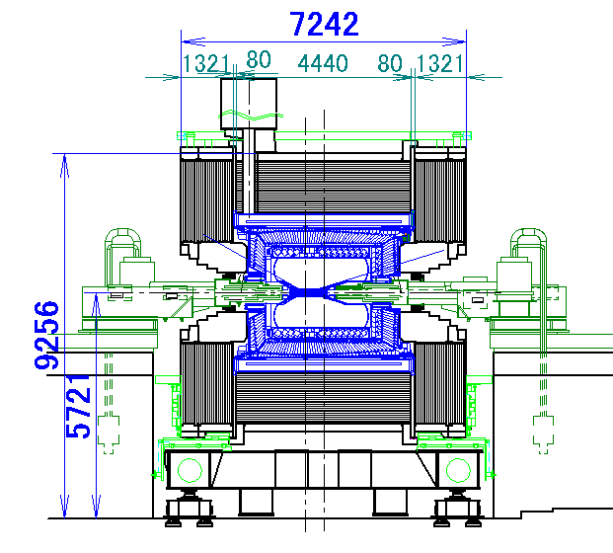
Measurement locations
(12/28/2009)
1300 tons
H.Yamaoka

Slide 18
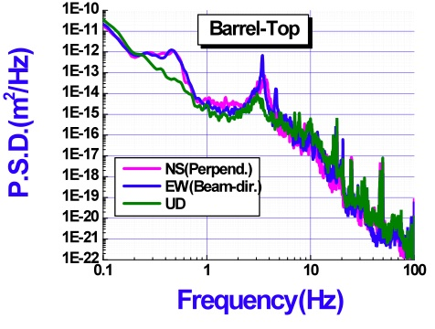
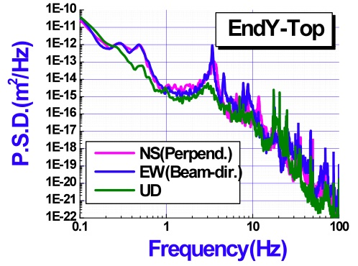
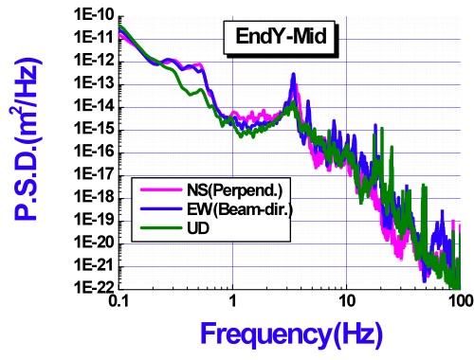
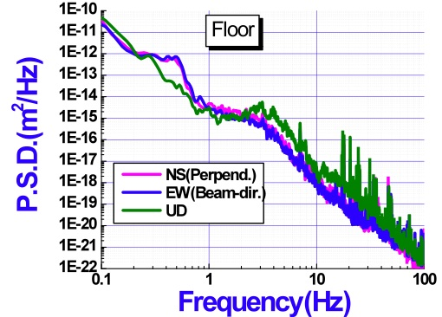
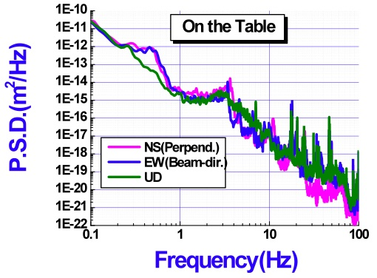
BELLE
PSD
4 Hz peak
grows
toward
the top
H.Yamaoka

Slide 19
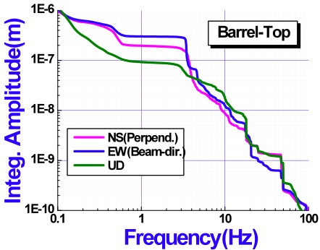
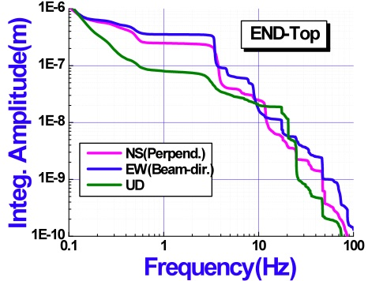
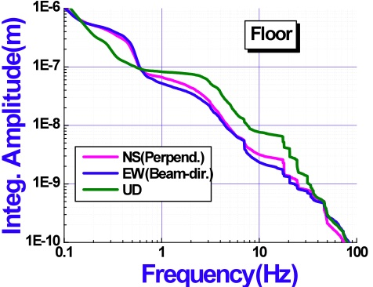
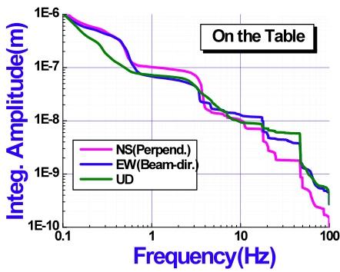
BELLE
Amplitude
196nm
301nm
93nm
248nm
354nm
80nm
25nm
17nm
20nm
9nm
12nm
18nm
204nm
254nm
121nm
14nm
27nm
19nm
4 Hz peak
grows
toward
the top
67nm
52nm
82nm
102nm
68nm
72nm
3nm
2nm
8nm
10nm
12nm
9nm
H.Yamaoka

Slide 20
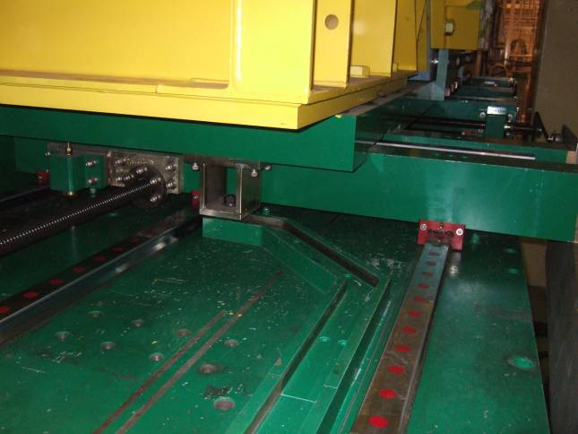
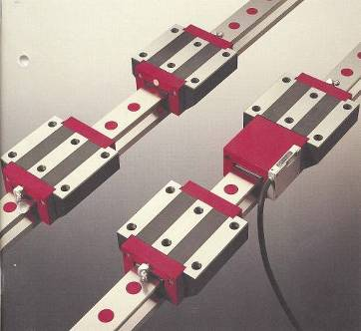
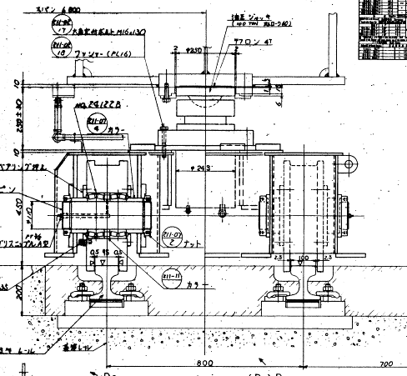
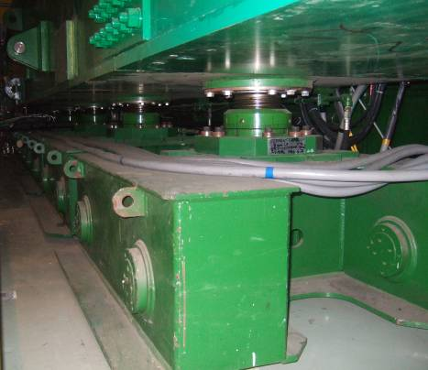
Measurement results
- First resonance is around ~3-4Hz.
- Amplitude on the barrel is bigger than on the table.
- Amplitude on the End-Yoke increases toward the top.
150tonnes
- The Belle detector is not fixed to the floor.
- The barrel yoke is just placed on the table.
- Top of the end-yoke is not fixed.
Improvements/modification are
being discussed.
H.Yamaoka

Slide 21
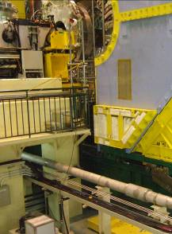
Summary
QC1RE
KEKB tunnel at the IP vibrates at
~ 0.3 Hz in the horizontal direction (micro-seismic)
~3 Hz in the vertical direction & horizontal
direction (resonance of the “Kanto loam”
soil around KEK)
In addition, magnets, the movable table
and the cryostat vibrate at ~ 8Hz.
QCS-boat
Movable table
KEKB tunnel floor
Belle-stand
B4 floor

Slide 22
Summary
BELLE detector vibration
First resonance is measured around ~3-4Hz, mainly in horizontal directions.
Amplitude on the barrel is bigger than at the table.
- Amplitude on the End-Yoke increases going towards the top.

Slide 23
Summary (vibration amplitude)
Summary table by H.Yamaoka
The vibration amplitudes of the IR magnets are much smaller than the size of the
colliding beams (~1 μm vertically & ~ 100 μm horizontally) for KEKB but comparable
for SuperKEKB.
Vertical vibration of ~0.1 μm at QC1 ⇒ COD of ~σy at the IP
The two beams will not collide well at SuperKEKB if we do not do
anything.

Slide 24
3. Strategy : What to do
Progress in understanding the characteristics of the IR vibration
are being made.
We understand where the 8 Hz (IR) and 4 Hz (BELLE) come from.
How to reduce the vibration of IR components & BELLE?
⇒ Being discussed/investigated.
Support structure of the final focusing superconducting
magnets. Single-arm support is a bad idea but easier
when assembling.
⇒Work with the BELLE-II group is necessary.
⇒The SuperKEKB IR design has not been finalized yet, which makes our evaluation more difficult.

Slide 25
3. What to do
Feedback system to maintain a good collision condition!
⇒There was a collision orbital FB system called “iBump
system” at KEKB, which worked very well. But it was a slow system (1Hz at most, which is limited by the BPM speed).
Faster vibration was not a problem as
beam size >> vibration amplitude at higher frequencies.
At SuperKEKB, a faster orbital (collision) feedback system is needed.
⇒From the vibration measurements at KEKB, the required
speed of the orbital FB system is around 50 Hz.
(Not as fast as bunch-by-bunch FB system.)
FB is our present choice, not an active (or passive) anti-vibration system.
Vibration issues is critical.

