Slide 1
PERMANENT MONITORING OF THE LHC LOW BETA TRIPLETS: LATEST RESULTS AND PERSPECTIVES

Slide 2
SUMMARY
Introduction: alignment systems configuration
Short term monitoring results
Warm-up of a cryostat and associated constraints
The importance of redundant and independent measurements
WPS readings during a ramping of magnet
Long term monitoring results
Case of triplet 1L
Stability of LHCb cavern versus tunnel
Status and first conclusions
Perspectives
Consolidation
Upgrade
Conclusions

Slide 3
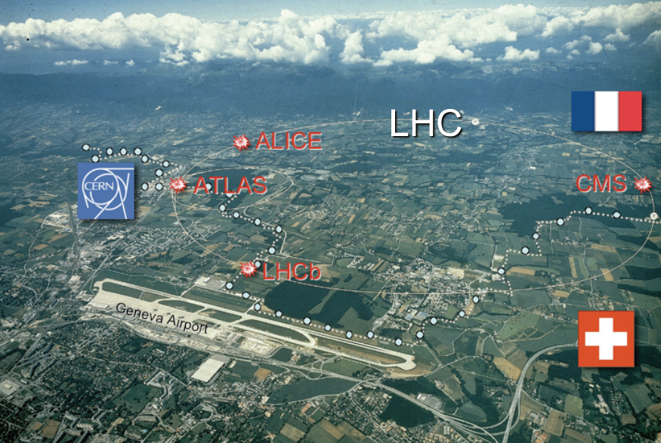
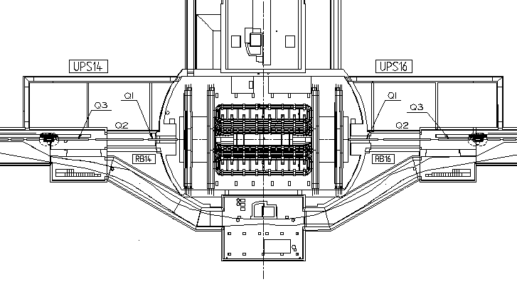
Introduction: alignment systems
Alignment requirements:
Positioning of one inner triplet w.r.t the other: ± 0.1 mm (1σ)
Stability of the positioning of one quadrupole inside its triplet: a few microns

Slide 4
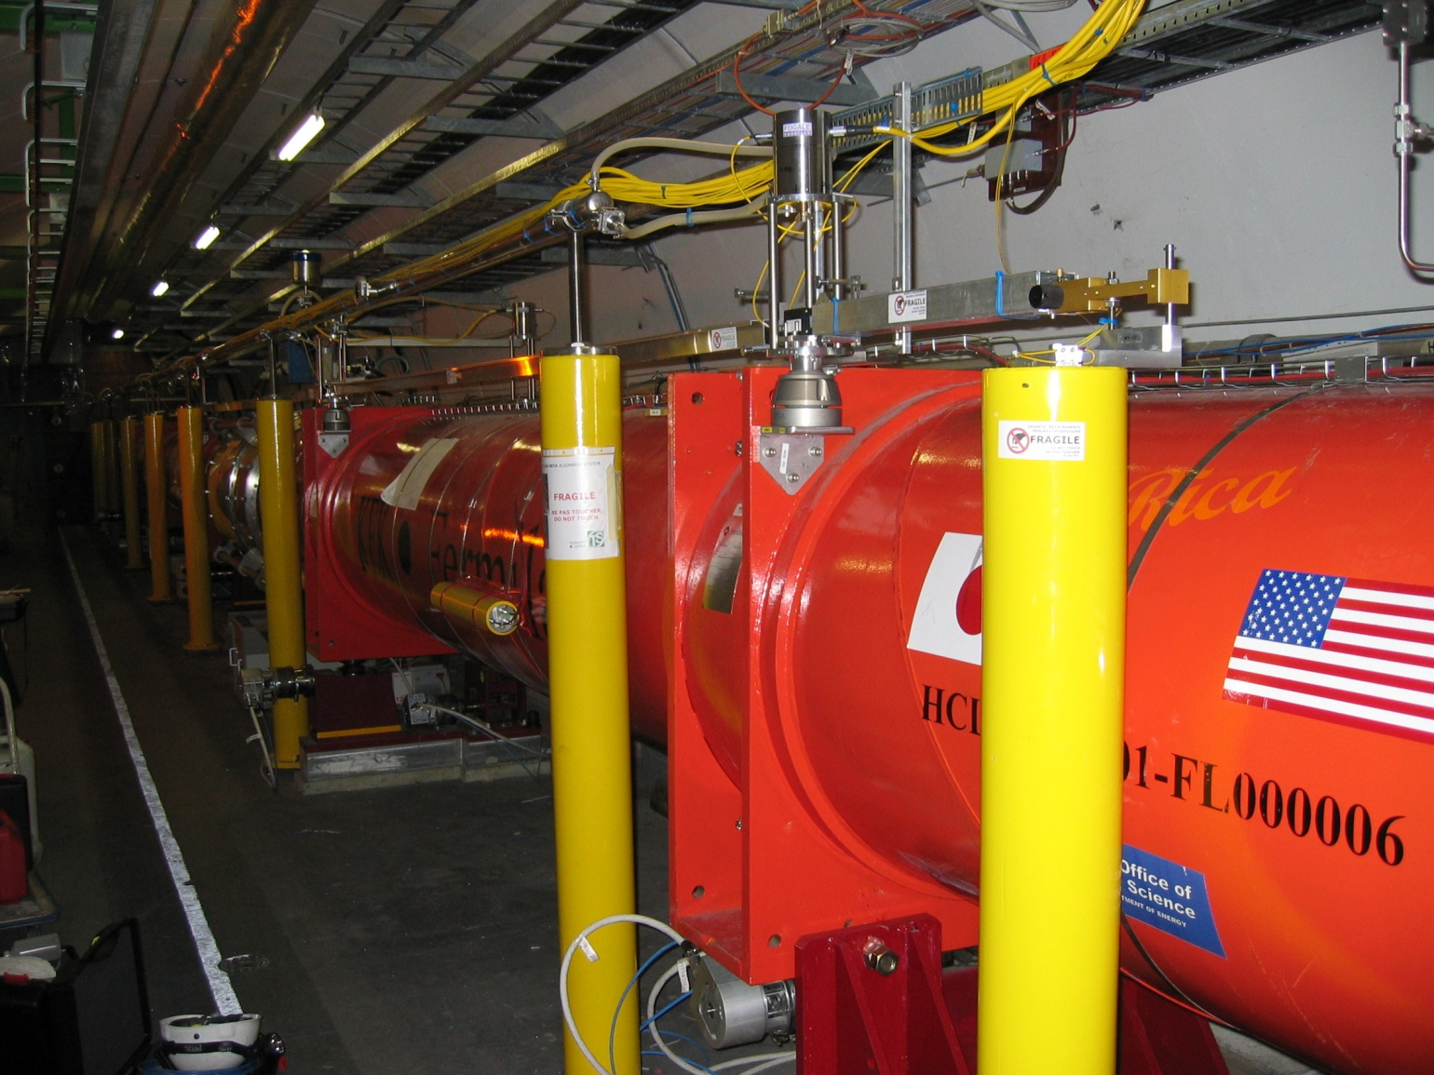
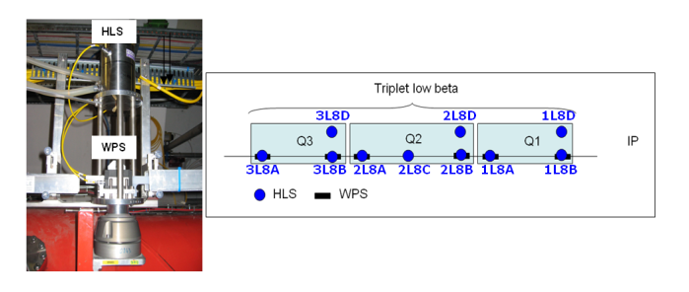
Introduction: alignment systems

Slide 5
SUMMARY
Introduction: alignment systems configuration
Short term monitoring results
Warm-up of a cryostat and associated constraints
The importance of redundant and independent measurements
WPS readings during a ramping of magnet
Long term monitoring results
Case of triplet 1L
Stability of LHCb cavern versus tunnel
Status and first conclusions
Perspectives
Consolidation
Upgrade
Conclusions

Slide 6
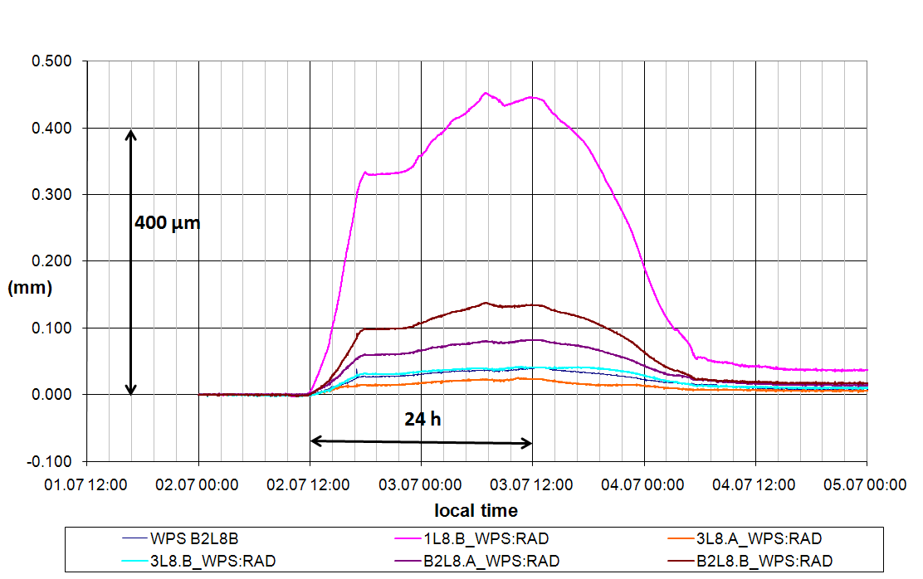
Short term monitoring
Warm-up of a cryostat and associated constraints
Radial WPS measurements 02-04 July 2008. Triplet 8L

Slide 7
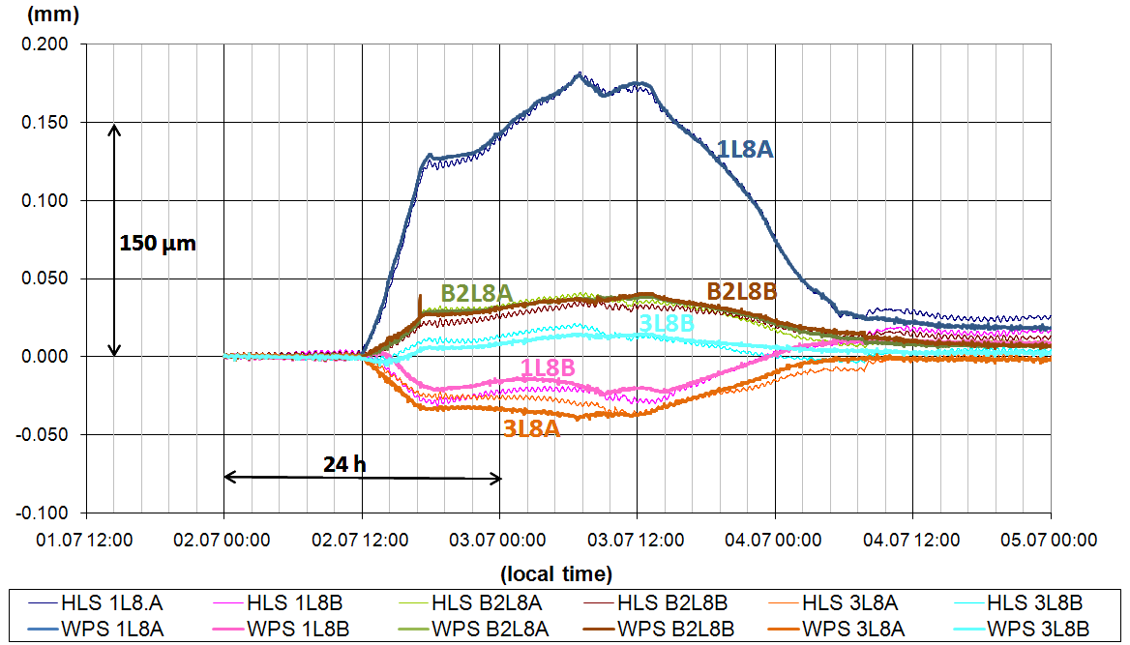
Warm-up of a cryostat and associated constraints
Vertical WPS and HLS measurements 02-04 July 2008. Triplet 8L

Slide 8
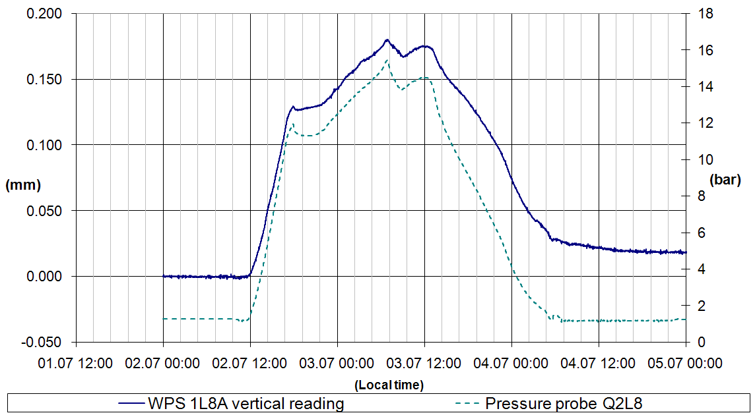
Warm-up of a cryostat and associated constraints
Increase of T° of triplet helium bath
Increase of internal pressure (limited to 17 bars by valves)
Development of internal stresses
Displacement of the triplet
Vertical WPS reading vs internal pressure probe
Displacements were monitored at the level of the fiducials ➔ what about cold mass?
After analysis of data concerning the 8 triplets of the LHC: an increase in internal pressure causes always a misalignment of triplet, variable according to the triplet (10 to 500 microns)
Importance of knowing the internal parameters of a triplet even for standard measurements

Slide 9
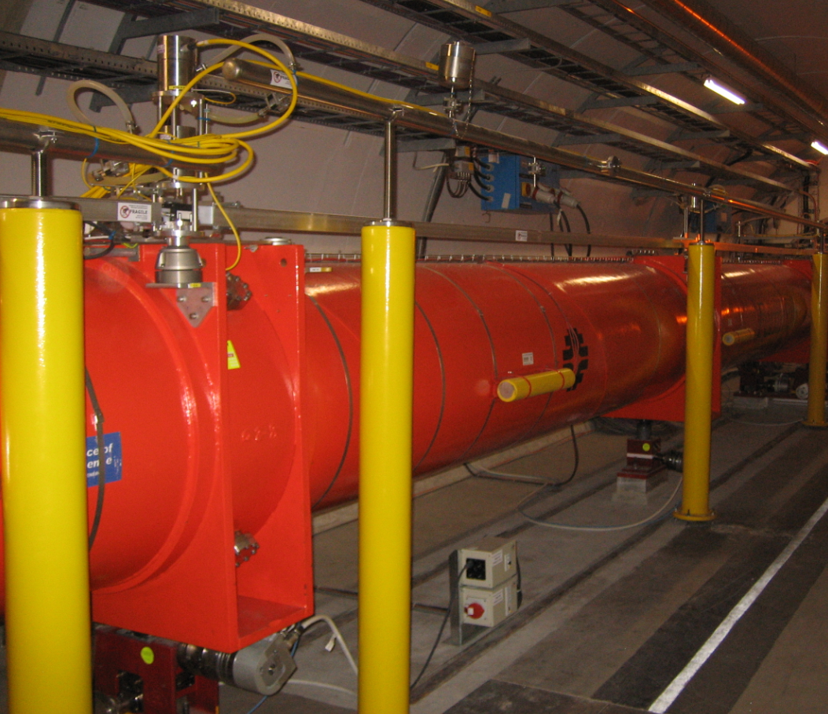
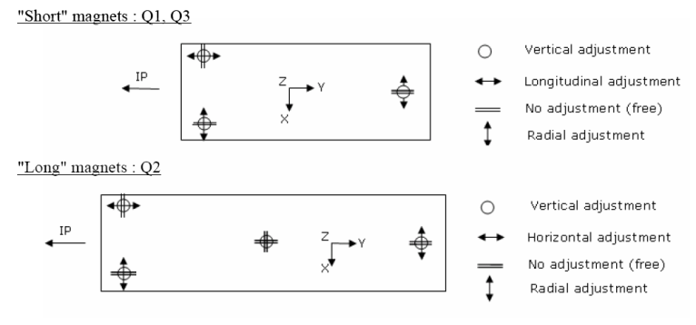
Short term monitoring
The importance of redundant and independent measurements
Repositioning of Q2 needed (~ a few tenths of mm)
Displacement confirmed by motor steps and associated encoders
No displacement seen on HLS and WPS systems

Slide 10
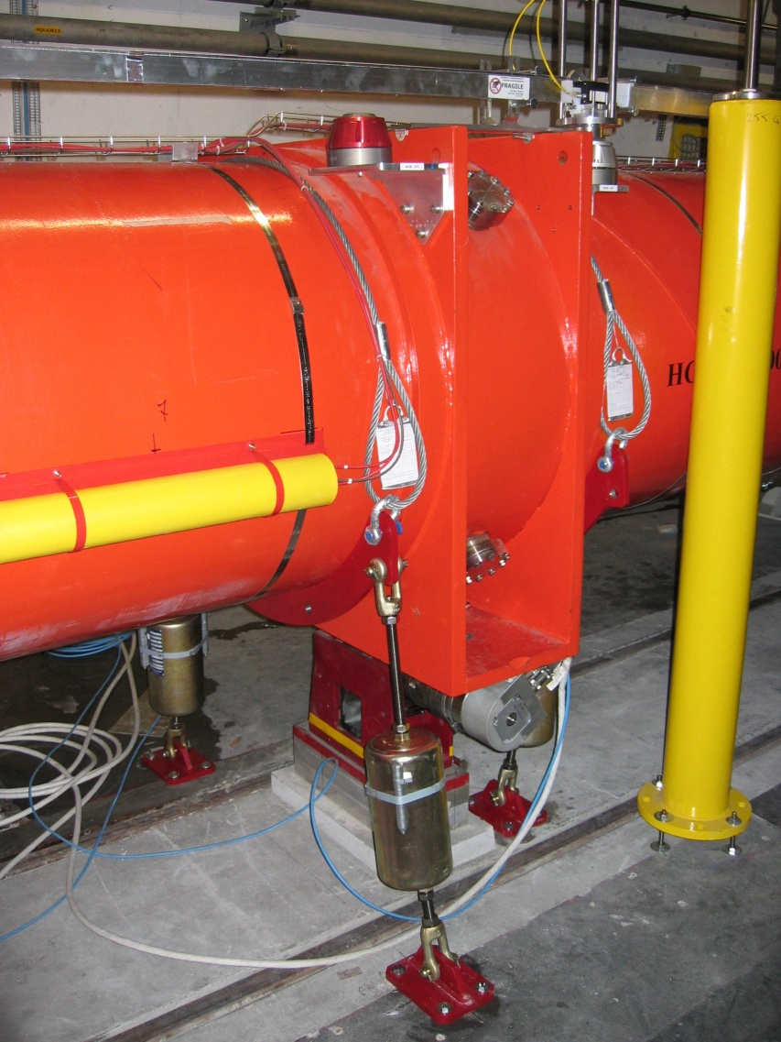
Short term monitoring
The importance of redundant and independant measurements
After analysis, heads of jacks no more in contact with cryostat
All load of Q2 (18t) applied on the central jack
Mechanical solution implemented to apply load on the external jacks
Importance of having control systems of displacement completely independent from the moving axis!

Slide 11
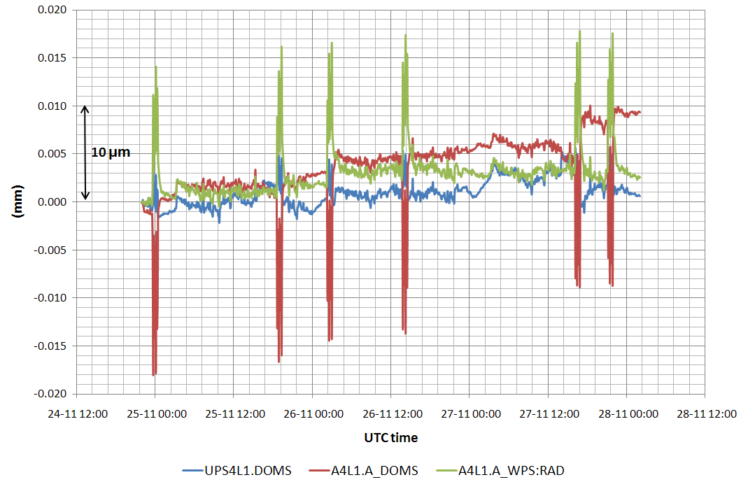
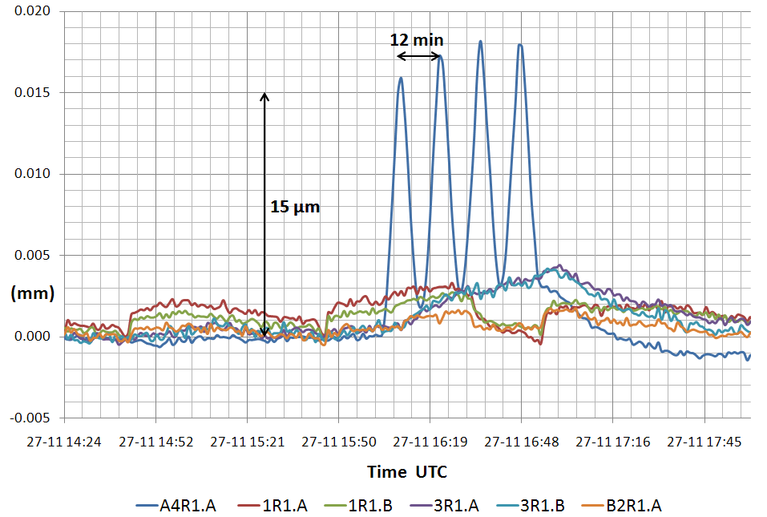
Short term monitoring
WPS readings during ramping of magnet
Real triplet movements or influence on the alignment system during ramping (earthing of stretched wire)?

Slide 12
SUMMARY
Introduction: alignment systems configuration
Short term monitoring results
Warm-up of a cryostat and associated constraints
The importance of redundant and independent measurements
WPS readings during a ramping of magnet
Long term monitoring results
Case of triplet 1L
Stability of LHCb cavern versus tunnel
Status and first conclusions
Perspectives
Consolidation
Upgrade
Conclusions

Slide 13
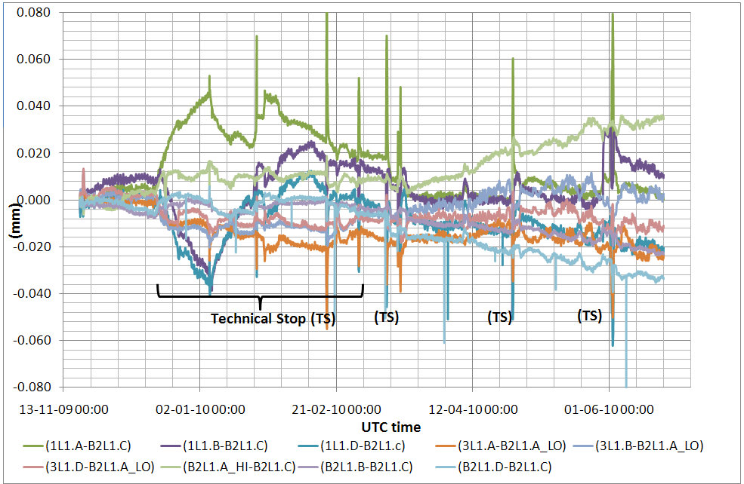
Long term monitoring results
Case of triplet 1L
Vertical stability of the triplet: ± 50μm over more than 7 months
Peaks during technical stops or warming of cold masses ➔ difficulty to achieve micrometric measurements during periods of access/works in the tunnel

Slide 14
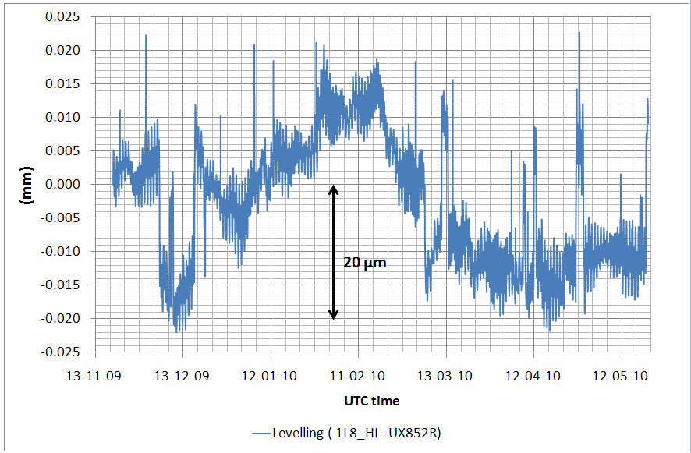
Long term monitoring results
Stability of LHCb cavern w.r.t tunnel
Vertical stability between cavern and tunnel areas around LHCb
Very good quality of readings

Slide 15
SUMMARY
Introduction: alignment systems configuration
Short term monitoring results
Warm-up of a cryostat and associated constraints
The importance of redundant and independent measurements
WPS readings during a ramping of magnet
Long term monitoring results
Case of triplet 1L
Stability of LHCb cavern versus tunnel
Status and first conclusions
Perspectives
Consolidation
Upgrade
Conclusions

Slide 16
Status and first conclusions
Sensors in good running order: no failure encountered (100 HLS and 60 WPS)
Only one stretched wire broke during installation
Wire validations necessary to detect a wire blocked in its protection
Installed sensors perform relative measurements about a few microns, and « absolute » measurements (with respect to the beam) of a few tenths of mm (including the determination of the fiducials w.r.t beam axis, stability of the position of the cold masses, determination of the supports on which sensors are installed)
Additional variables added in beam coordinate system for operational purpose, with an on-line monitoring in the CCC.

Slide 17
SUMMARY
Introduction: alignment systems configuration
Short term monitoring results
Warm-up of a cryostat and associated constraints
The importance of redundant and independent measurements
WPS readings during a ramping of magnet
Long term monitoring results
Case of triplet 1L
Stability of LHCb cavern versus tunnel
Status and first conclusions
Perspectives
Consolidation
Upgrade
Conclusions

Slide 18
Perspectives
Consolidation
Remote preventive maintenance in preparation:
Remote displacement of stretched wire
Filling / purging station for hydraulic networks
Remote detection of a broken wire
Installation of additional WPS independent from the magnets to be aligned, closed to the stretching device
Training on a prototype magnet
Simplification of remote repositioning ➔ development of semi- automatic repositioning

Slide 19
Perspectives
Upgrade
Upgrade of low beta triplets postponed (2014 ➔ 2018)
Study of the following improvements:
Monitoring of the position of the cold mass w.r.t external fiducials
Extension of the HLS hydraulic network in order to have a very precise levelling reference of the triplet displaced in an area with much less radiation.
Permanent installation of stretched wire between triplet and Long Straight Sections (LSS) over more than 150m.

Slide 20
CONCLUSION
Monitoring of the position of the low beta quadrupoles by HLS and WPS is a success thanks to:
A clear strategy of development: mechanical and electronic prototypes prepared in our workshops ➔ tests ➔ series in production in industry
A multi-disciplinary team
Great experience gained for the next projects
Next step: study data with persons from Operation of the machine

