Slide 1
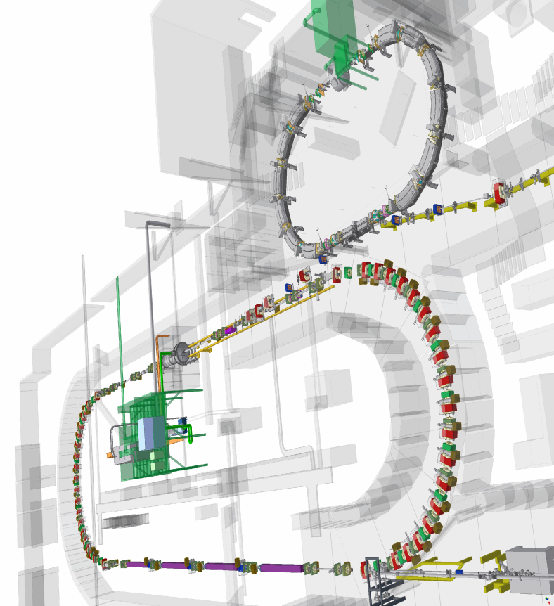
Beam Based Alignment of High Intensity Gamma Source (HIGS) Targets at Duke University Free Electron Laser Laboratory (DFELL) M. Emamian, Changchun Sun, Ying Wu
Mark Emamian IWAA2010 9-14-2010

Slide 2
Beam Based Alignment of HIGS Targets at DFELL
DFELL Storage Ring/ HIGS Facility
Mark Emamian IWAA2010 9-14-2010

Slide 3
Beam Based Alignment of HIGS Targets at DFELL
DFELL Storage Ring / HIGS Floor Monuments Layout
Mark Emamian IWAA2010 9-14-2010

Slide 4
Beam Based Alignment of HIGS Targets at DFELL
DFELL Booster Ring
Mark Emamian IWAA2010 9-14-2010

Slide 5
HIGS Experimental Area
Beam Based Alignment of HIGS Targets at DFELL
Mark Emamian IWAA2010 9-14-2010

Slide 6
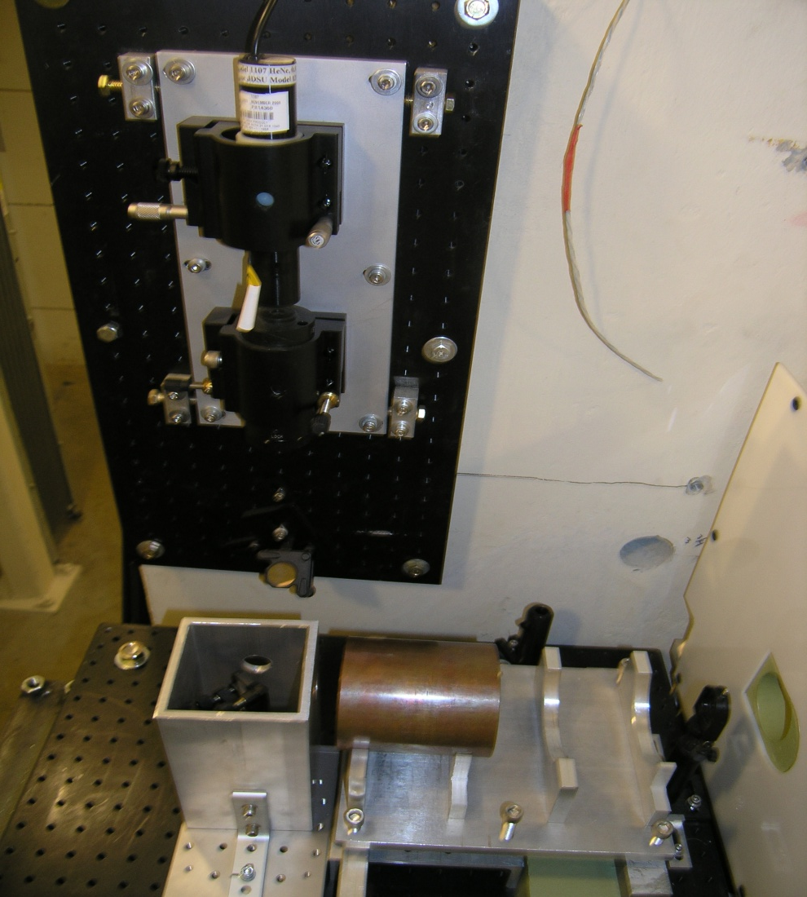
Beam Based Alignment of HIGS Targets at DFELL
HIGS Collimator Area
Mark Emamian IWAA2010 9-14-2010

Slide 7
Beam Based Alignment of HIGS Targets at DFELL
HIGS Collimators
Mark Emamian IWAA2010 9-14-2010

Slide 8
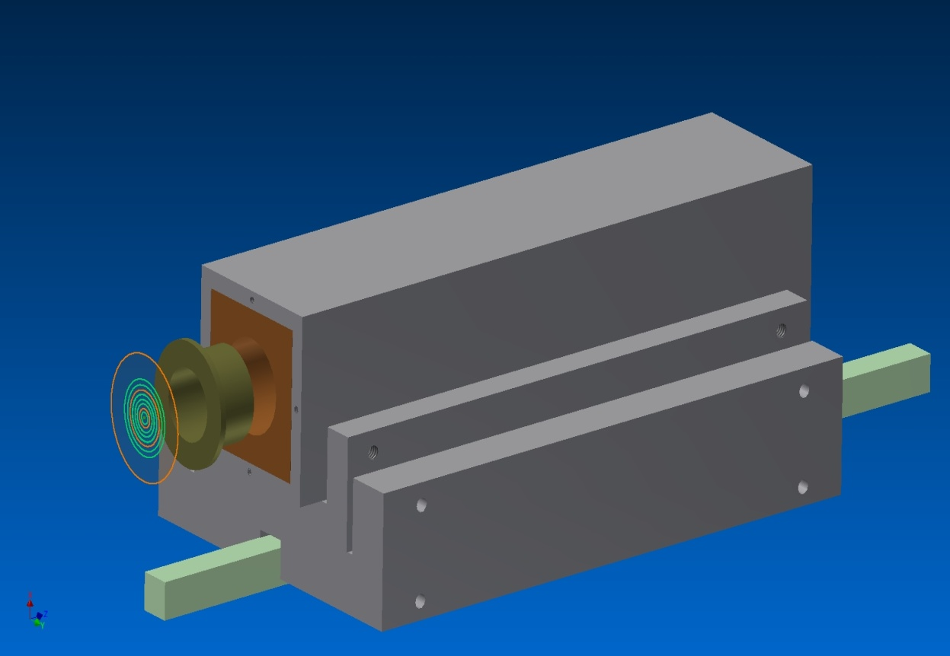
Beam Based Alignment of HIGS Targets at DFELL
HIGS Gamma Beam Collimator Design
Mark Emamian IWAA2010 9-14-2010

Slide 9
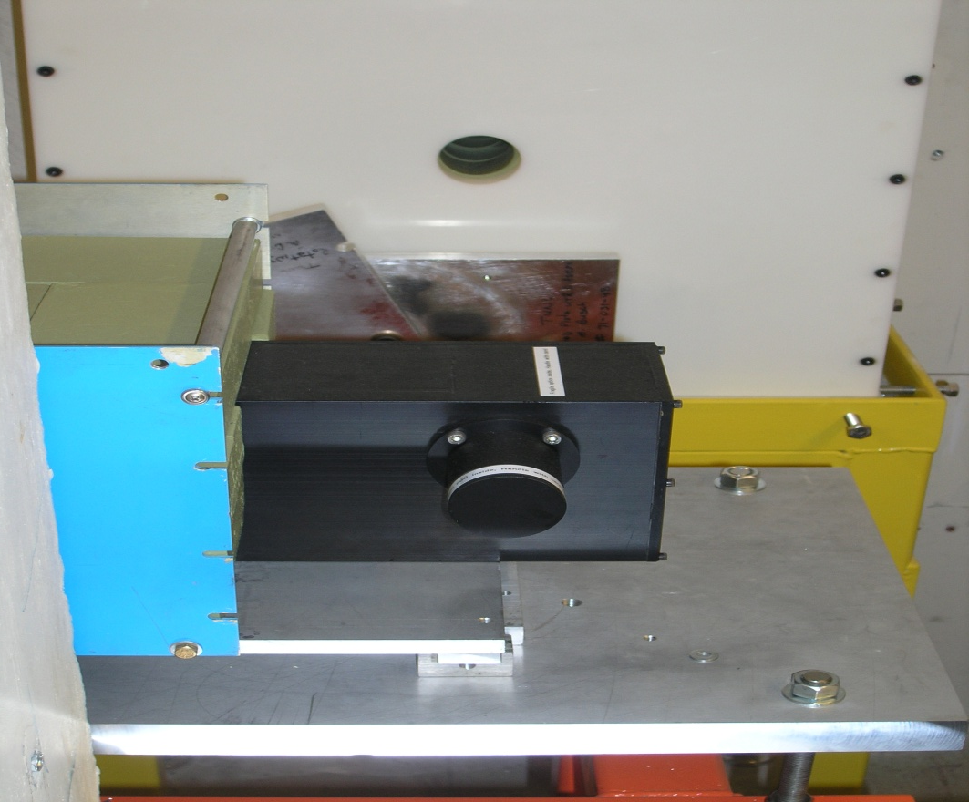
Beam Based Alignment of HIGS Targets at DFELL
HIGS Gamma Beam Imager #2
Mark Emamian IWAA2010 9-14-2010

Slide 10
Beam Based Alignment of HIGS Targets at DFELL
HIGS Gamma Beam Imager 3
Mark Emamian IWAA2010 9-14-2010

Slide 11
Beam Based Alignment of HIGS Targets at DFELL
BGO Imager 3
HIGS Collimator Alignment With G. Beam Imager
Mark Emamian IWAA2010 9-14-2010

Slide 12
Beam Based Alignment of HIGS Targets at DFELL
HIGS Gamma Vault
Mark Emamian IWAA2010 9-14-2010

Slide 13
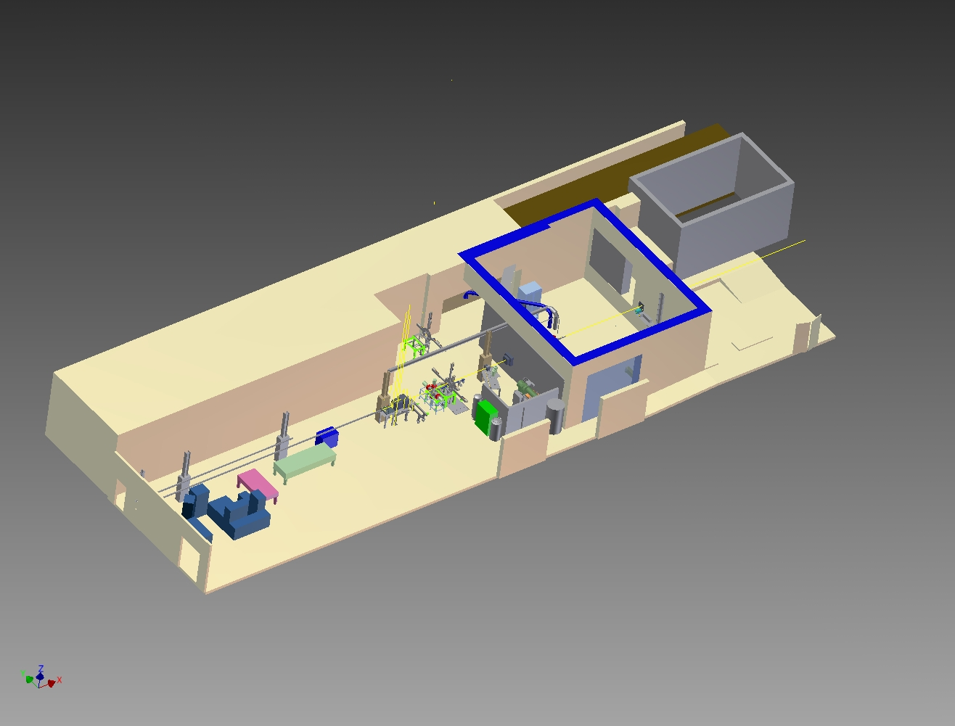
Beam Based Alignment of HIGS Targets at DFELL
HIGS Model Isometric View
Mark Emamian IWAA2010 9-14-2010

Slide 14
Beam Based Alignment of HIGS Targets at DFELL
Imager 3
Mark Emamian IWAA2010 9-14-2010

Slide 15
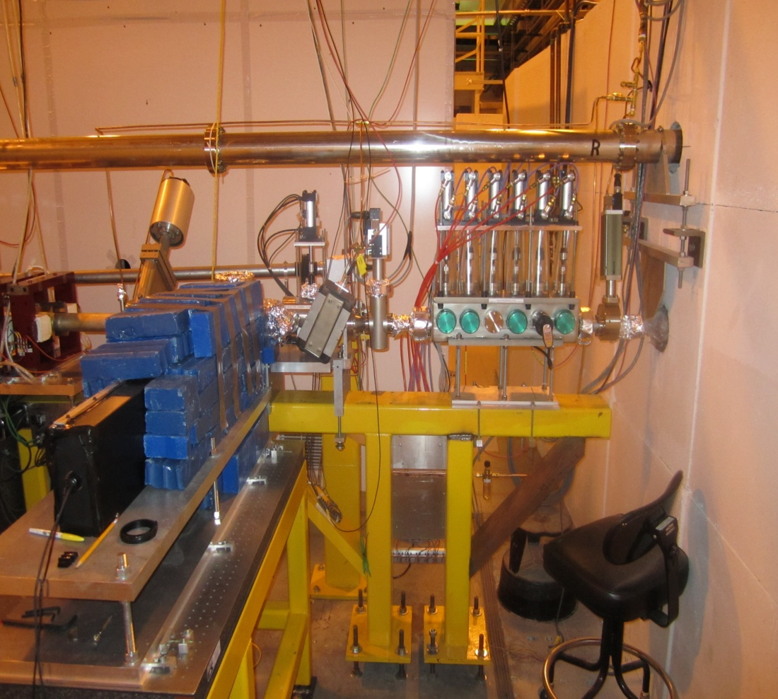
Beam Based Alignment of HIGS Targets at DFELL
East Cavity Mirror/ Gamma Imager 1
Mark Emamian IWAA2010 9-14-2010

Slide 16
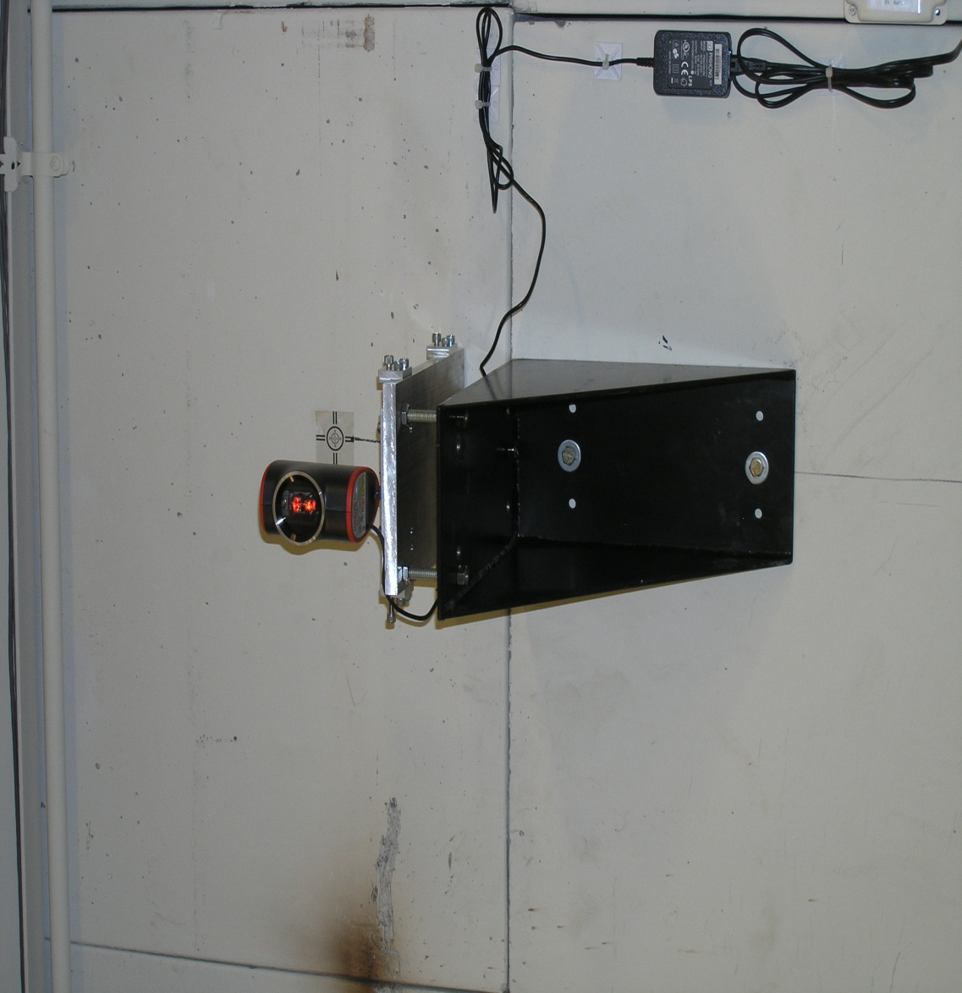
Beam Based Alignment of HIGS Targets at DFELL
Auxiliary Alignment Lasers in UTR and Gamma Vault
Mark Emamian IWAA2010 9-14-2010

Slide 17
HIGS Experimental Area
Beam Based Alignment of HIGS Targets at DFELL
Mark Emamian IWAA2010 9-14-2010

Slide 18
Beam Based Alignment of HIGS Targets at DFELL
O-TPC Setup
Mark Emamian IWAA2010 9-14-2010

Slide 19
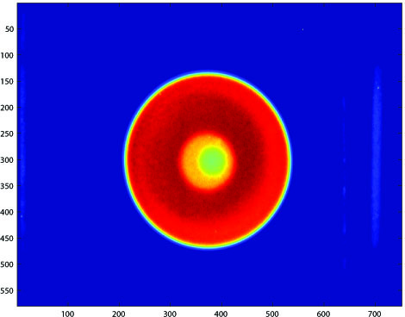
Beam Based Alignment of HIGS Targets at DFELL
HIGS Target Alignment With BGO Imager
Mark Emamian IWAA2010 9-14-2010

Slide 20
End of Presentation
Thank You
Mark Emamian IWAA2010 9-14-2010

