Slide 1
The alignment of the LHC during the shut-down 2008-2009
D. Missiaen

Slide 2
Outline
Repair of sector 34
Maintenance alignment
  Roll angle measurements
  Vertical smoothing of the LHC
  Horizontal smoothing of the LSS
  Case of the LSS with experiments
Conclusions

Slide 3
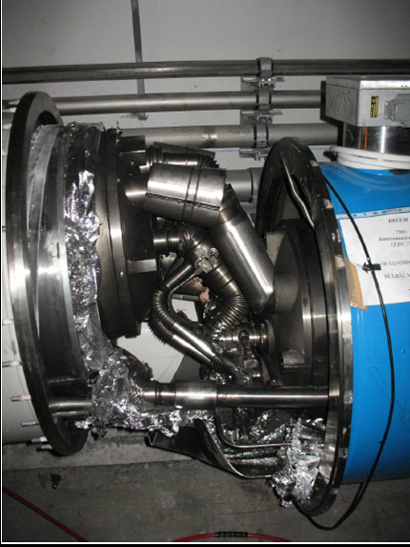
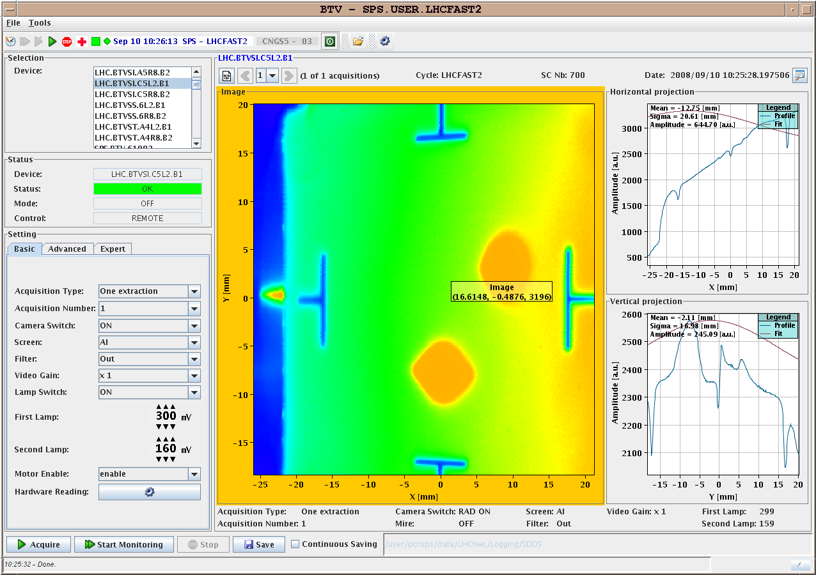
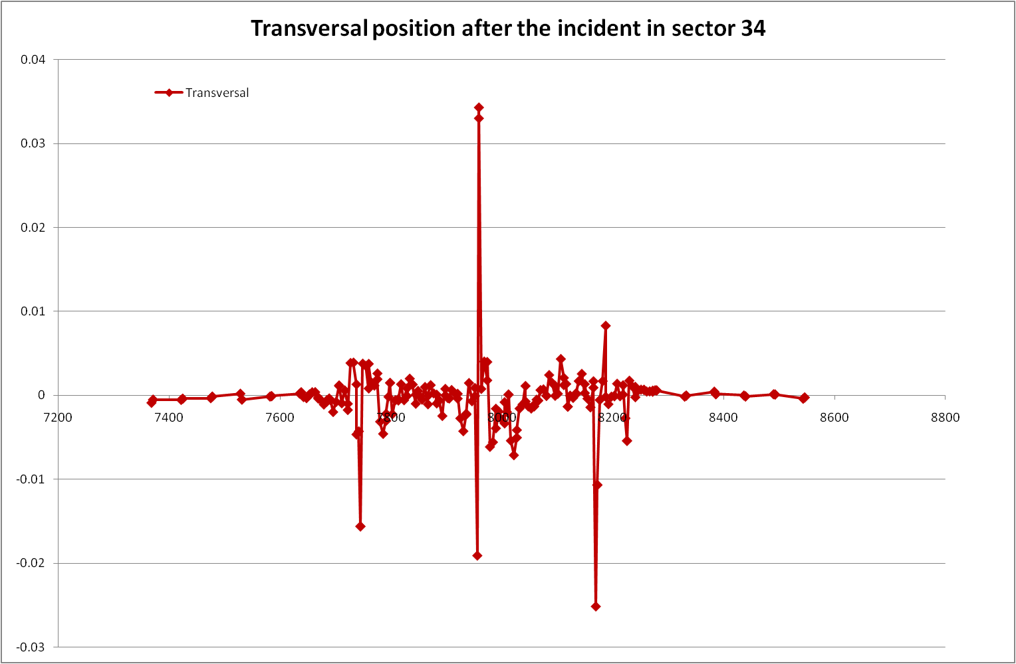
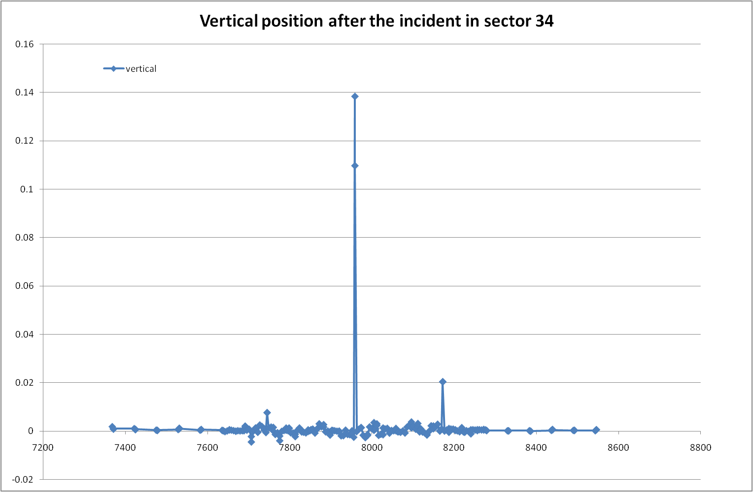
Repair of sector 34
A measurement of the position « after incident » was done

Slide 4
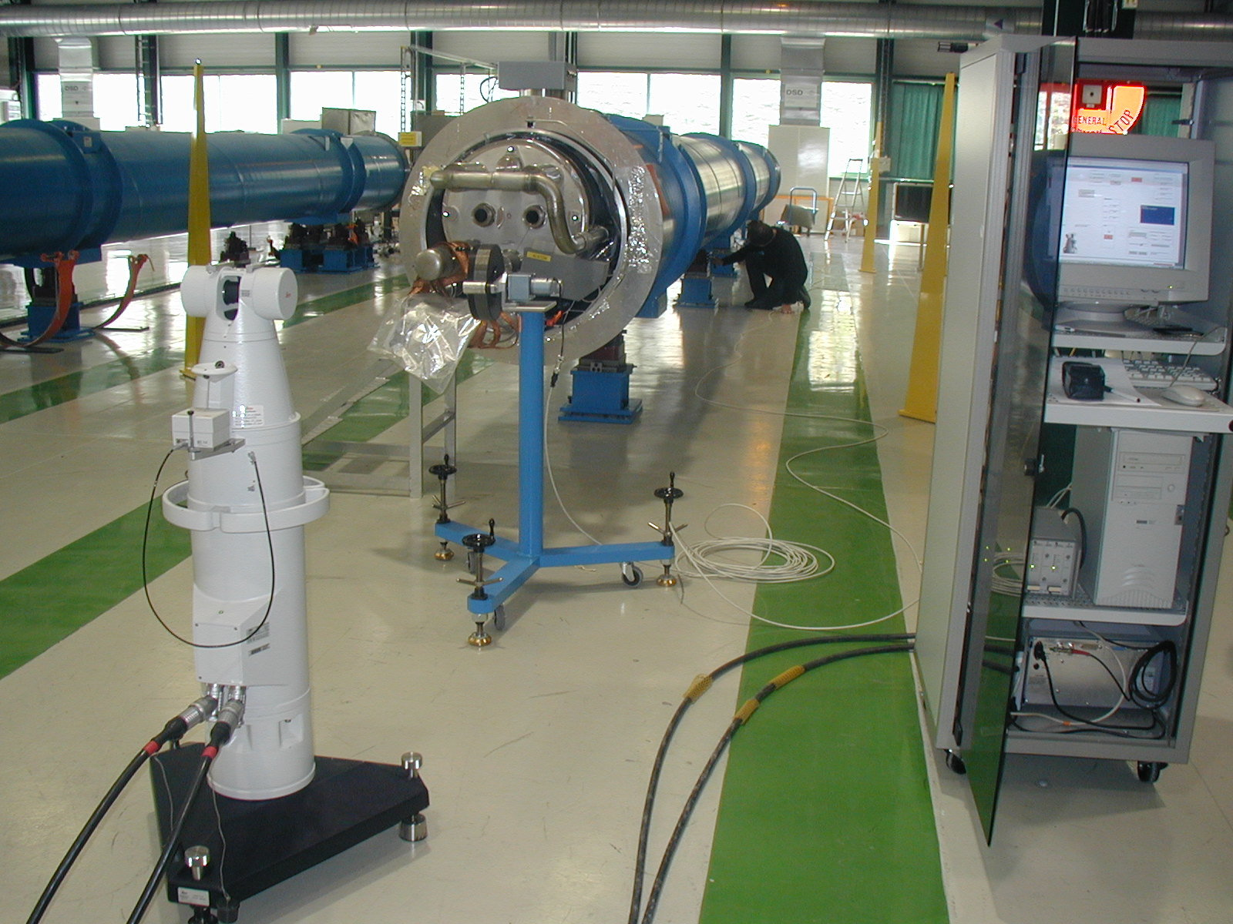
Repair of sector 34
A zone of 700 m of 39 dipoles and 14 quads
  Fiducialisation
  Alignment of BPM in quads
  Beam screen and Tubes positioning on both types
  Main difficulty was to re-start an activity stopped two years before
    « Fiducialisation » benches were dismantled
    Motorized system without maintenance
    Software not running
    Interface to database had to be updated
  After a re-learning curve, whole job done in 3-4 months

Slide 5
Repair of sector 34 (2)
Initial alignment done with respect to the geodetic network
  NOT the normal procedure
  BUT geodetic network was still consistent with magnets
  Accuracy obtained 0.3 mm at 1σ.
Local smoothing done directly on fiducials on areas of 100m. => OK to the interconnection team
  Offsets to a stretched wire – Digital levels
  Accuracy obtained 0.15 mm at 1 σ.

Slide 6
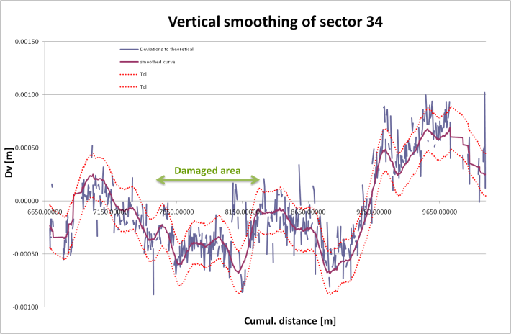
Vertical Smoothing of sector 34
49 magnets realigned (22%)
No more in the damaged area than elsewhere

Slide 7
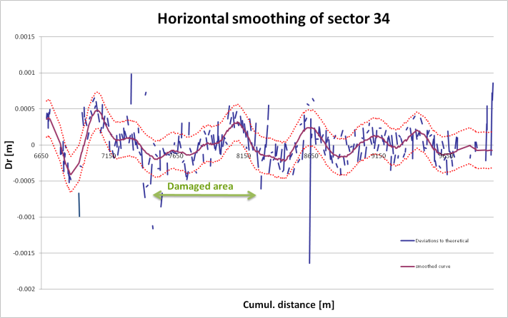
Horizontal smoothing of sector 34
41 magnets realigned
MB.B29L4.E:1.5 mm

Slide 8
Alignment Maintenance
SU always claimed that it will take two to three shut-downs to have the « best smoothed» position of the magnets
This was an opportunity to start with the improvement campaigns
All magnets were under cold conditions

Slide 9
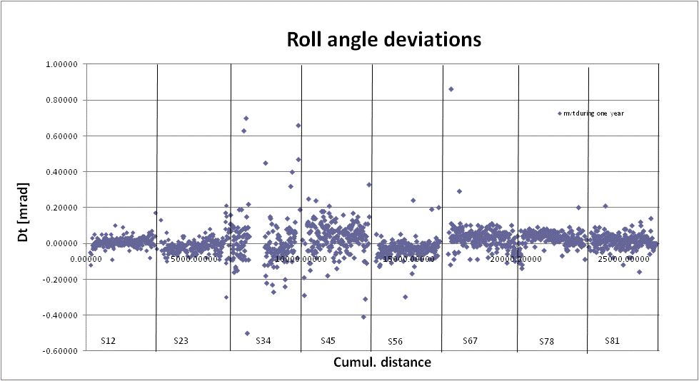
Roll angle measurements
Mvts between 2008 and 2009
For each sector :
  Avg is close to 0
  Stdev is between 0.06 and 0.09 mrad
  55 magnets realigned
  S34 : stdev = 13mrad, 100 magnets realigned
S67: q8r6 moved due to concrete slab problem

Slide 10
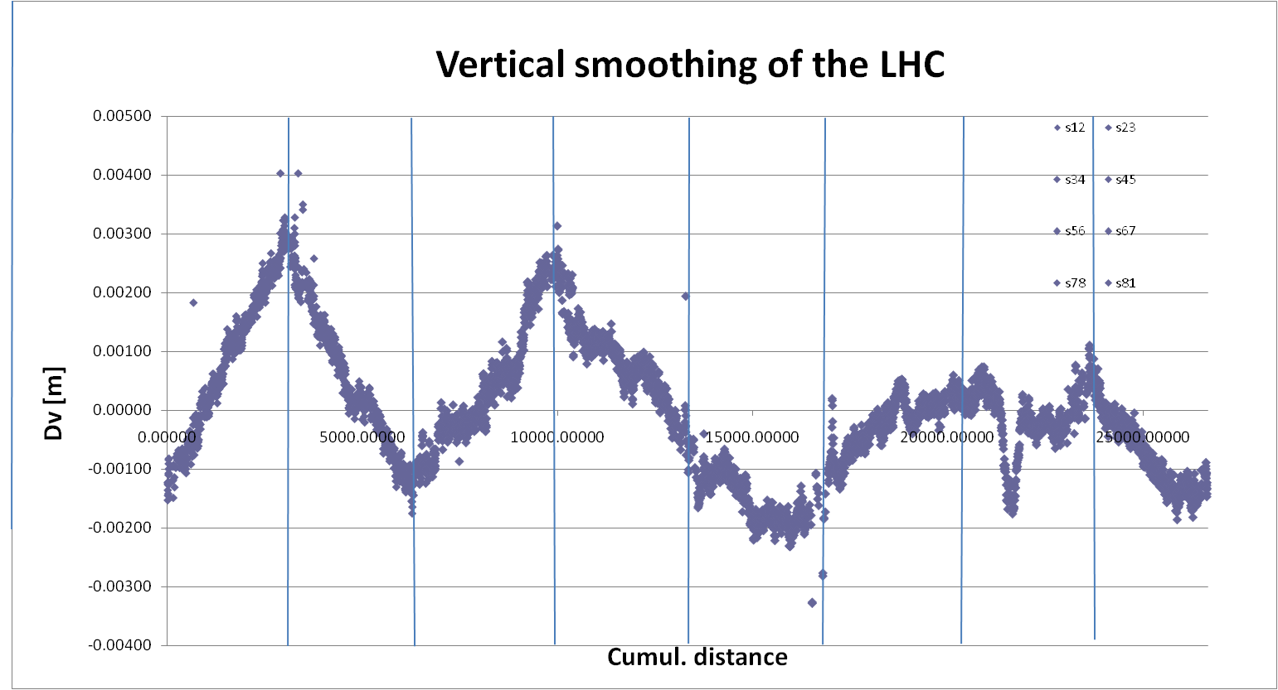
Vertical smoothing
Absolute vertical shape
Closure +2.4 mm
Not fixed on the deep references
Pb with concrete slab in LSS6
Hole of S78

Slide 11
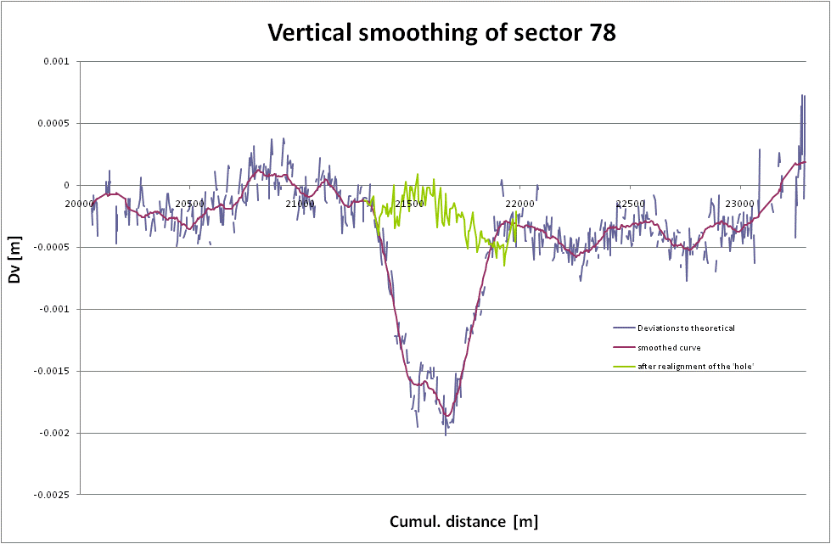
Sector 78
The well known « LEP hole » of 2mm per year re-appeared in 2009
We should have left it like that because it is smooth but finally it was decided to realigned to the theoretical position

Slide 12
Vertical smoothing
The relative position of the magnets is more important for the beam than the absolute one
The deviations w.r.t a smooth curve, much more significant, were calculated with PLANE
offset
Length of the window

Slide 13
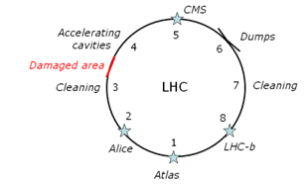
Horizontal survey of LSSs
Straight lines of 500 m on each part of the IP from Q8Ln to Q8Rn
4 of them are equiped with permanent monitoring systems because of the obstacle of the Experiment and of the low beta quadrupoles
The aim was to link
  the standard arc with the LSS
  The LSS to the low beta quads
  Before these areas become radioactive

Slide 14
Horizontal survey of LSSs
Methodology
  Long stretched wire of 160 m with an overlap of almost 100m
  Measurements issued from permanent sensors values
Calculations
  Q2Ln considered as fixed point, Q2Rn orientation point
  Radial corridors of 1 mm at the vicinity of the Q8s in order NOT to make a step at the junction
  Add relative position of « standard » and « permanent monitoring » fiducials
  Residuals were better than 0.1mm. Some inconsistencies between measurements of different types and accuracies

Slide 15
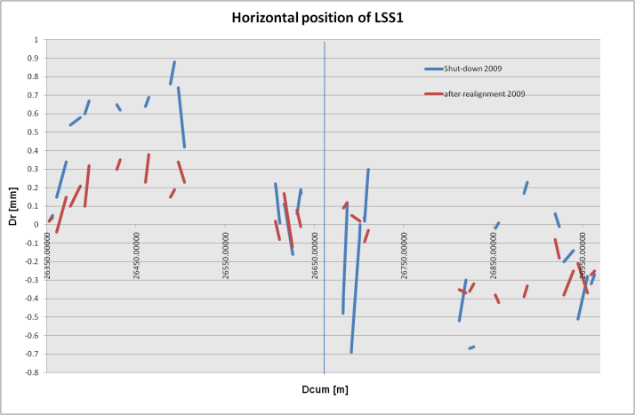
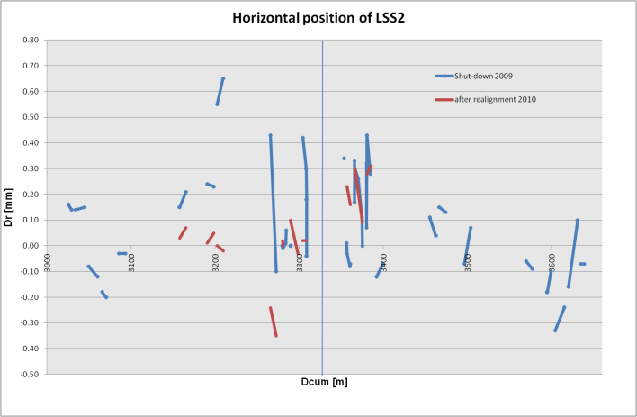
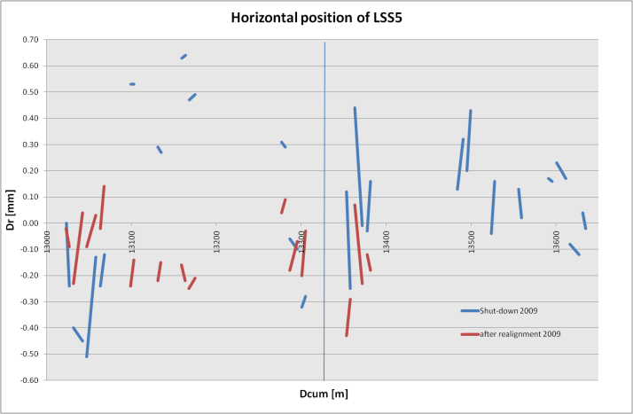
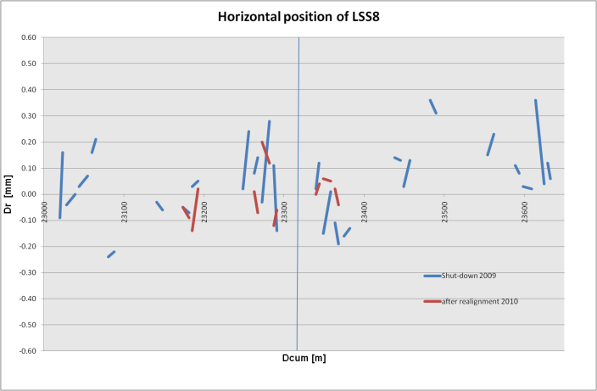
Horizontal survey of LSSs1, 2, 5 and 8

Slide 16
CONCLUSIONS
Leveling and roll angles allowed the detection of unstable areas (sector 78, LSS6R, etc)
The vertical smoothing of all LHC sectors improved the relative accuracy to better than 0.1 mm at 1 σ
Horizontal smoothing with long stretched wires was a success
Horizontal position of the low beta quads was improved
A huge effort to measure and to realign but it is worth it
LHC will run until the end of 2011, then a huge shut-down in 2012 and part of 2013. A rythm of a shut-down every three years will be adopted

Slide 17
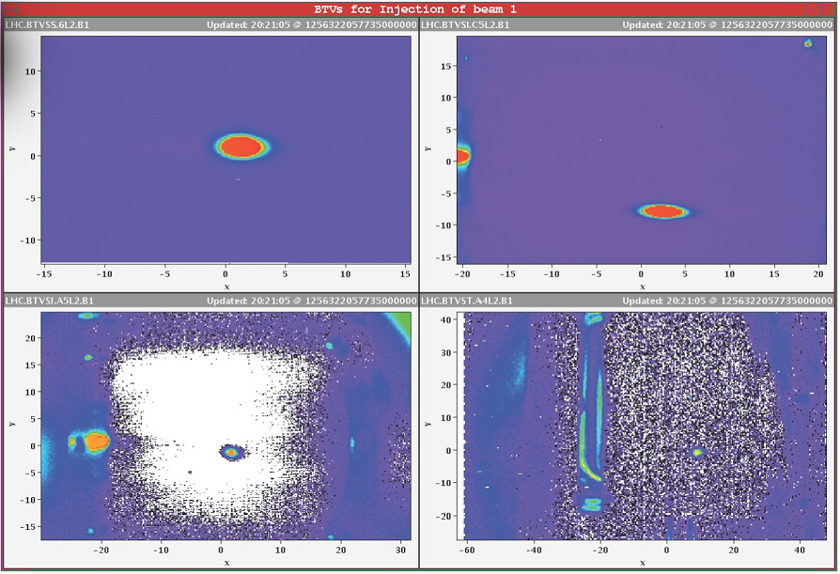
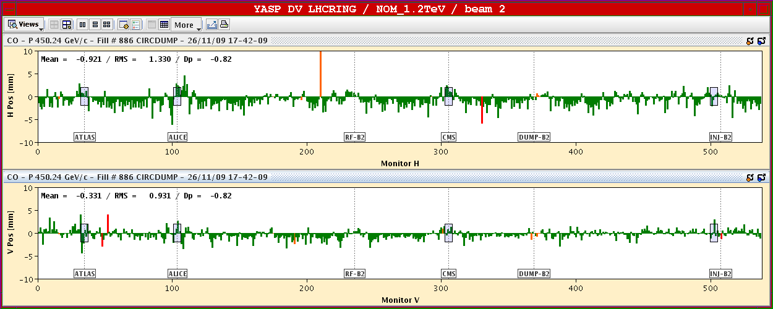
CONCLUSIONS

