Slide 1
Survey of KEKB magnets and monuments for SuperKEKB
Mika Masuzawa(KEK)
Yasunobu Ohsawa(KEK)
Naohiro Abe, Kenji Mishima (PASCO)

Slide 2
Contents
Introduction
SuperKEKB
Need for new geodetic network
Additions of survey monuments
Survey
New laser tracker
Comparison with design
Conclusion
Issues to be pursued
Questions to be answered

Slide 3
1. Introduction
From KEKB to SuperKEKB
SuperKEKB is
the next-generation B-factory

Slide 4
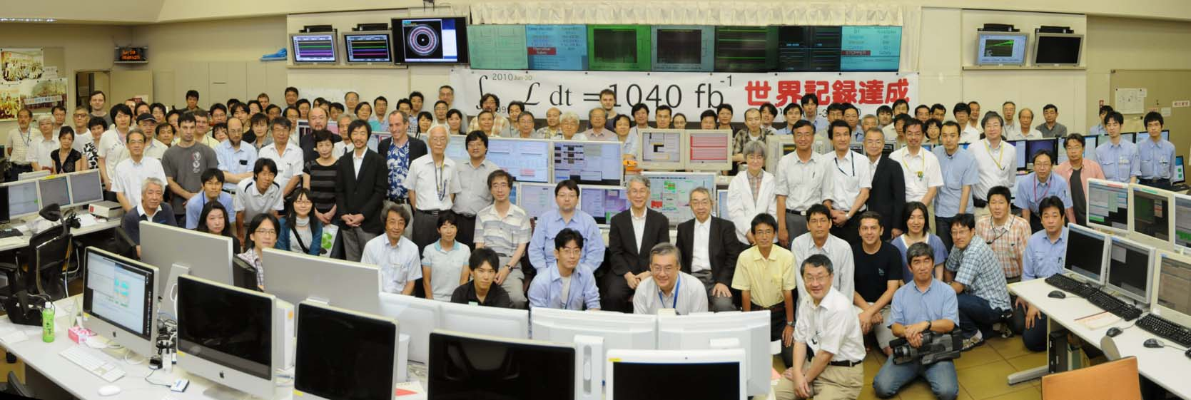
From KEKB to SuperKEKB
KEKB operation ended at 9:00 am June 30, 2010
SuperKEKB budget is partially approved
- Damping ring : 580M yen (~5.8M$) (FY2010)
- Special budget “Very Advanced Research Support Program”
10B yen (~100M$) (FY2010-2012)
→Start construction (FY2010-2013)

Slide 5
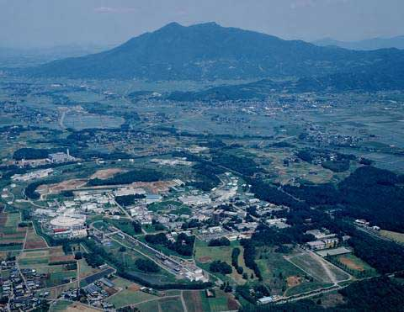
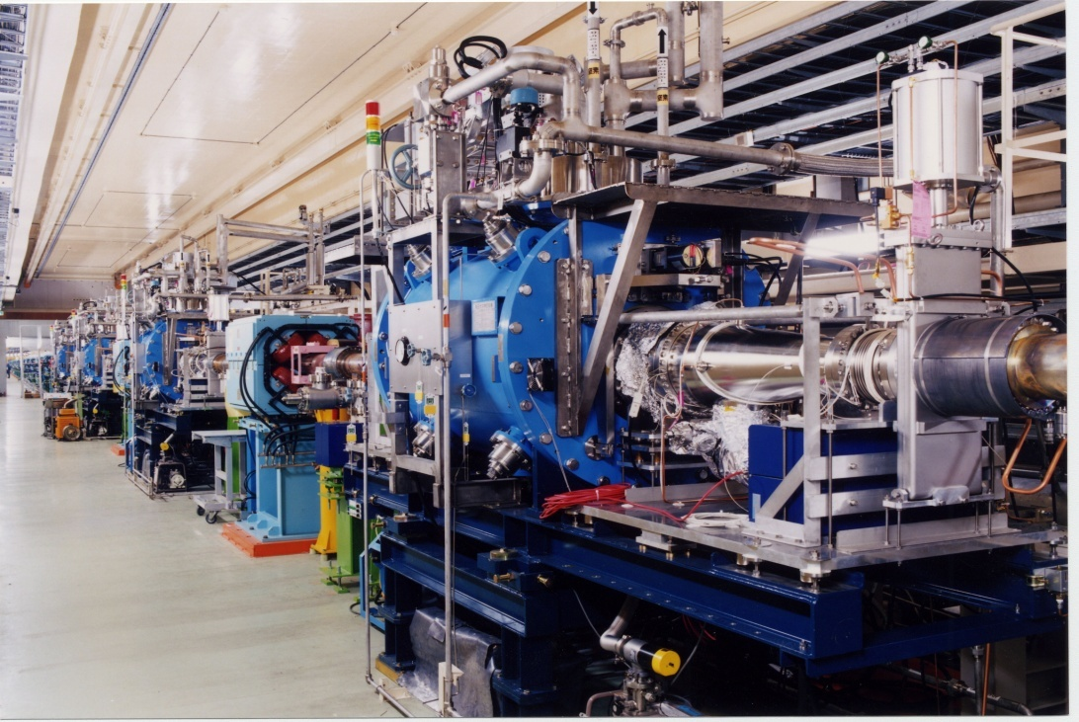
From KEKB to SuperKEKB
KEKB accelerator
SuperKEKB accelerator
1km
The KEKB B-factory in Japan
More than 1 ab⁻¹ data / 11 years
The world’s highest luminosity
Will be upgraded to SuperKEKB
x40 higher luminosity

Slide 6
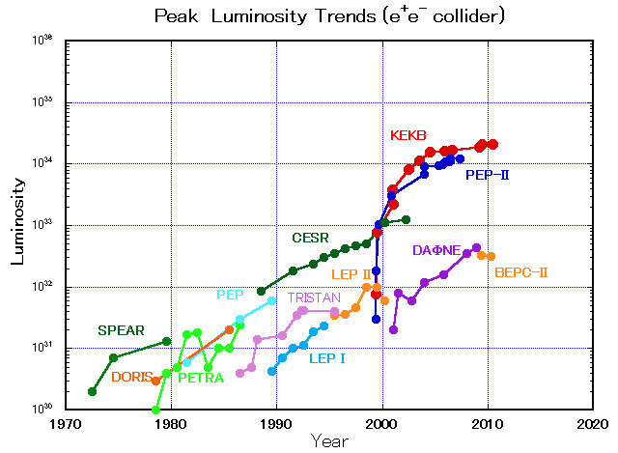
From KEKB to SuperKEKB
SuperKEKB
10³⁶
40 times higher luminosity
Next generation
B-factories
KEKB
E.Kikutani / M. Masuzawa

Slide 7
Three major factors determining luminosity:
Stored current:
1.7 / 1.4 A (e⁺/ e⁻ KEKB)
Beam-beam parameter:
0.09 (KEKB)
Lorentz factor
Geometrical correction factors due to crossing angle and hour-glass effect
Classical elec. radius
Beam size ratio
Luminosity:
0.21 ×10³⁵ cm⁻²s⁻¹ (KEKB)
Vertical β at the IP:
5.9 /5.9 mm (e⁺/ e⁻ KEKB)

Slide 8
Design concepts
Our initial approaches :
Extrapolations of PEP-II & KEKB
More beam currents ⇒ larger power consumption
Crab crossing
Higher ξ_{y}
Somewhat reduced β_{y}*
Shorter bunch length ⇒ Challenges from HOM heating. ⇒ Bunch lengthening due to Coherent Synchrotron Radiation (CSR).
Low emittance (“nano-beam”) scheme
⇒ first proposed by P. Raimondi for SuperB.
Collision with very small spot size beam.

Slide 9
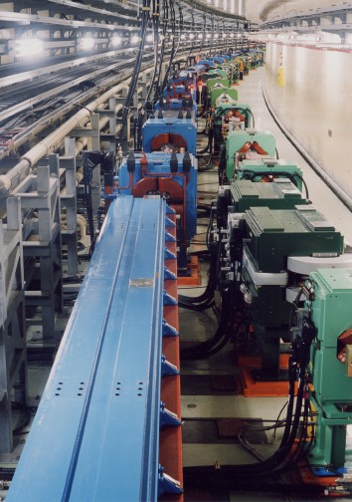
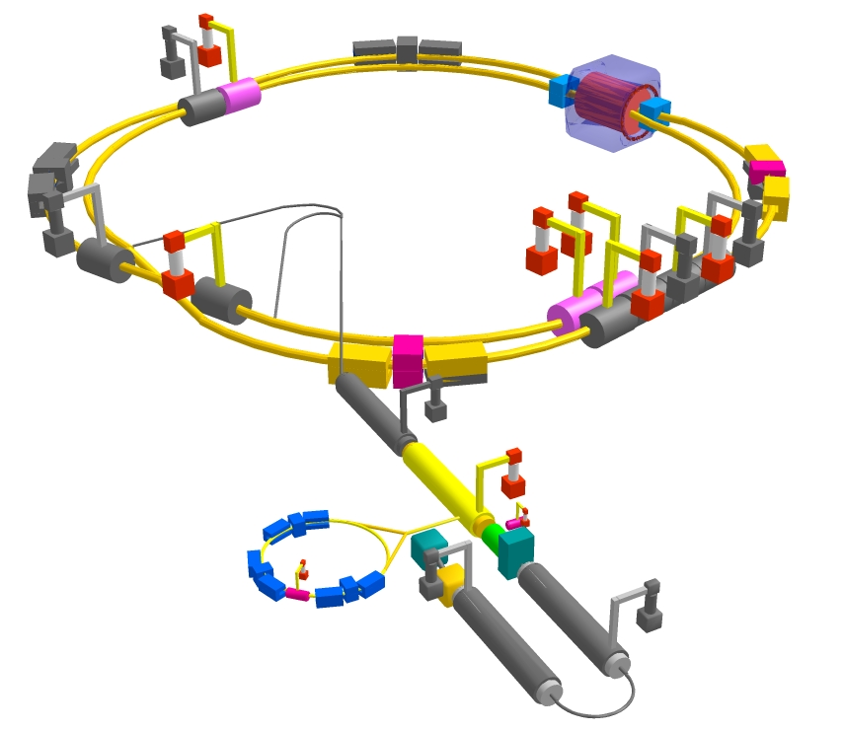
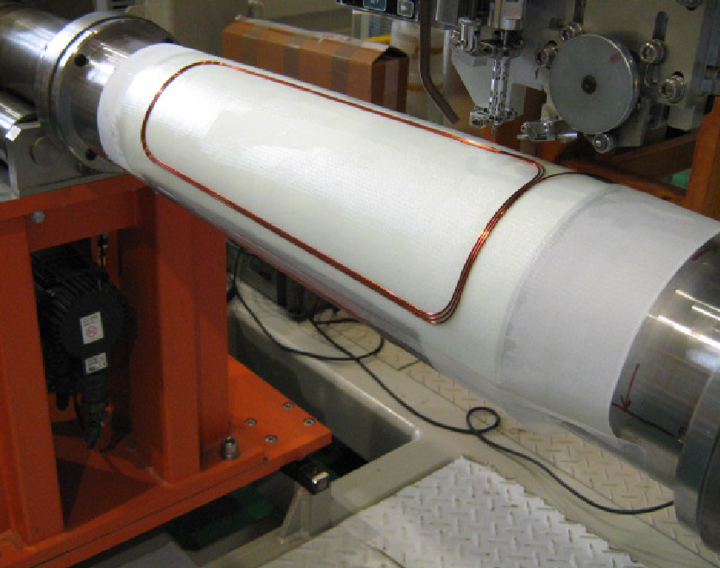
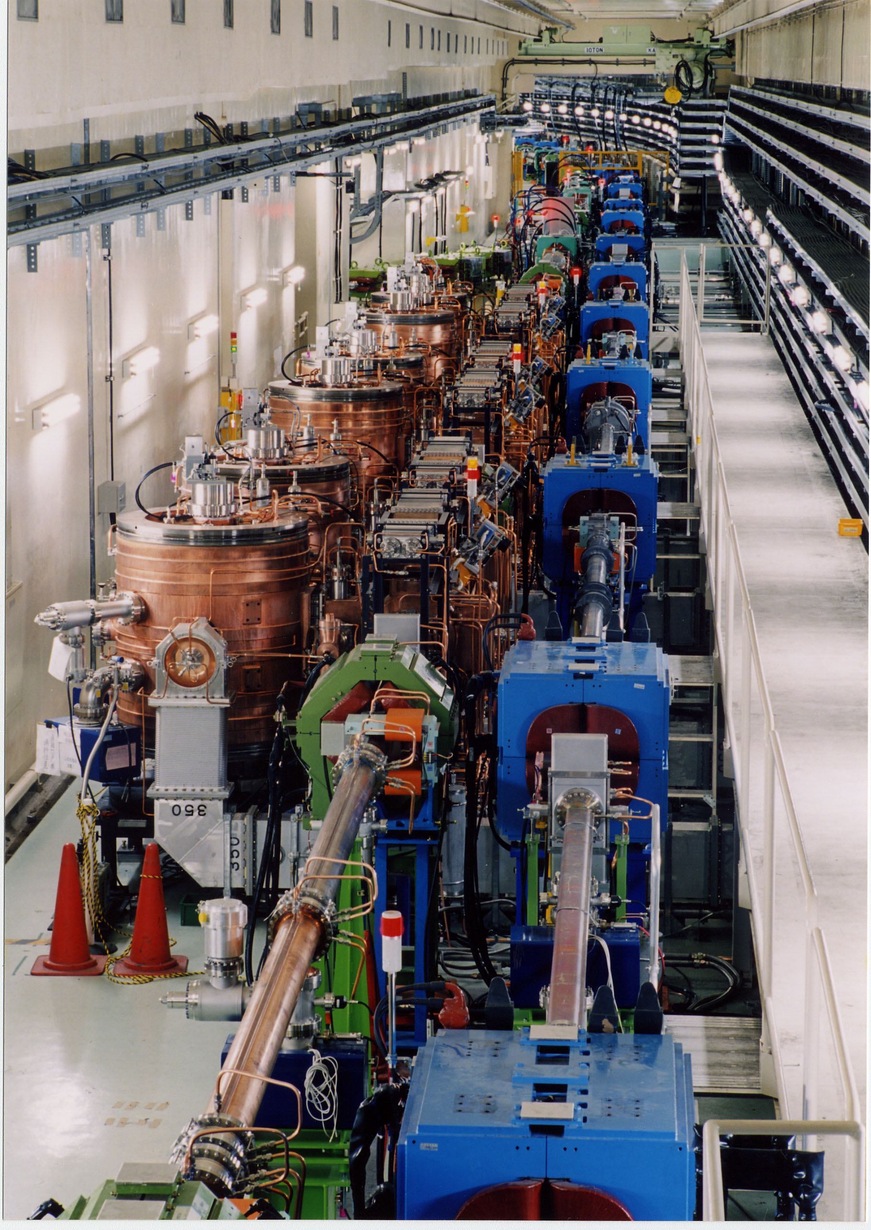
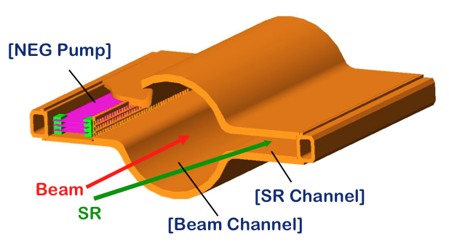
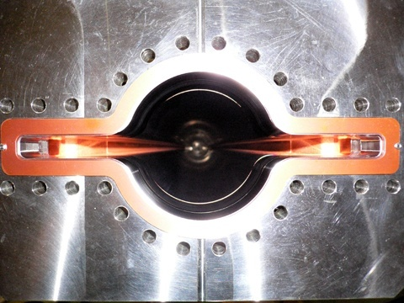
New IR straight section
Colliding bunches
3.016 km
New IR with S.C.
& P.M. final focusing quads
e- 2.6 A
Nano-Beam
SuperKEKB
e+ 3.6 A
Replace dipoles with longer ones (LER).
Change the wiggler layouts, add more wigglers LER & HER.
Add / modify RF systems
for higher currents.
Tighter tolerances on
alignment around the IP.
Vibration more critical.
e⁺ damping ring
Low emittance positrons to inject
Low emittance gun
Low emittance electrons to inject
New positron target / capture section
TiN coated beam pipe with antechambers
~40 times gain in luminosity

Slide 10
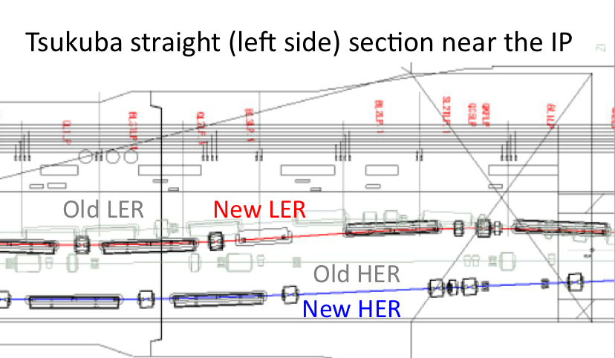
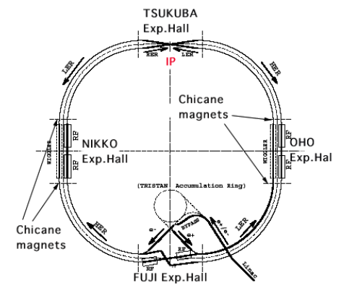
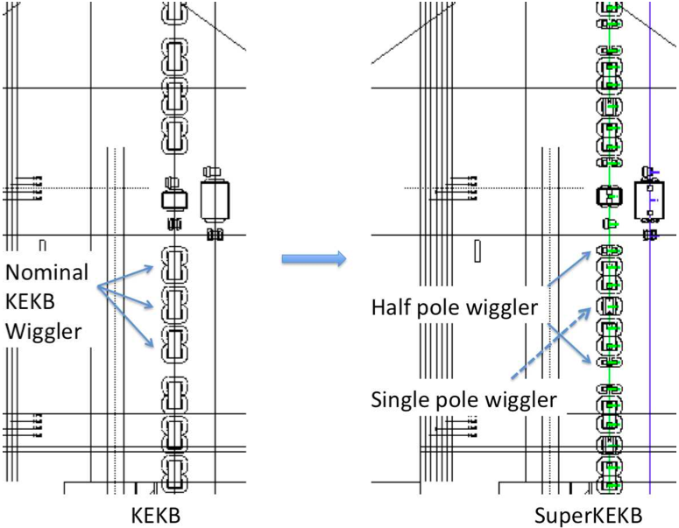
2. Need for new geodetic network
Completely new layout
LER diploles (~110)
replaced.
Partially new layout
at the wiggler
sections
Some magnets remain &
some magnets go away
Consistency between the old (KEKB) and new (SuperKEKB) beam lines is critical

Slide 11
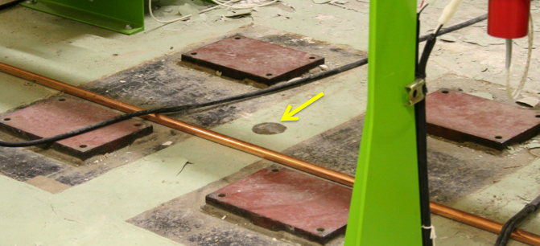
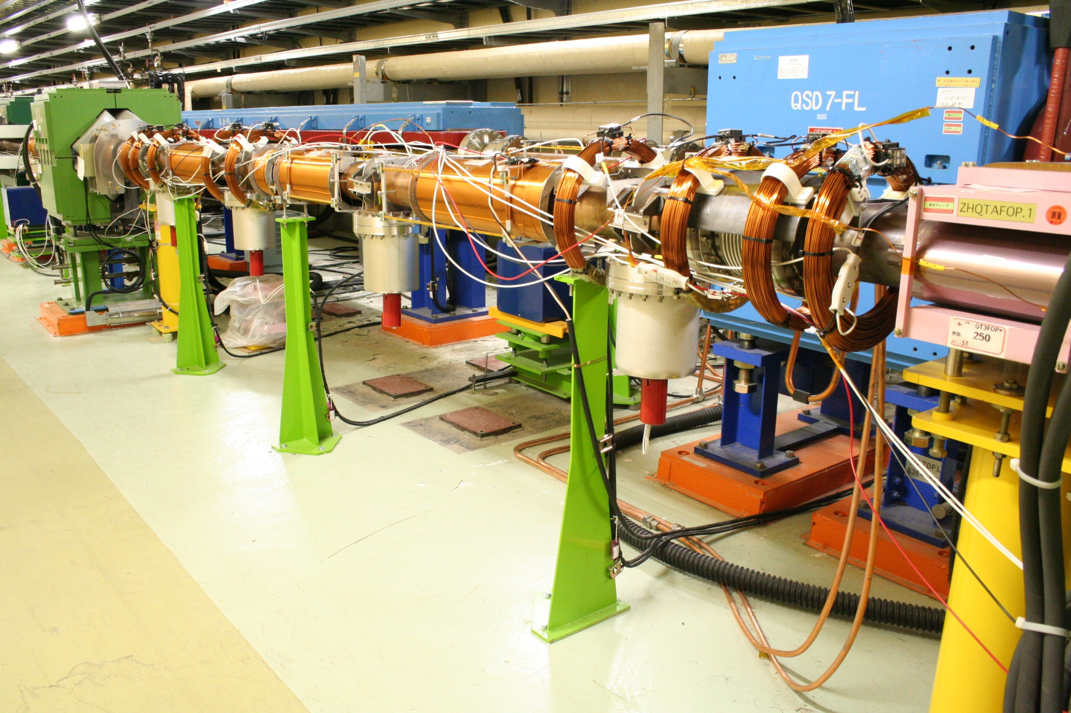
2. Need for new geodetic network
When the KEKB magnets were first installed in the TRISTAN tunnel in 1997, there was no sophisticated geodetic network to be used.
There were only floor monuments, which indicate the central positions of the removed TRISTAN quadruple magnets, every ~8 m.
Some are covered by KEKB magnets,
cables, supports…
We need more monuments which can be seen
now.
We need to understand the present coordinates of the KEKB magnets because most of the magnets in the arc sections will remain in the beam line.
We also need to add more monuments
and survey them along with the KEKB magnets.

Slide 12
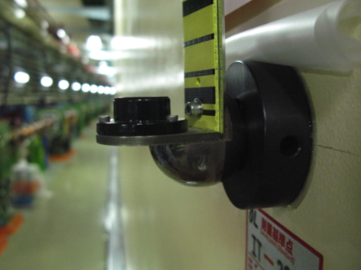
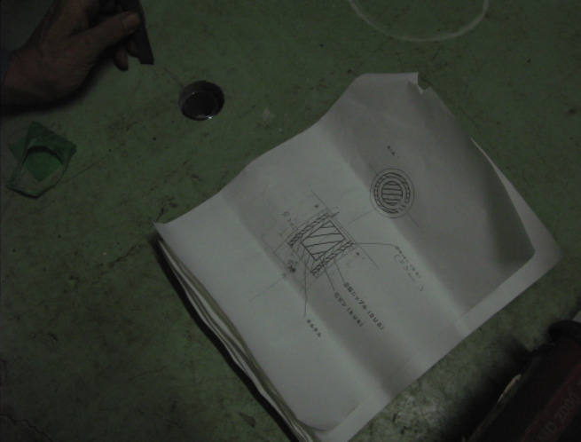
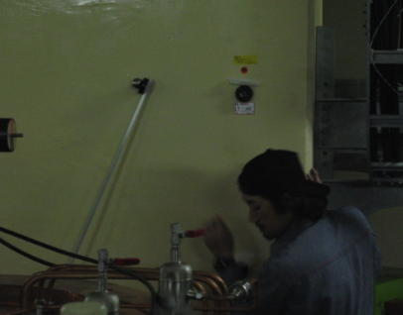
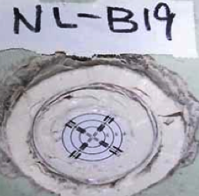
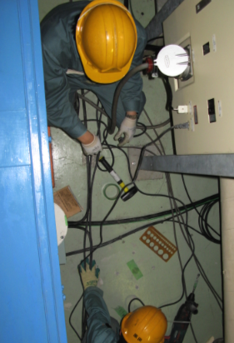
Newly installed monuments mounted on the walls, floor etc.
Poster presentation by Y. Ohsawa, “SURVEY MONUMENT PREPARATION FOR SUPERKEKB”
Our tunnel is ~3 decades old.
It has experienced two generations of accelerators,
TRISTAN (single ring) and KEKB (double ring, more crowded).
Lots of junk (cables, pipes…), and not much space, especially on the cable rack side.
Very difficult to find space for stable monuments.

Slide 13
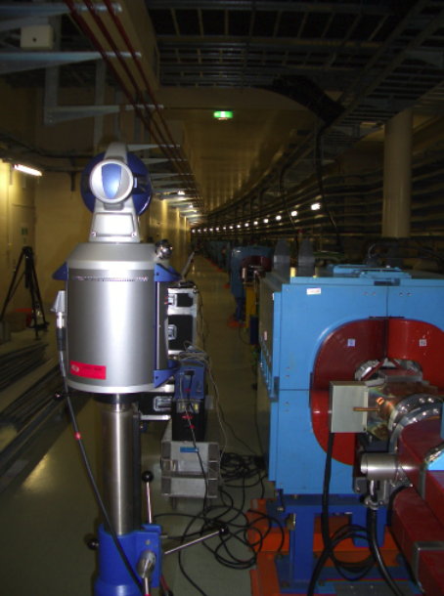
3. Survey New laser tracker
We purchased three FARO ION laser trackers.
We put color lables on them (“red”, “blue” and “white”).
Operation software, “Insight”.
No experience with FARO, only Leica.
To understand its quirks, performance test was done.
“Red” tracker broke in a month or so and was sent back
to SingaporeIt came back to KEK but …
There is a slow drift in the angle output > 0.1mrad
(“white” tracker) when used inthe AMD mode.
⇒Poster presentation by R. Sugahara
“PERFORMANCE TEST OF LASER TRACKERS OF
FARO”
FARO ION

Slide 14
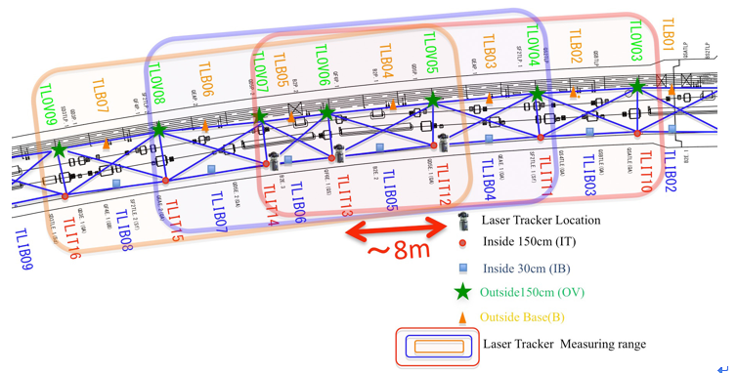
3. Survey
The surveying network is constructed as successive unit rectangles, ~8 m in length and ~1.8 m in width.
~32 m-long area (4 unit rectangles) was covered by one tracker setup (station).

Slide 15
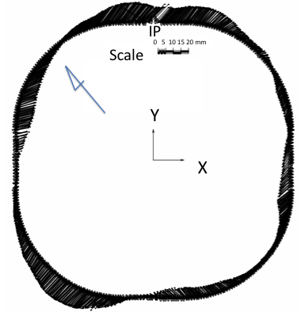
3. Survey Comparison with the design (magnet positions)
S
The 3 km beam line is
deformed by
as much as ~20 mm.
1300 monuments
900 x 2 Quadrupole magnet points
220 x 2 Dipole magnet points
preliminary
By PAG-U (PASCO)

Slide 16
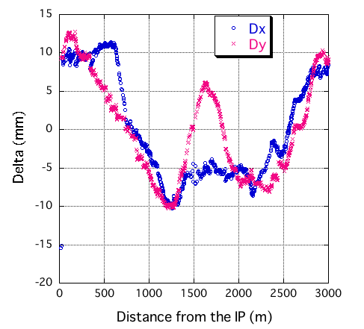
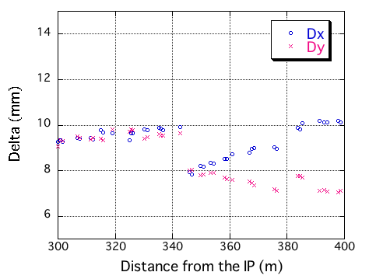
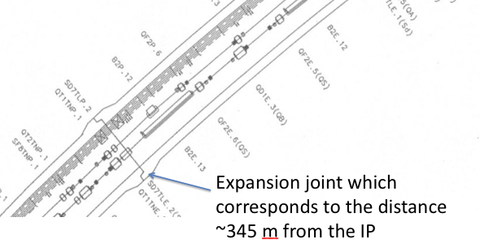
3. Survey Comparison with design (magnet positions)
Dx & Dy plotted against the distance from the IP
along the beam line. Generally smooth, but:
~2 mm jump in both X and Y.
This “jump” happens to correspond to one of the expansion joints in the tunnel.
Not all of the discontinuities correspond to expansion joints though.

Slide 17
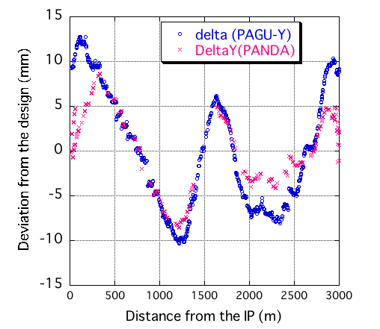
3. Survey PANDA test (I am the one that is being tested)
We purchased a network software called PANDA
(Program for Adjustment of Geodetic Networks and Deformation Analysis)
from GEOTEC GmbH, Laatzen. The analysis is underway.
We need to learn more.
A very rough comparison is made between PAG-U and PANDA.
A fairly good agreement is seen in the analysis in one direction (in this case, the “Y” direction) , though the agreement in X is not as good.
An effort will be made to better understand how to use this new program so that we can properly compare the results of the two different programs.

Slide 18
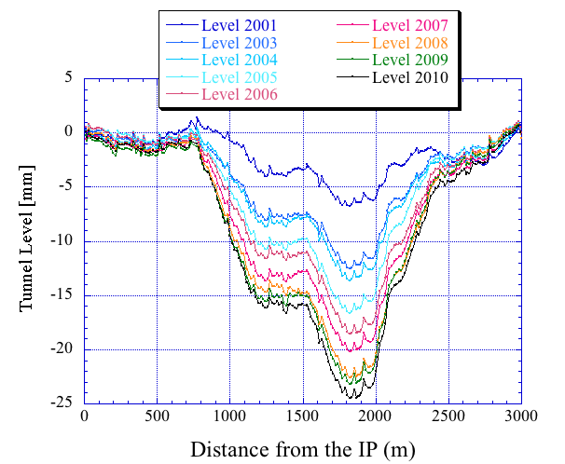
3. Survey Tunnel Level survey
S
South arc continues to sink
at an average rate of 2.5 mm/year,
though the rate seems to vary year-to-year.
The reason why this particular part
of the tunnel sinks is not known.
S

Slide 19
4. Conclusion
About 1300 new monuments were installed in the KEKB tunnel to construct a more complete survey network for SuperKEKB.
A survey of the existing (not yet removed from the beam line) magnets and the new monuments was carried out using FARO ION laser trackers.
Preliminary coordinates of the monuments were obtained.
This is the first time for us to build a network with such a large number of points.
Time was required to become familiarized with the new FARO trackers and operation software (Insight).

Slide 20
4. Conclusion Issues to be pursued
The network at the IP needs to be improved.
Re-measurements are needed for some tracker stations where the RMS of the fits to the design coordinates are much larger than expected.
Independent analysis, for example via PANDA, would help in understanding the stability of the solutions.
Another way of confirming the deformation is needed, such as via GPS. Reference points in the tunnel need to be transferred to the ground surface in order to use GPS. It is estimated that GPS has enough accuracy to verify the 20 mm distortions.
Monitors are important especially around the IP.
Tests with WPS, HLS (thanks to SLAC,etc.) to be installed around the IP are on going.

Slide 21
4. Conclusion Questions to be answered
Questions that remain to be answered include:
How to use the network data for SuperKEKB when some magnets remain in the tunnel.
Whether to re-level the beam line to compensate for the sinking of the tunnel, as was done for KEKB.
In addition, the effect of the measured deformations on the emittance of the nano-beam lattice requires study by the optics group.
We will continue working closely with the optics group on this issue.

