Slide 1
CLIC ACTIVE PRE-ALIGNMENT SYSTEM: PROPOSAL FOR CDR AND PROGRAM FOR TDR

Slide 2
SUMMARY
Introduction
Solutions for CDR
Solutions concerning re-adjustment
Solutions concerning the determination of the position
Validation on two beam prototype modules
Towards TDR

Slide 3
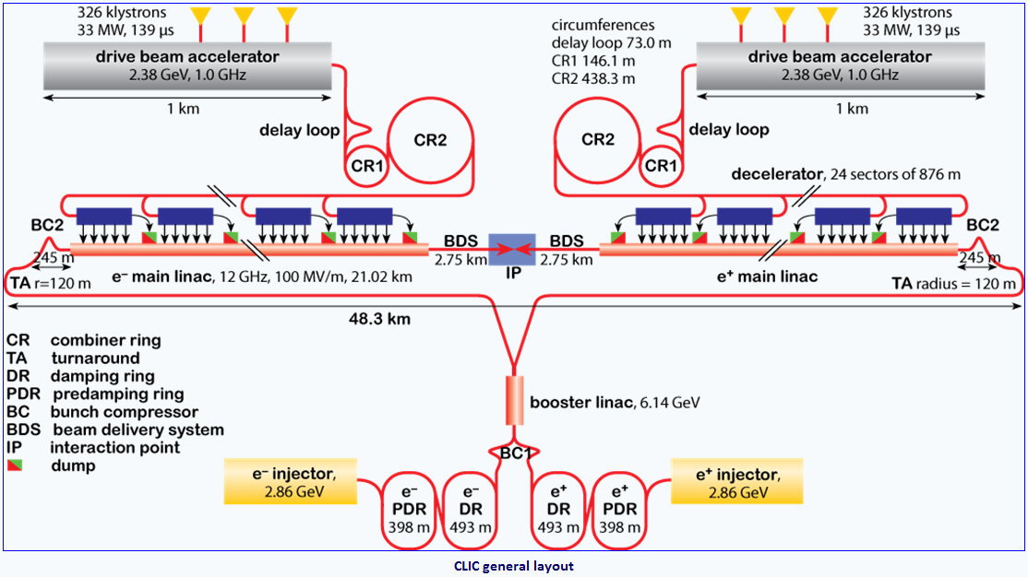
Introduction of the main challenge
CLIC: Compact Linear Collider
Feasibility study to develop an electron-positron linear collider (nominal center of mass energy of 3 TeV)
Conceptual Design Report ready mid 2011.

Slide 4
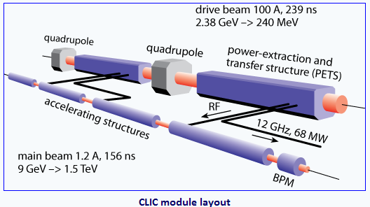
Introduction of the main challenge
Relying on a two beam acceleration concept: 12 GHz RF power is generated by a high current beam (drive beam DB) running parallel to the main beam, decelerated in PETS, with generated RF transmitted to the main beam (MB)
Main linac consists of repeated sequences with a length of 2 m: modules
➔ more than 20 000 modules in total.
The required luminosity will be reached with powerful beam colliding with extremely small dimensions (1 nm in vertical) and high stability. This can only be obtained with small emittances. As a consequence: tight pre-alignment tolerances

Slide 5
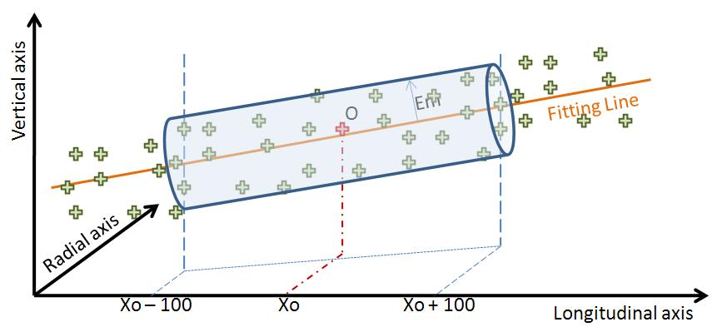
Introduction of the main challenge
PRE-ALIGNMENT (beam off)
Mechanical pre-alignment
Active pre-alignment
Beam based alignment
Beam based feedbacks
Within +/- 0.1 mm (1σ)
Within ± 3 μm (1σ)
Pre-alignment of 3 microns along a sliding window of 200 m, all along each linac
After computation, for a sliding window of 200 m, the standard deviations of the transverse position of each component w.r.t. the straight fitting line must be inferior to 3 μm
Determination of the position of the components in a general coordinate system thanks to alignment systems
=
+
Active pre-alignment
Re-adjustment thanks to actuators

Slide 6
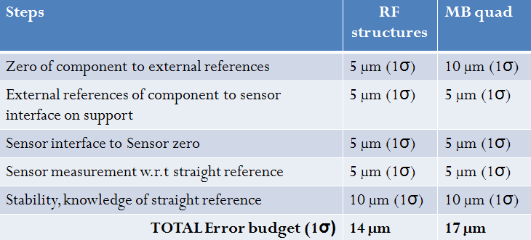
Introduction: hypotheses for study
3 μm over 200 m (1σ) is a target for study and development.
« trade off » with beam dynamics for realistic and achievable values for CDR.
Budget errors ➔ Determination of the position
Main linac mover requirements
Range: ± 3 mm
Step size: ~ 1 µm, resolution: ~ 0.5 µm

Slide 7
SUMMARY
Introduction
Solutions for CDR
Solutions concerning re-adjustment and feasibility
Solutions concerning the determination of the position and feasibility
Validation on two beam prototype modules
Towards TDR

Slide 8
General strategy : re-adjustment
Several components will be pre-aligned on supports:
➔ Along the MB: ➔ Along the DB:
RF structures on girders ➔ PETS + DB quad on girders
MB quad on interface plate
DB and MB girders will be interlinked with their extremities, based on so-called cradle. This allows a movement in the transverse girder interlink plane within 3 degrees of freedom (“articulation point between girders”). (Longitudinal direction adjusted thanks to a mechanical guiding).
MB quad is mounted on an interface plate, allowing an adjustment along 5 degrees of freedom (longitudinal position will be positioned manually).

Slide 9
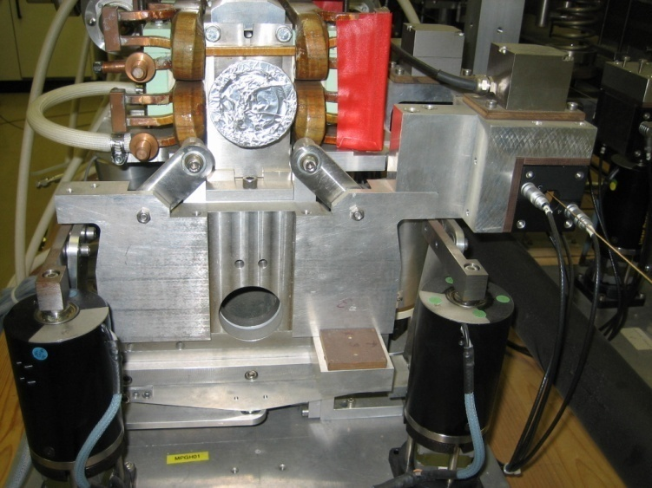
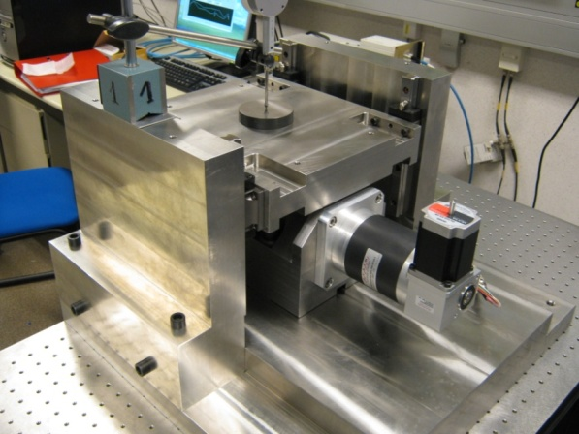
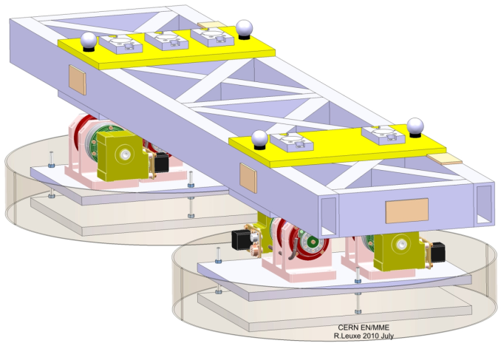
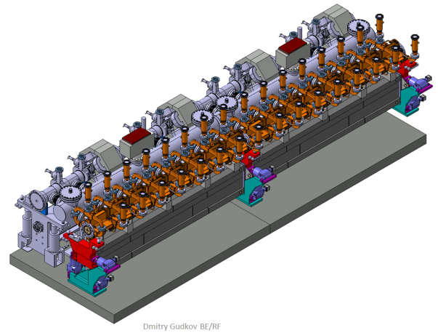
Strategy of re-adjustment
MB Quad // cam movers
DB and MB girders // linear actuators
Validation of a SLS type cam mover (1 DOF mock-up)
Validation of on a 5 DOF mock-up
Validation on a pre-alignment mock-up
Validation on the two beam prototype modules

Slide 10
SUMMARY
Introduction
Solutions for CDR
Solutions concerning re-adjustment and feasibility
Solutions concerning the determination of the position and feasibility
Validation on two beam prototype modules
Towards TDR

Slide 11
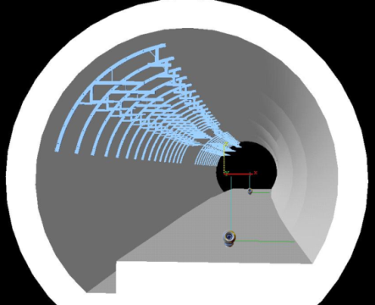
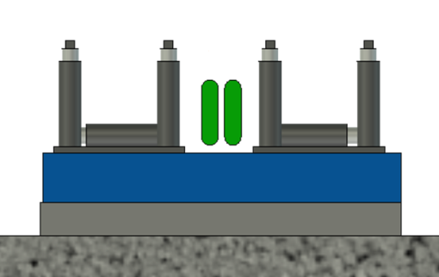
General strategy: determination of the position of the components
Geodetic Reference Network (GRN)
Backbone for all the tunnels and areas
Will allow the installation of all services and of the MRN
Metrologic Reference Network (MRN)
As it is not possible to implement a straight alignment reference over 20 km: use of overlapping references
11
For CDR: reference = wire stretched over 200 m

Slide 12
General strategy: determination of the position of the components
Geodetic Reference Network (GRN)
Metrologic Reference Network (MRN)
Support Pre-alignment Network (SPN)
12

Slide 13
General strategy: determination of the position of the components
Geodetic Reference Network (GRN)
Metrologic Reference Network (MRN)
Support Pre-alignment Network (SPN)
Alignment and fiducialisation of each component on the supports (AFC)
13

Slide 14
Status of the different solutions
Strategy towards the feasibility
Stretched wire for MRN and SPN
14

Slide 15
Required solutions: feasibility of the concept
STEPS
ISSUES
Determination of the metrological network w.r.t the straight alignment reference
Stable alignment reference, known at the micron level
Determination of the position of each sensor w.r.t metrological network
Submicrometric sensors providing « absolute » measurements
Active pre-alignment
Fiducialisation: determination of the zero of each component w.r.t the sensor (external alignment reference)
Measure 2m long objects within a few microns
Re-adjustment: displacement of the component supporting structure according to the sensor readings
Submicrometric displacements along 3/5 DOF
Other issues:
Compatibility with the general strategy of installation and operation
Compatibility with other accelerator equipment or services
15

Slide 16
Stretched wire
Main issue: long term stability of a wire
(effects of temperature, humidity, creeping effects, air currents)
Modelization of the wire using Hydrostatic Levelling Systems (HLS)
but only in the vertical direction
but HLS system follows the geoid which needs then to be known
➔ studies undertaken concerning the determination of the geoid
➔ Is a stretched wire really straight (radial direction)?
First idea: comparison with a laser beam under vacuum (NIKHEFF)
→ on short distances (50 m) this autumn at CERN
Subject of a thesis: « Determination of a precise gravity field for the CLIC feasibility studies » Sébastien Guillaume
See talk by Mark Jones (Friday AM)
Notes:
Se

Slide 17
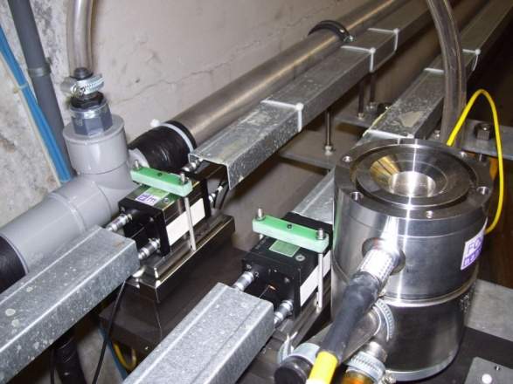
Stretched wire and MRN
Minimum configuration
TT1 facility
Objectives:
To determine the precision and accuracy of a MRN consisting of overlapping stretched wires
To study the behavior of wires of different lengths
To study the modelization of a stretched wire

Slide 18
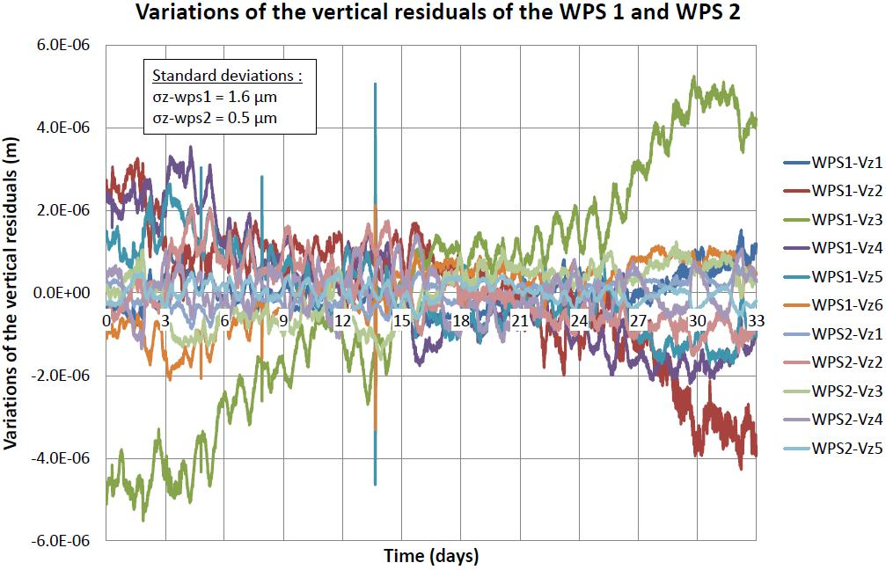
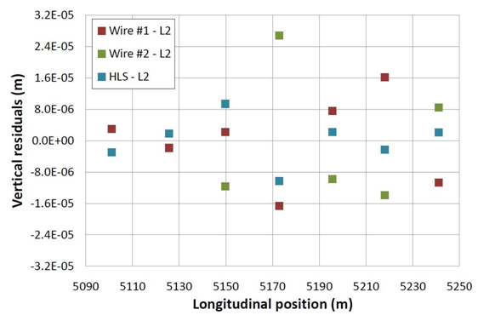
Stretched wire and MRN
See talk by Thomas Touzé (Thursday AM)
Results in TT1
Precision on a 140 m wire: better than 2 microns over 33 days
Accuracy: 11 microns in vertical, 17 microns in radial. Can be improved!
Vertical residuals of the 2 longest wires:
σ (wire 1) = 1.6 µm
σ (wire 2) = 0.5 µm
Accuracy of the TT1 network adjusted by the least squares method in vertical:
σ = 11 µm r.m.s (27 µm max. value)
Subject of a thesis: « proposal of an alignment method for the CLIC linear accelerator: from the geodetic networks to the active pre-alignment » Thomas Touzé.

Slide 19
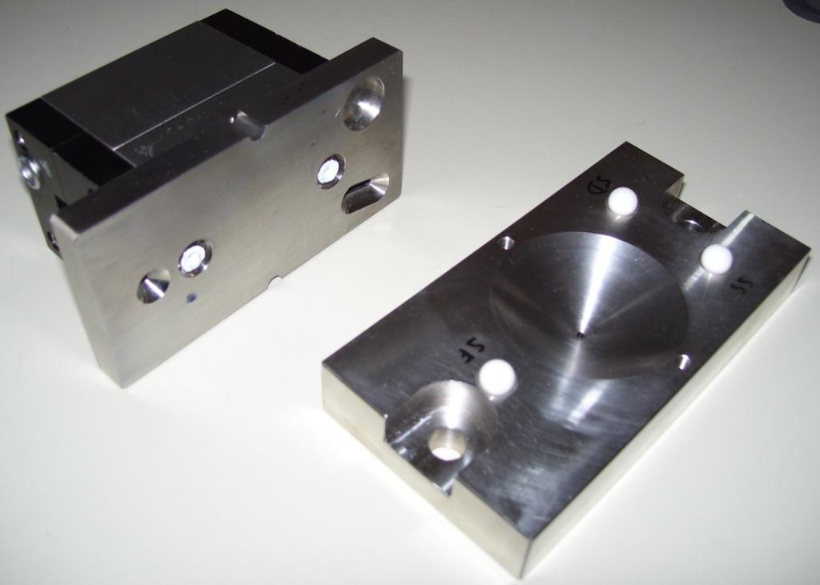
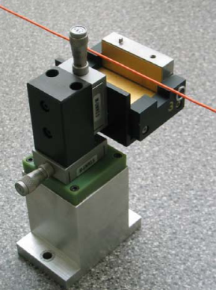
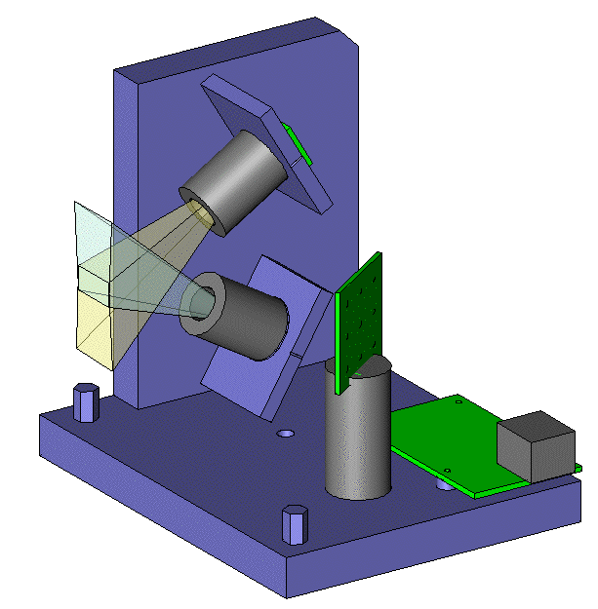
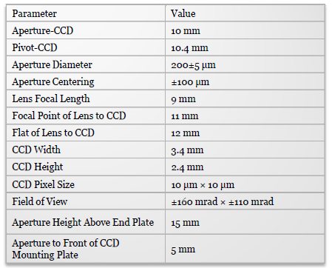
Sub-micrometric sensors
Issue: WPS sensor fulfilling the requirements
« absolute measurements » (known zero w.r.t mechanical interface)
no drift
sub micrometric measurements
Capacitive based WPS (cWPS)
Optical based WPS (oWPS)
Upgraded WPS
Resolution: 0.2 µm
Range: 10 x 10 mm
Repeatibility: 1 µm
Bandwidth: 10 Hz

Slide 20
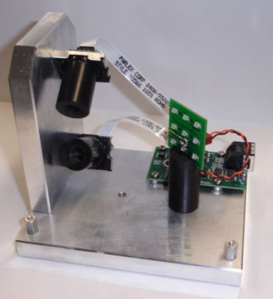
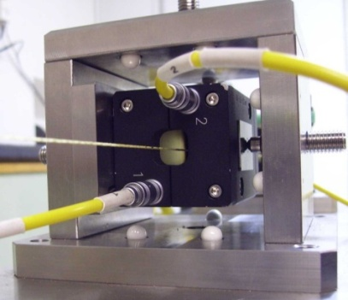
Status of the different sensors technologies
See poster by Andreas Herty and Patrick Bestmann
 | cWPS | oWPS
Technology | Capacitive | Optical
Accuracy (μm) | 7 | ~ 10 (TBC)
Repeatability (μm) | 1 | 2
Precision (μm) | 1 | 2
Acq. Frequency (Hz) | 100 | 1 /sensor
Resistance to radiation | 200 kGy (sensor) 500 Gy (remote electronics) | TBC
Wire | Carbone peek | Vectran
Sag (mm) for 200 m | 76.5 mm | 45.5 mm
Cost | 5000 CHF | 500 $
20

Slide 21
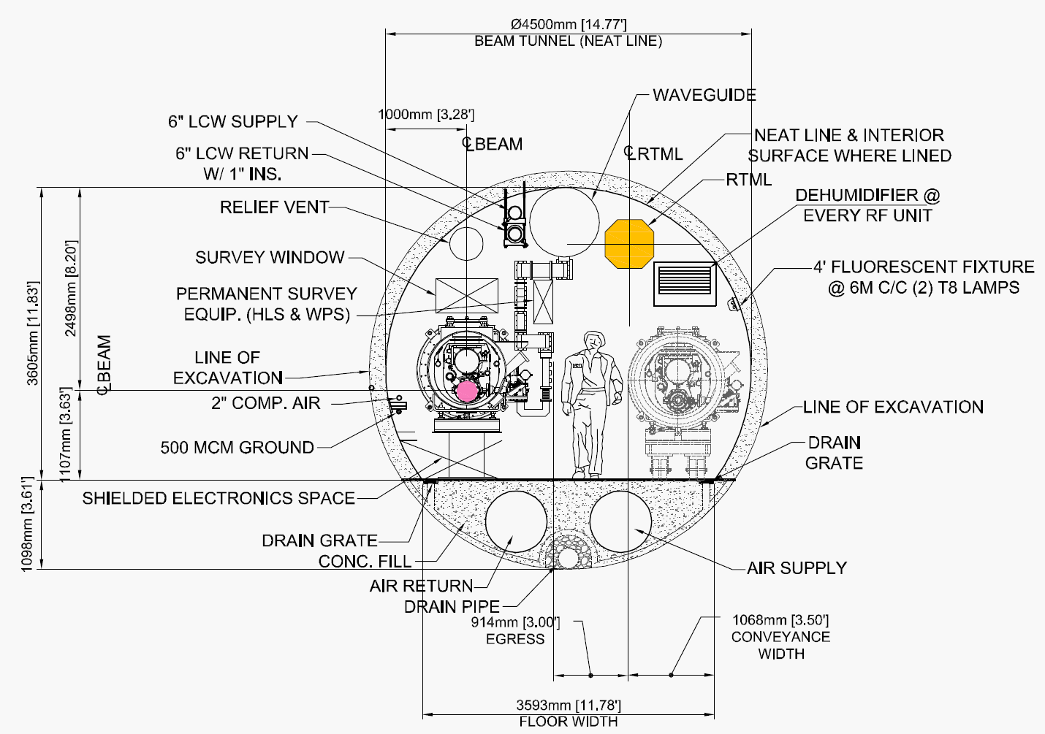
Inter-comparison between sensors:
Web site: https://clic-pral.web.cern.ch/clic-pral/
See talk by Andreas Herty (Tuesday AM)
Status of the inter-comparison:
➔ WPS [SLAC, CERN] : inter-comparison at SLAC. Facility ready in July 2010.
HLS [Fermilab, SLAC, DESY, USTC]: long term stability tests at Fermilab, other tests at CERN.

Slide 22
SUMMARY
Introduction
Solutions for CDR
Solutions concerning re-adjustment and feasibility
Solutions concerning the determination of the position and feasibility
Validation on two beam prototype modules
Towards TDR

Slide 23
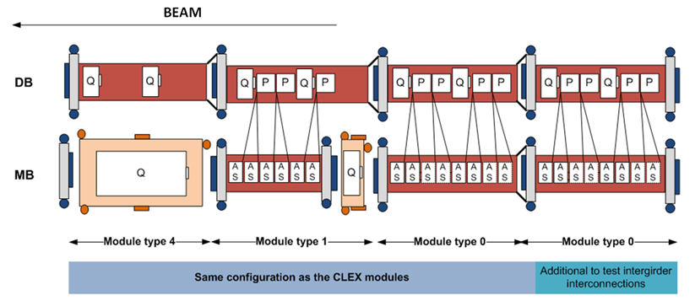
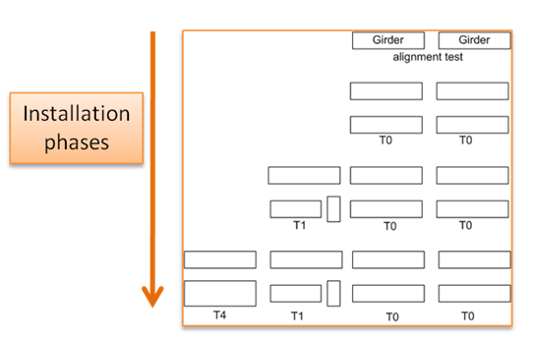
Test program on CLIC two beam prototype modules
End 2010

Slide 24
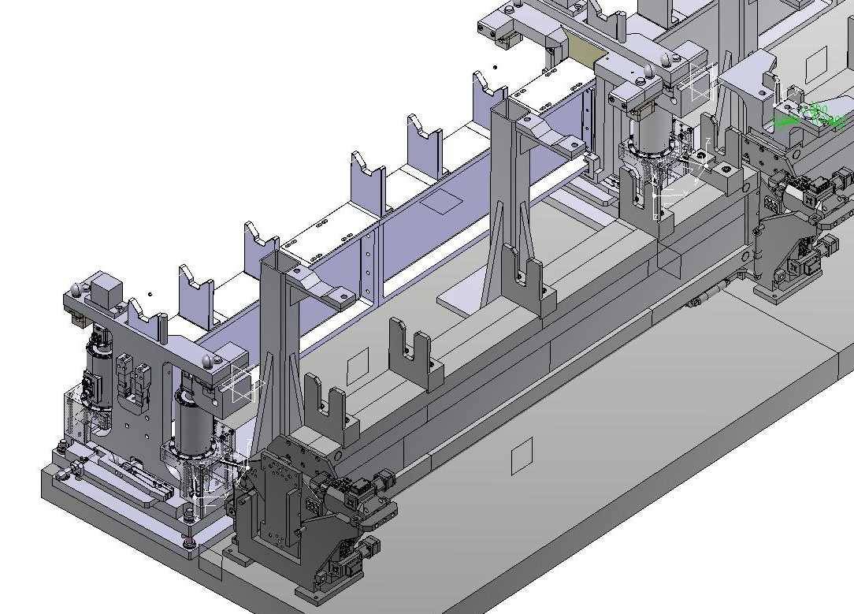
Proposed solution for two beam prototype modules
(N. Chritin)
Validation of the repositioning concept (possibility of sub-micrometric displacements)
Before the installation of all other systems (waveguides, vacuum,…)
After installation of all other systems (waveguides, vacuum,…)
Measurement of the eigenfrequencies of the girders
Validation of the fiducialisation strategy
Validation of the stability of the components on the girders
Impact of the transport on a micrometric pre-alignment
Impact of variation of temperature, thermal cycles
Feedback for the CLEX test module, and all associated technical specifications
Feedback for the general strategy of installation
Feedback for the schedule
Inter-comparison between solutions of SPN networks.
24

Slide 25
SUMMARY
Introduction
Solutions for CDR
Solutions concerning re-adjustment and feasibility
Solutions concerning the determination of the position and feasibility
Validation on two beam prototype modules
Towards TDR

Slide 26
Alternative studies for TDR
Determination of the position of the components:
➔ In collaboration with NIKHEF : development of alternative solutions (laser beam)
Design of a short range / long range solution adapted for CLIC requirements
Integration of the short range solution on the two beam prototype modules
Inter-comparison of the long range solution in TT1 / TZ32 tunnels
Re-adjustment:
➔ Validation of the concept of articulation point with cam movers
Other studies (in order to reduce the number of sensors):
➔ Study of a mono-girder (DB & MB components)
➔ Study of longer girders
➔ Development of low cost WPS sensors with FOGALE Nanotech (technical specification under definition)
Development of a Laser Alignment Multipoint Based: LAMBDA project

Slide 27
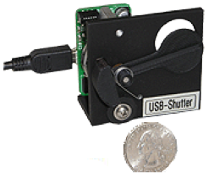
LAMBDA Project
LAMBDA for Laser Alignment Multipoint Based – Design Approach
Description:
Reference of alignment : laser beam under vacuum
N-point alignment system: sensors distributed along the beam
Speckles are measured on a surface on each point (sensor) using a CCD
Measurement surface = mechanical or optical shutter, which will not alter the beam and keep the straightness of the reference of alignment.
Each sensor consists of a measurement surface, a convergent lens and a CCD camera, allowing an indirect observation of the speckles on the surface by the CCD
➔ reducing the angular sensitivity of the system.
According to the first simulations, to detect micometric displacement, angular orientation should be better than 0.2 mrad, and repeatability of shutter 12 µm
Status: looking for a PhD student.
(F. Lackner)

Slide 28
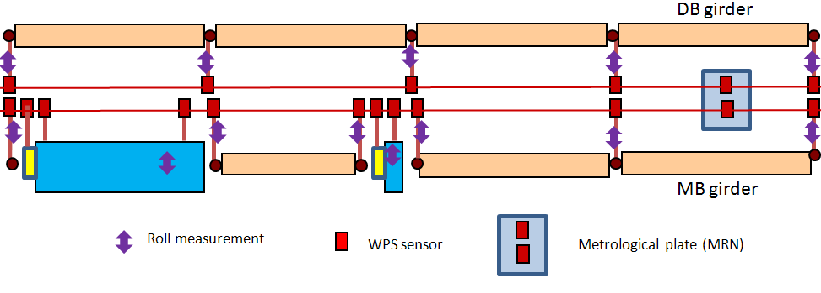
CONCLUSION
Proposed solution for CDR
Determination of the position of the components:
➔ stretched wire + WPS sensors for MRN and SPN
Re-adjustment:
➔ MB quad: cam mover
➔ Girders: high precision linear actuators
Feasibility will be endorsed on the CLIC prototype modules

