Slide 1
Company Presentation
Automated Precision

Slide 2
International
API Americas: Headquarters in Rockville,
MD, USA
API Europe: Heidelberg, Germany
API Asia: Shanghai, China
Worldwide distributors

Slide 3
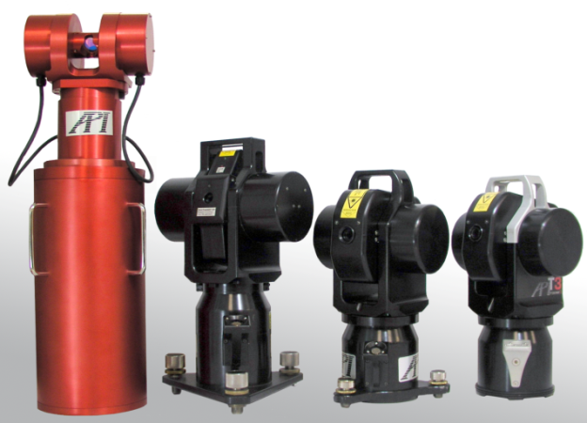
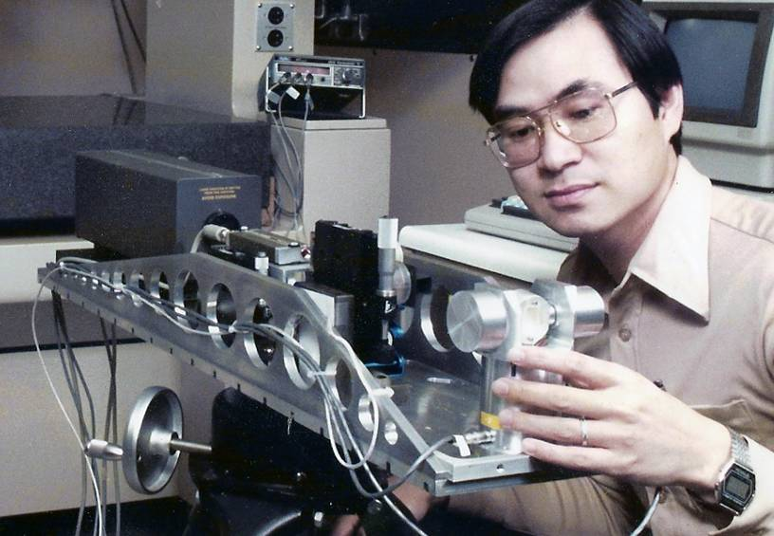
History of innovations
2010
2008
Intelli 360° Products…
2006-7
VEC (Volumetric Error Compensation)
2005
Iprobe, Iscan, Siemens/API
2002
Tracker 3, XD Laser,
1999
Tracker 2+, STS
Tracker 2 (2nd Generation)
1996
CMM Controller, Machine Error, Swivel
1991
1989
WINNER: Spindle, Compliance, Level, Ballbar, 6D Laser
1987
API licensed Leica
Invention of 1st generation Laser Tracker

Slide 4
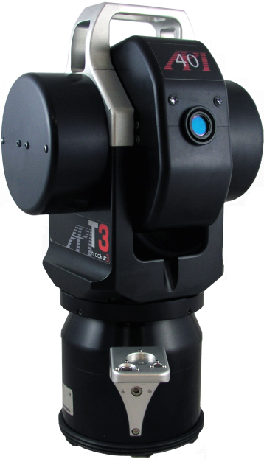
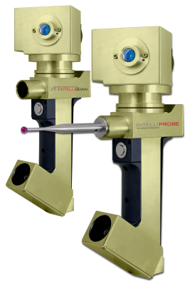
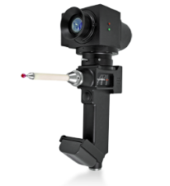
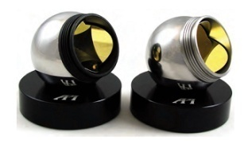
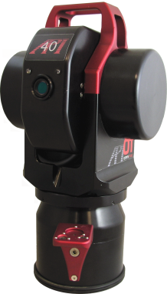
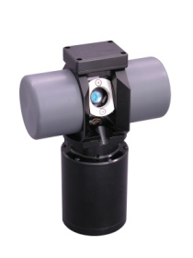
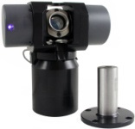
Laser Tracker Product Line
T3 IFM / ADM
BRANDNEW: Wireless
ADM only
DYNAMIC TARGETS

Slide 5
ADM only system with full Laser Tracker functionality such as dynamic sampling, working range from 0-60m
..and all this for the price of an advanced Totalstation

Slide 6
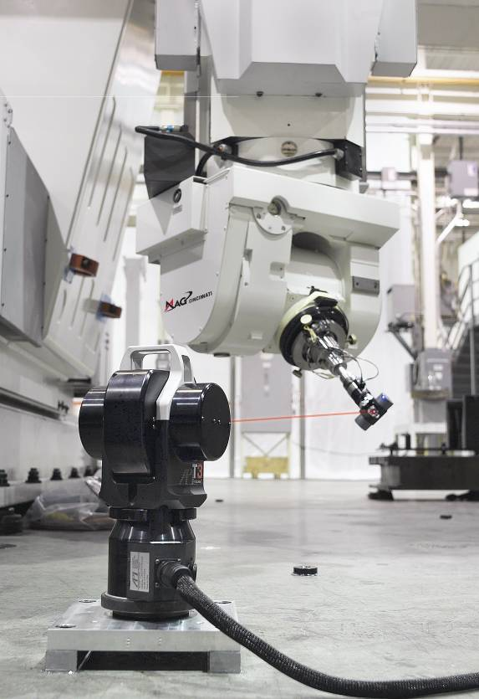
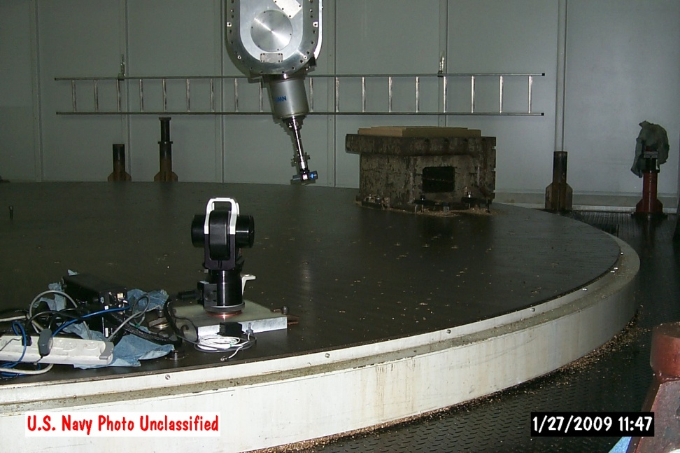
NEW! API VEC
Volumetric Error Compensation

Slide 8
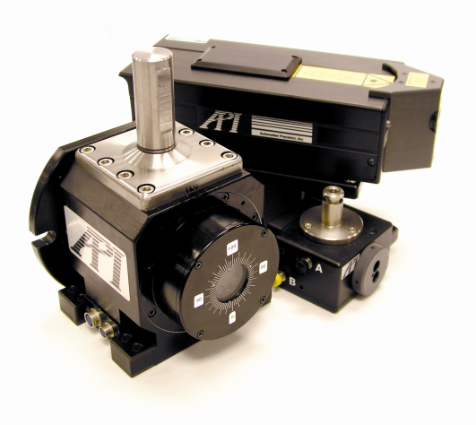
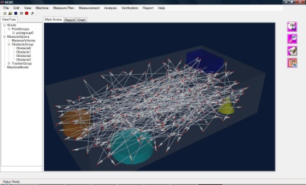
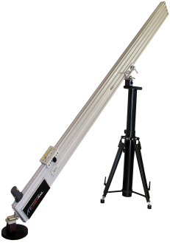
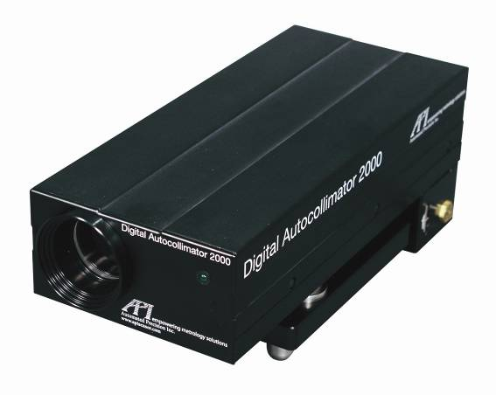
Metrology Product Line
MACHINE TOOL
METROLOGY
NEW!

Slide 9
Thank you!
Questions?

