Slide 1
Instrument Tests with the new Leica AT401
Georg Gassner September 16th 2010

Slide 2
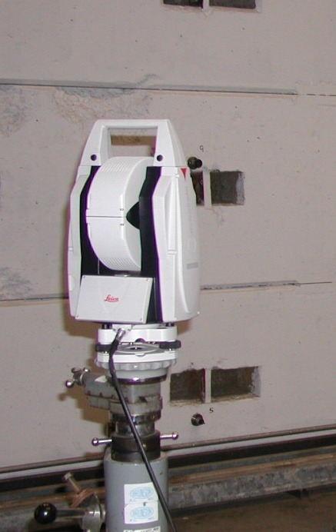
Leica Specifications
Distance:
Range: ~1.5 m - ~80 m (Brochure)
Accuracy: < 10 µm (Factsheet)
MPE: ± 10 µm (Brochure)
Angle:
Vertical Range 0° - 145°
0.5 arcsec (2.5 µrad)
MPE: ± 15 µm + 6 µm/m
U_{XYZ} = ± 15 µm + 6 µm/m (±45°)
Level to gravity
PowerLock
Battery Operated
CCD Camera
Notes:
Added – to range, spaces between values and units, ° symbol to angles in degrees

Slide 3
Distance Measurements - Setup
Test Bench at SLAC in Sector 10
Notes:
Changed “Sect 10” to “Sector 10”

Slide 4
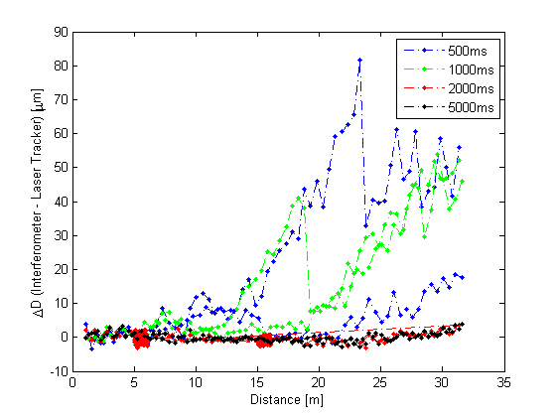
Distance Measurements - Different Measurement Time Settings

Slide 5
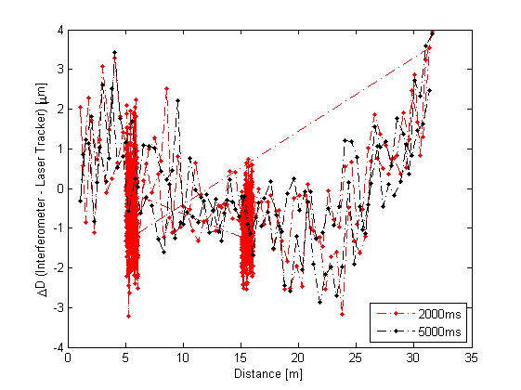
Distance Measurements - Different Measurement Time Settings - Zoom
Std: 1.5 µm
Laboratory environment
Distances 1.5 m to 32 m

Slide 6
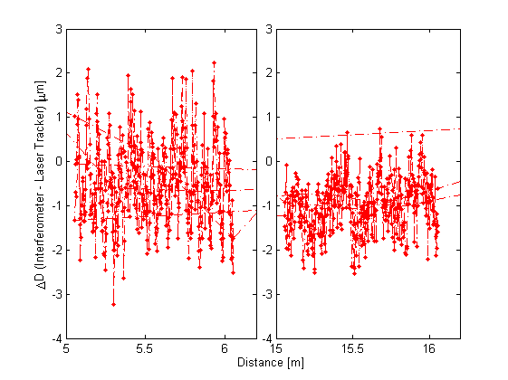
Distance Measurements – Small Sampling Distance

Slide 7
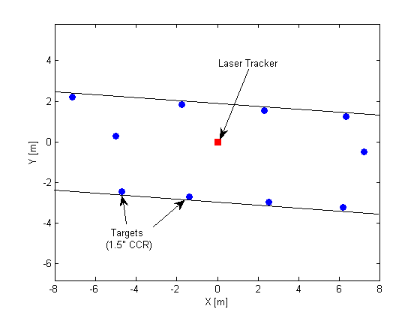
Horizontal Angle Test - Setup
10 setups with the instrument at the same position but rotated by 30° Targets at same height as instrument
Horizontal Angle Meas.
Manual Targeting
Level of Instrument
Notes:
Shockingly, removed period after 30° since there was none after “instrument”

Slide 8
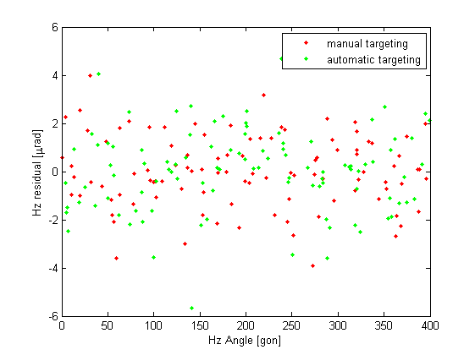
Horizontal Angle Test – Hz-Results
Std: 1.6 µrad (0.3 arcsec)
Laboratory environment
Distances 3 m to 8 m

Slide 9
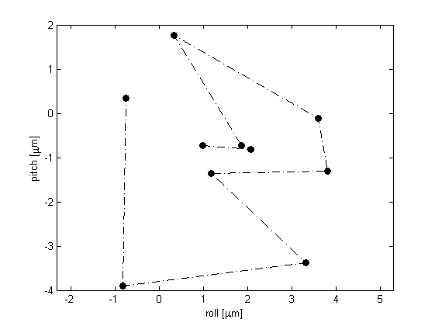
Horizontal Angle Test – Level Sensor
Pitch [µrad]
Roll [µrad]

Slide 10
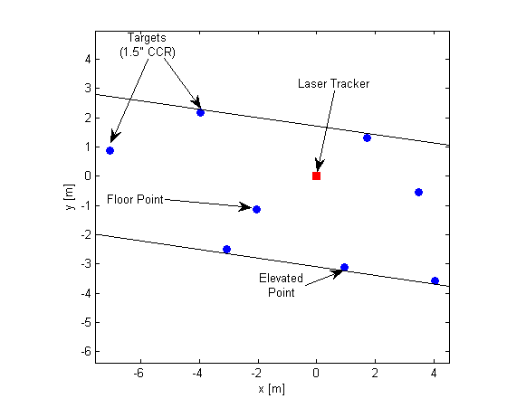
Warm-up Test – Setup
Set measurement every 5 minutes after the instrument was turned on

Slide 11
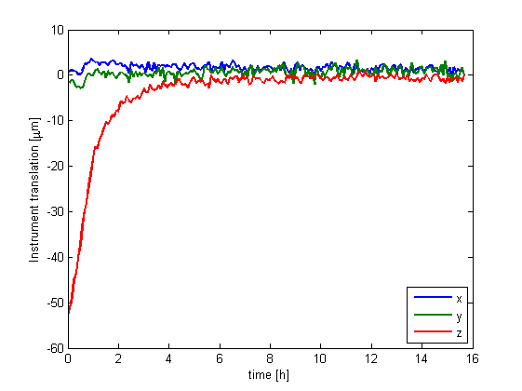
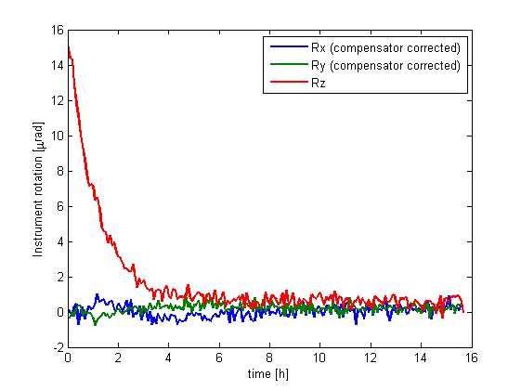
Warm-up Test – Results (1)

Slide 12
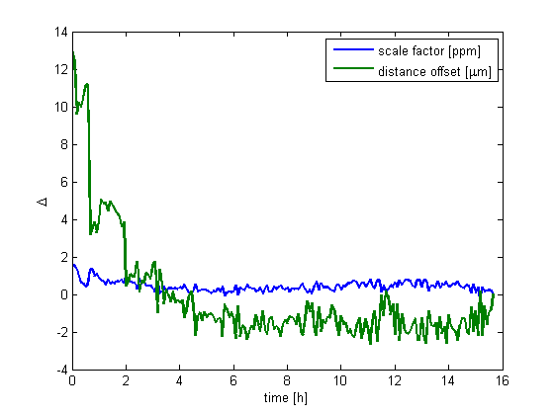
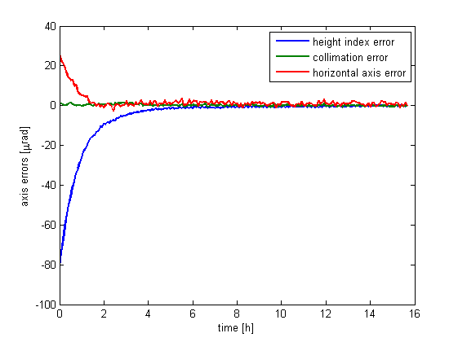
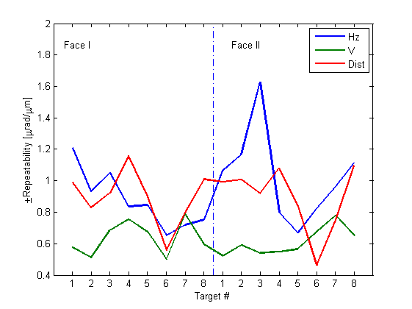
Warm-up Test – Results (2)
Repeatability [µrad] resp. [µm]

Slide 13
Acceptance/Verification Test – ISO 10360-LT
6.4 Length Error
Measure a multitude of 3D distances in space and compare them to a “known” distance. Compare the difference to the manufacturer’s MPE specification or your requirements.

Slide 14
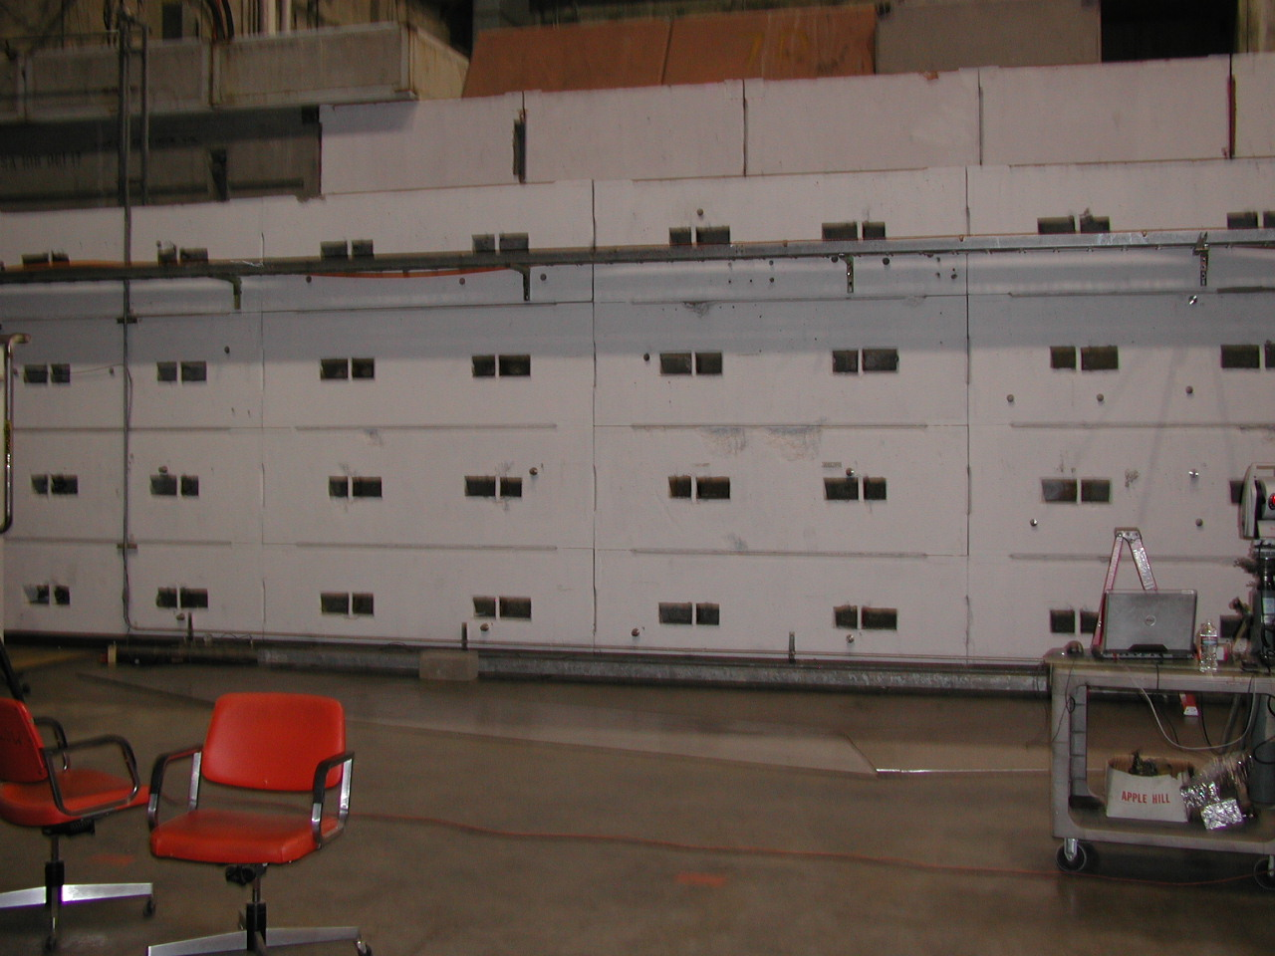
Acceptance/Verification Test – Example
10 m
3m
Notes:
“Example of a realization”, sounds redundant, whatever a “realization” is. “An Example” would be sufficient. It’s up to you.

Slide 15
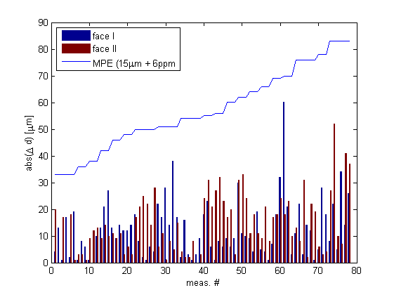
Acceptance/Verification Test – Results

Slide 16
Summary
Pro
Portable
Accurate
PowerLock
Level sensor
CCD camera
Long range
Con
Official min. dist 1.5m
No scanning
PowerLock (new firmware?)

Slide 17
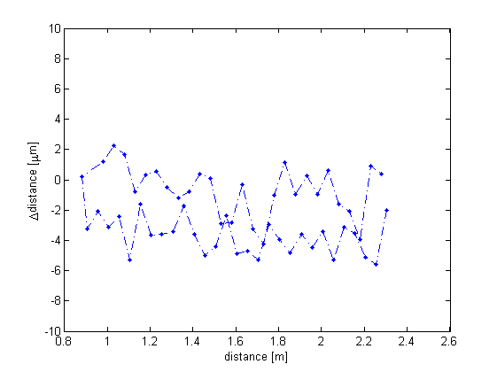
Close Range (<1.5 m)

