Slide 1
Camera Choices for Photogrammetric Surveys
IWAA2010, September 13-17, 2010
DESY Hamburg, Germany
Catherine LeCocq, Robert Ruland SLAC

Slide 2
Introduction
There are many factors that can influence the quality of a photogrammetric survey, this presentation concentrates on the camera aspect.
The steps for the selection of a new camera are described based on the analysis of the results on a test wall surveyed by a standard Nikon D200 and by a modified GSI Nikon D300.

Slide 3
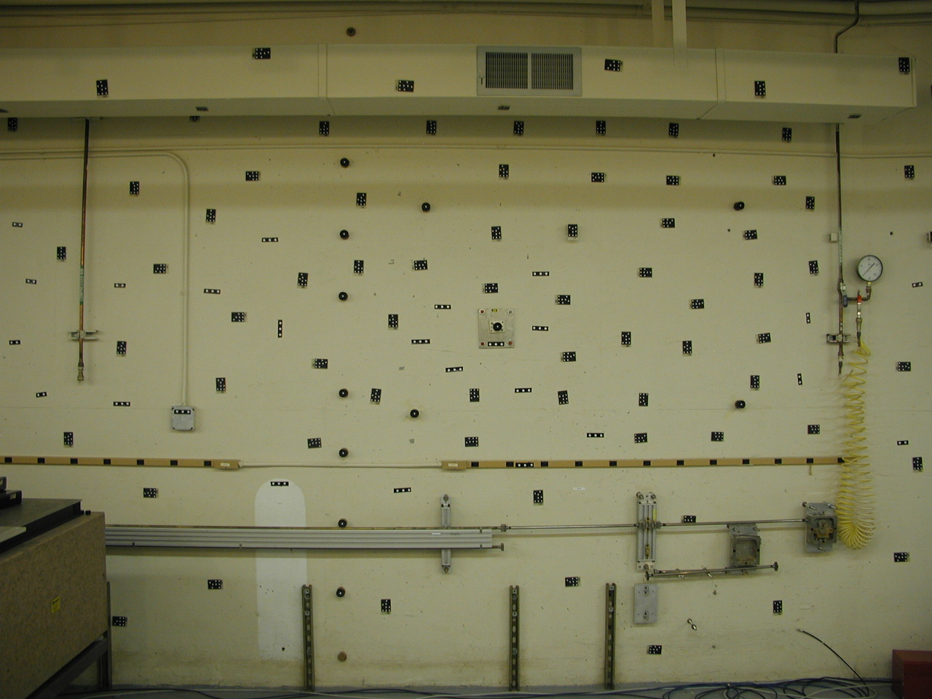
Testing Wall

Slide 4
Testing Wall
Z
X

Slide 5
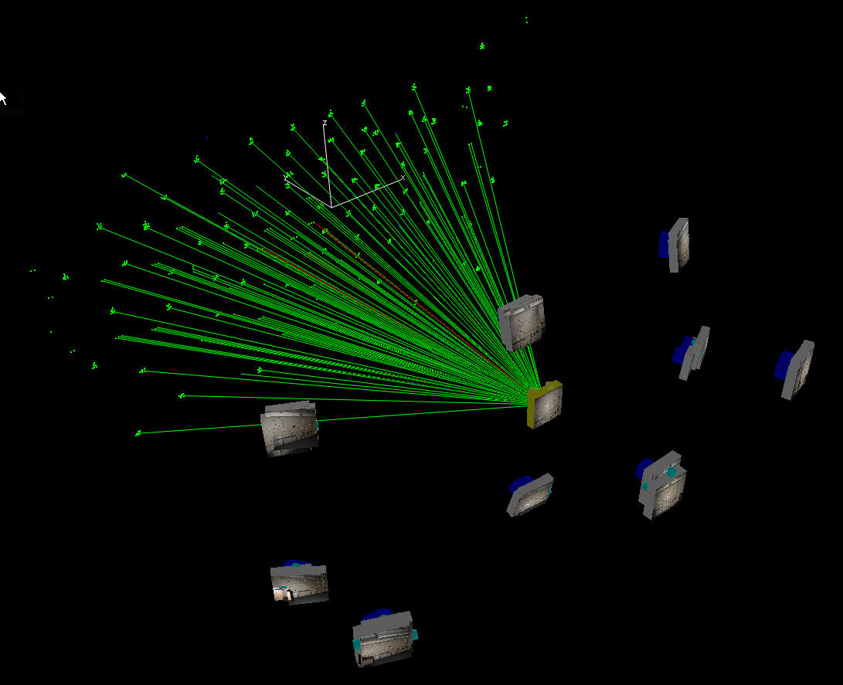
Photogrammetric Survey

Slide 6
Nikon Cameras
Target | DX | DY | DZ | DX | DY | DZ
PT002 | -0.172 | -0.017 | -0.062 | -0.016 | -0.012 | 0.039
PT003 | -0.107 | -0.001 | -0.094 | -0.021 | 0.014 | 0.006
PT004 | -0.086 | -0.035 | -0.088 | -0.057 | -0.015 | 0.015
PT005 | -0.004 | 0.027 | -0.029 | 0.014 | -0.004 | 0.028
PT006 | 0.041 | 0.013 | 0.016 | 0.016 | 0.004 | -0.012
PT007 | 0.111 | -0.031 | 0.205 | 0.035 | 0.011 | -0.009
PT008 | 0.155 | 0.019 | 0.316 | 0.043 | -0.008 | 0.024
PT009 | -0.143 | 0.005 | -0.035 | -0.023 | -0.019 | -0.007
PT010 | -0.074 | 0.016 | 0.011 | 0.031 | 0.005 | 0.008
PT011 | 0.050 | -0.043 | -0.224 | -0.035 | -0.027 | -0.034
PT012 | 0.353 | 0.040 | 0.066 | 0.038 | 0.018 | -0.012
M15 | -0.122 | 0.006 | -0.082 | -0.025 | 0.034 | -0.044
Camera | D200 |  |  | D300 – GSI Modified
RMS | 0.152 | 0.026 | 0.143 | 0.033 | 0.018 | 0.025

Slide 7
D200 Repeatability Studies
Global RMS fit to the 12 Control Points in mm

Slide 8
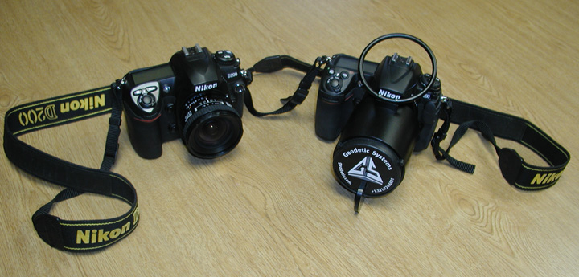
D200 vs GSI Modified D300

Slide 9
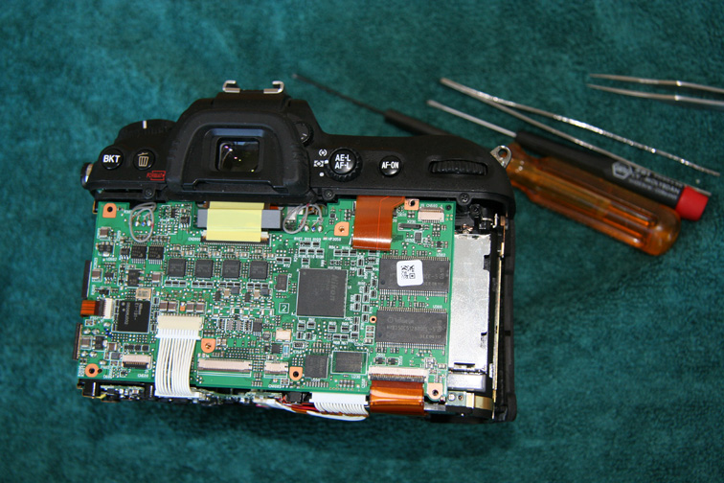
Inside of D200

Slide 10
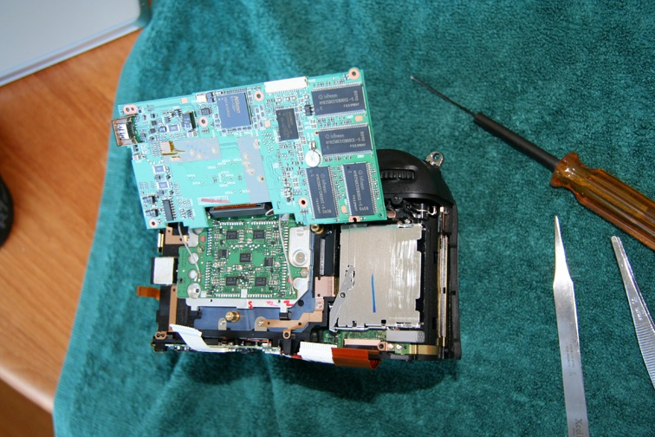
Inside of D200

Slide 11
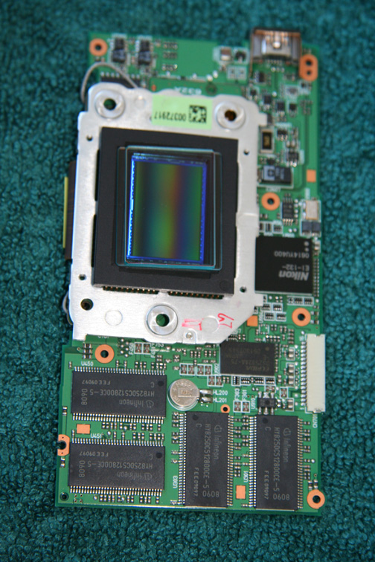
Inside of D200

Slide 12
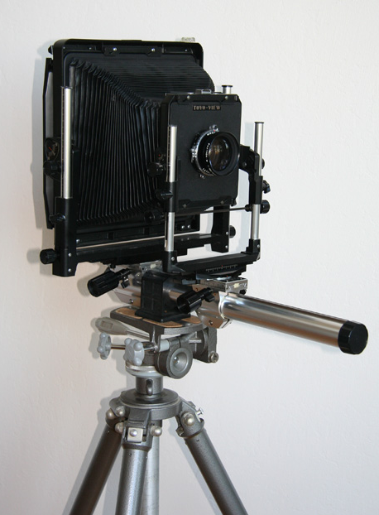
New Camera
Back to the concept of a View Camera:
A body
A lens board
A film board
Select each component independently.
Work on optimal integration

Slide 13
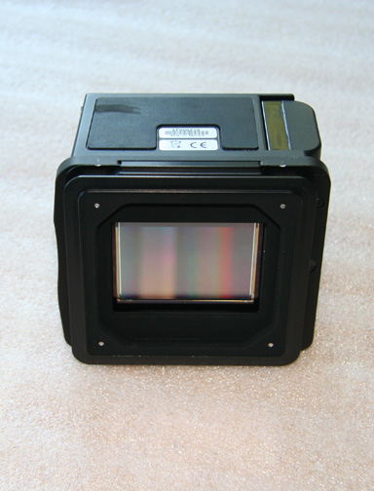
Sensor
Phase One Achromatic+ Digital Back
Designed and developed by Bear Images Photographic of Palo Alto, CA
Made by Phase One of Copenhagen, Denmark
Nikon DX
35 mm
Phase One Achromatic+
CCD Size 49.1mm x 36.8mm
Actual Pixels 7216 x 5412
Sensitivity 50 to 800 ISO
Exposure 1/10000s to 1 hour
Image BW 16 bits

Slide 14
Lens
Digitar lenses are developed by Schneider Optics for digital chips and consequently possess:
Higher resolving power
Better apochromatic correction
Shorter focal length for wide angle capabilities
Use of full perspective control with view cameras and digital backs
They come with two possible shutter systems:
Mechanical: Copal 0
Electronic: Schneider, Rollei
Schneider Apo-Digitar 5.6/35mm XL

Slide 15
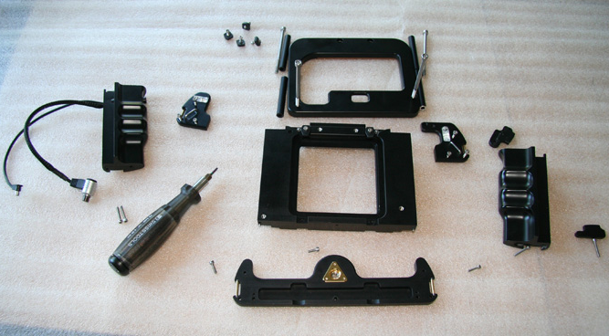
Body Parts

Slide 16
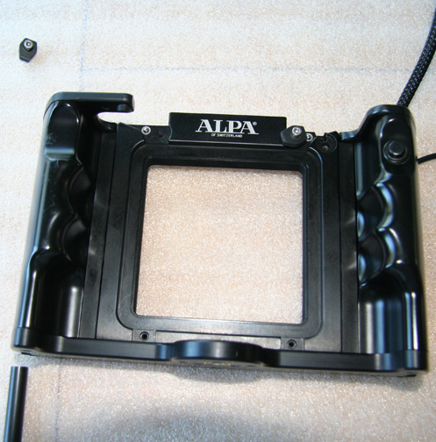
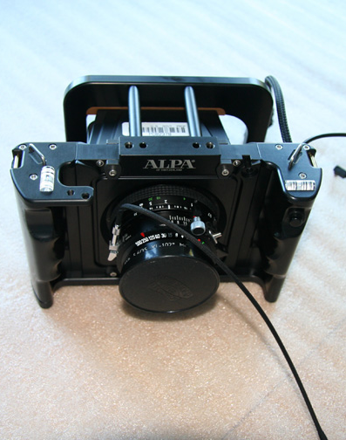
Camera Assembly

Slide 17
Wall Results
Target | DX | DY | DZ | DX | DY | DZ
PT002 | 0.018 | 0.011 | -0.009 | -0.016 | -0.012 | 0.039
PT003 | -0.004 | 0.025 | 0.001 | -0.021 | 0.014 | 0.006
PT004 | -0.030 | -0.008 | 0.011 | -0.057 | -0.015 | 0.015
PT005 | -0.023 | 0.000 | 0.030 | 0.014 | -0.004 | 0.028
PT006 | -0.032 | 0.003 | -0.028 | 0.016 | 0.004 | -0.012
PT007 | -0.011 | -0.004 | 0.009 | 0.035 | 0.011 | -0.009
PT008 | 0.015 | -0.015 | -0.016 | 0.043 | -0.008 | 0.024
PT009 | 0.043 | -0.040 | -0.057 | -0.023 | -0.019 | -0.007
PT010 | -0.021 | 0.003 | 0.036 | 0.031 | 0.005 | 0.008
PT011 | 0.030 | 0.015 | 0.064 | -0.035 | -0.027 | -0.034
PT012 | -0.001 | -0.019 | -0.031 | 0.038 | 0.018 | -0.012
M15 | 0.016 | 0.029 | -0.011 | -0.025 | 0.034 | -0.044
Camera | Alpa35 |  |  | D300 – GSI Modified
RMS | 0.024 | 0.019 | 0.033 | 0.033 | 0.018 | 0.025

Slide 18
Laser Tracker Survey
Target | DX | DY | DZ | DX | DY | DZ
PT002 | 0.018 | 0.011 | -0.009 | -0.006 | 0.006 | -0.012
PT003 | -0.004 | 0.025 | 0.001 | -0.003 | 0.000 | -0.007
PT004 | -0.030 | -0.008 | 0.011 | -0.007 | -0.017 | 0.014
PT005 | -0.023 | 0.000 | 0.030 | 0.007 | -0.004 | 0.004
PT006 | -0.032 | 0.003 | -0.028 | 0.005 | -0.011 | 0.019
PT007 | -0.011 | -0.004 | 0.009 | 0.001 | 0.009 | 0.006
PT008 | 0.015 | -0.015 | -0.016 | 0.027 | 0.006 | 0.005
PT009 | 0.043 | -0.040 | -0.057 | 0.029 | -0.014 | -0.064
PT010 | -0.021 | 0.003 | 0.036 | -0.004 | 0.005 | 0.023
PT011 | 0.030 | 0.015 | 0.064 | -0.038 | -0.022 | 0.032
PT012 | -0.001 | -0.019 | -0.031 | 0.008 | 0.014 | -0.032
M15 | 0.016 | 0.029 | -0.011 | -0.020 | 0.027 | 0.013
Camera | Alpa35 |  |  | Laser Tracker Survey Repeatability
RMS | 0.024 | 0.019 | 0.033 | 0.018 | 0.014 | 0.026

Slide 19
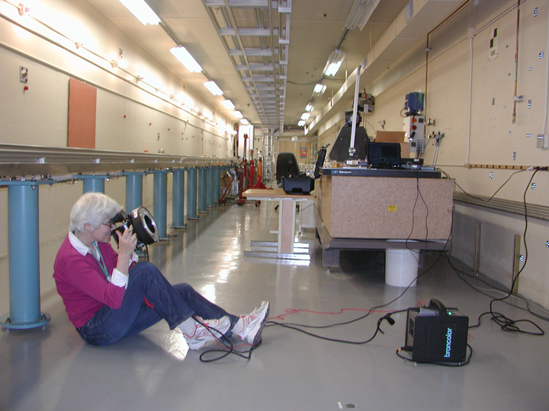
Field Operations

Slide 20
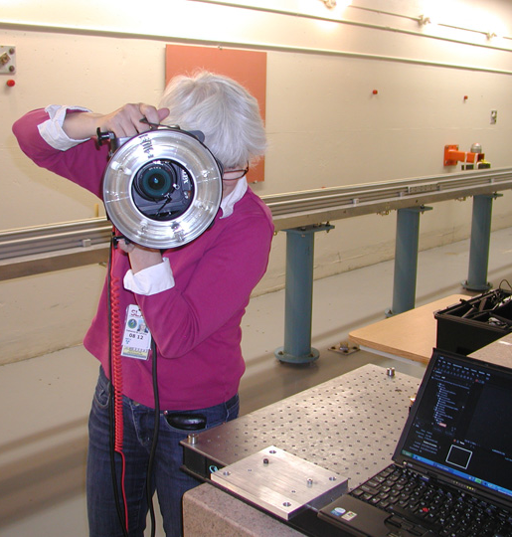
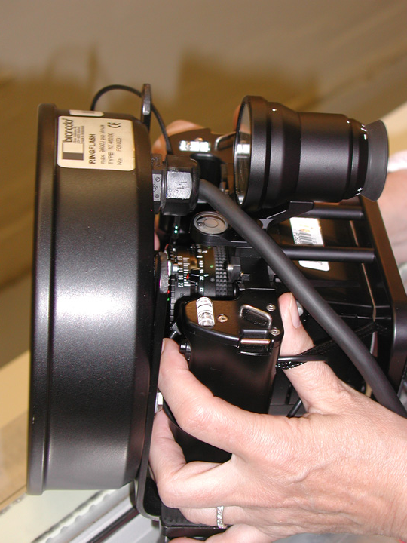
Field Operations

Slide 21
Modifications
Laptop
PC to Mac to improve FireWire performance
Looking for Wireless technology with the Mac
Flash
Mounting of ring flash
Hot-shoe flash
Body
Wider version
Simplified mounting

Slide 22
Outlook
Three (for now) cameras to cover all varieties of photogrammetric surveys at SLAC.
Extension of a camera toolbox based around an Alpa mount system.
Start of a modular lighting system.
Develop a better testing area.

Slide 23
Acknowledgments
Clive Fraser from the University of Melbourne, Australia
Jim Taskett from Bear Images Photographic INC., Palo Alto, California
http://kevincollinsphoto.smugmug.com/gallery/7467474_o3wCB/1
SLAC MET Alignment Engineering Team

