Slide 1
Design Considerations for the ESRF Upgrade Program Experimental Hall EX2 Slab
David Martin

Slide 2
Design Considerations for the ESRF Upgrade Program Experimental Hall EX2 Slab
The ESRF Upgrade program
Tolerances for the experimental hall slab
What we can say about these tolerances
Summary

Slide 3
The ESRF Upgrade Program
The 286M€ Upgrade will focus
on five highlight areas:
Nano-science and nanotechnology
Pump-and-probe experiments and time-resolved science
Science at extreme conditions
Structural and functional biology and soft matter
X-ray imaging
X-rays are an ideal tool to study nano-objects, as X-ray wavelengths are perfectly matched to this length scale.

Slide 4
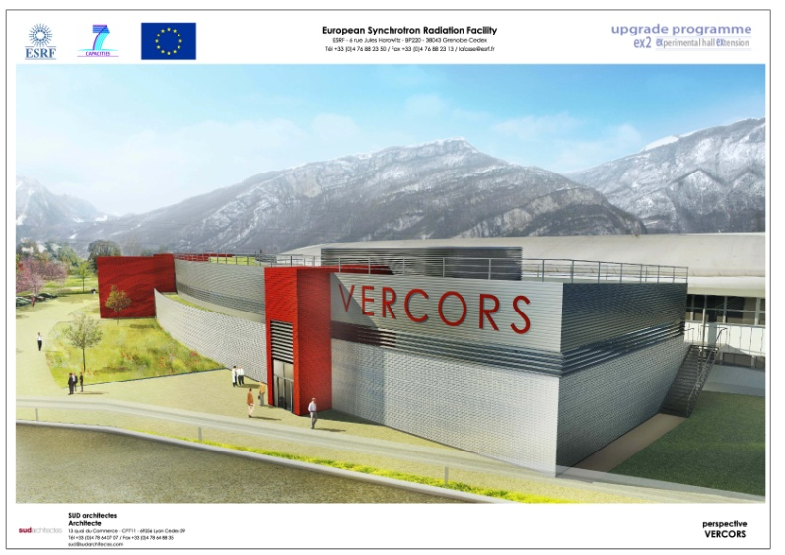
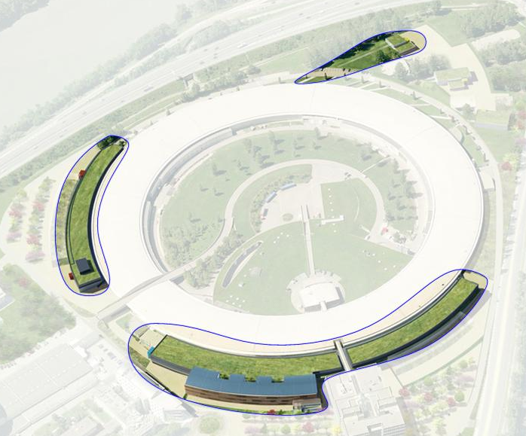
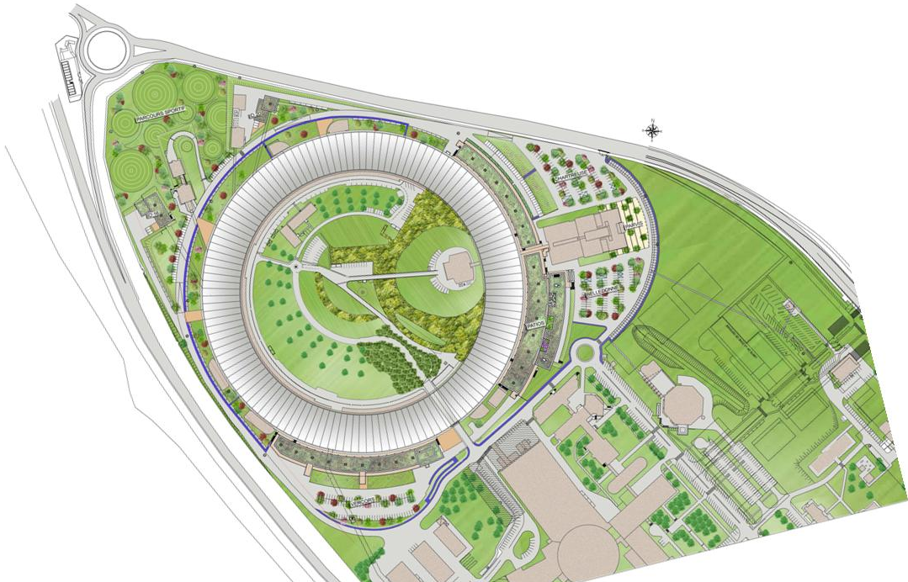
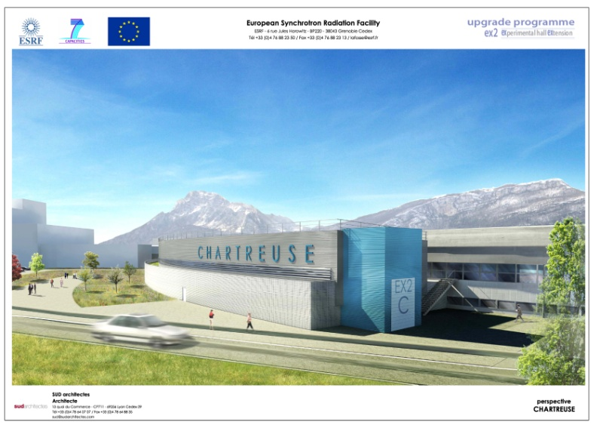
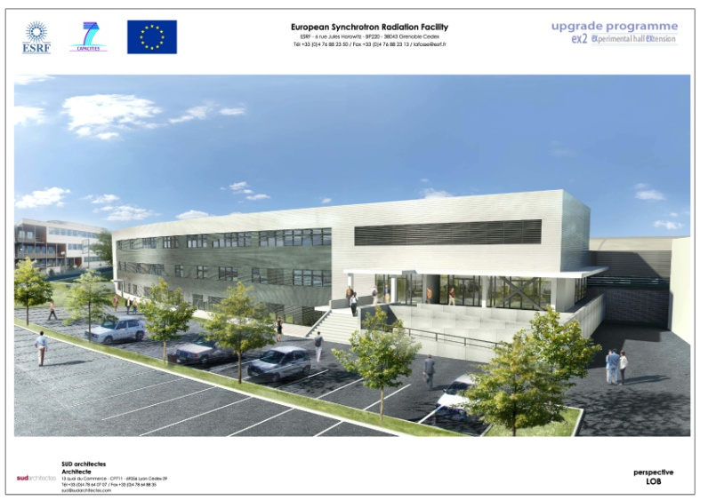
The ESRF Upgrade Program

Slide 5
Long Synchrotron Radiation Beamlines
Long beamlines can be compared to a microscope. The principal measure of merit is spatial resolution.

Slide 6
Long Beamlines
At the ESRF p=150 m and q=0.05 m so q/p=3000⁻¹ → theoretical probe size ~10 nm
The size of the focused x-ray probe spot size depends on:
the source size,
the distance between the source and the focusing optics p, and
the working distance between optics and the experimental sample q.

Slide 7
Translation Tolerance
Tolerance is 10% of 50 nm probe size e = 5 nm over a period of 30 minutes
150 m
U(trans) =
× 5nm
= 15 µm
0.05 m

Slide 8
Rotation Tolerance
Tolerance is 10% of 50 nm probe size e = 5 nm
over a period of 30 minutes
5 nm
U(rot) =
= 100 nrad
0.05 m

Slide 9
Long Term Site Movements
1997 to 2008

Slide 10
Medium Term Site Movements - Excavation

Slide 11
Medium Term Site Movements – Dam Purging

Slide 12
Medium Term Site Movements – Dam Purging

Slide 13
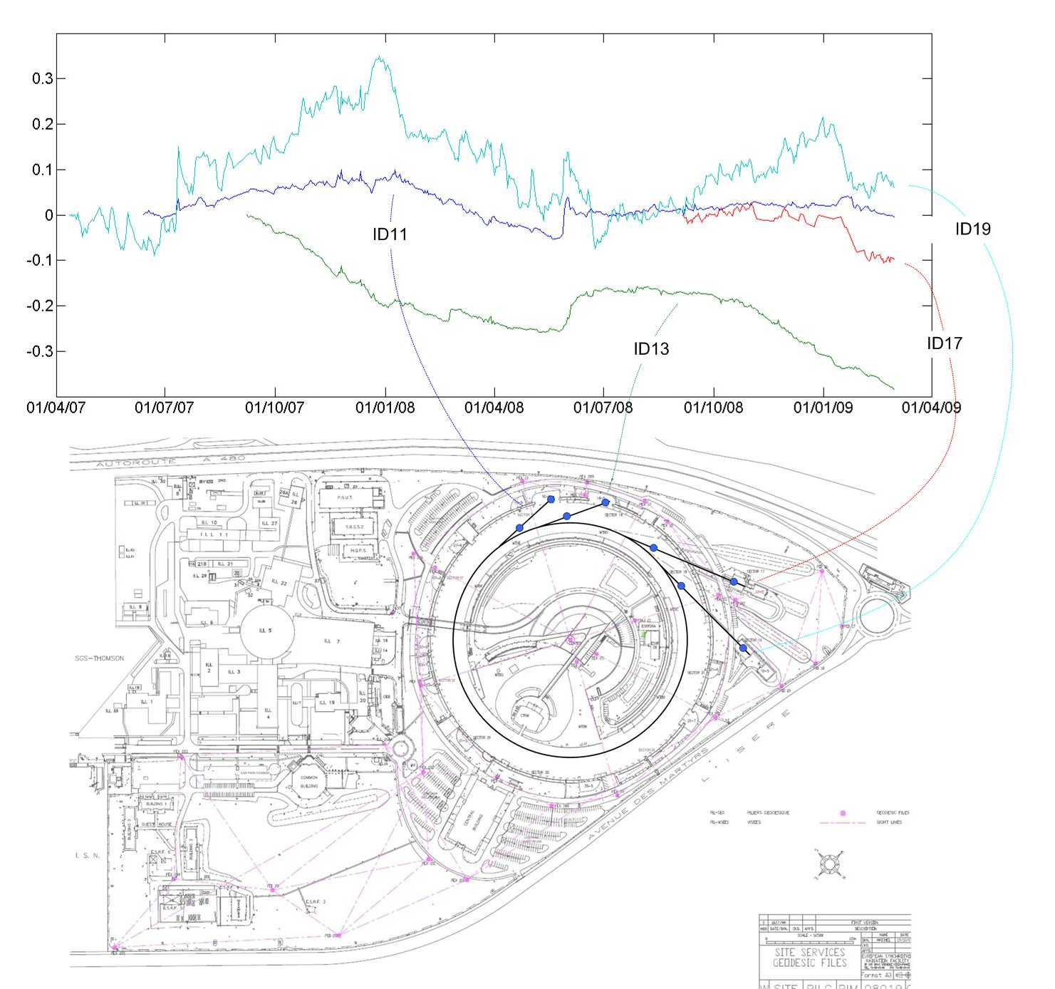
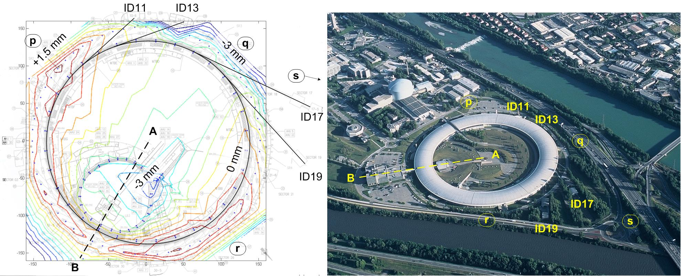
Medium to Short Term Movements

Slide 14
Sampling Explanation –Short Term Movements

Slide 15
Sampling

Slide 16
Sampling

Slide 17
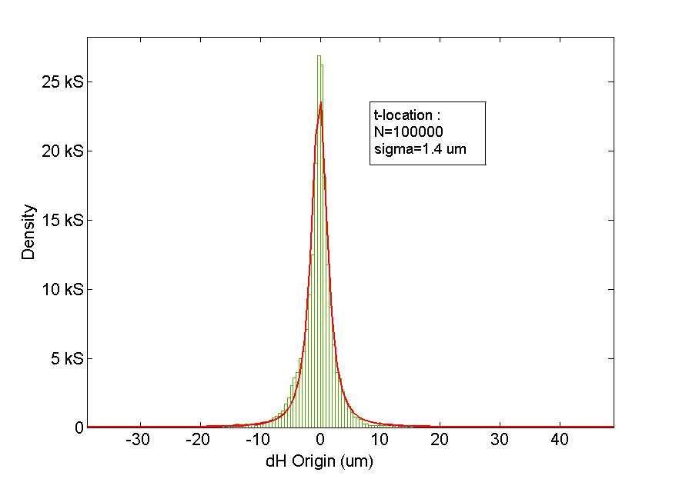
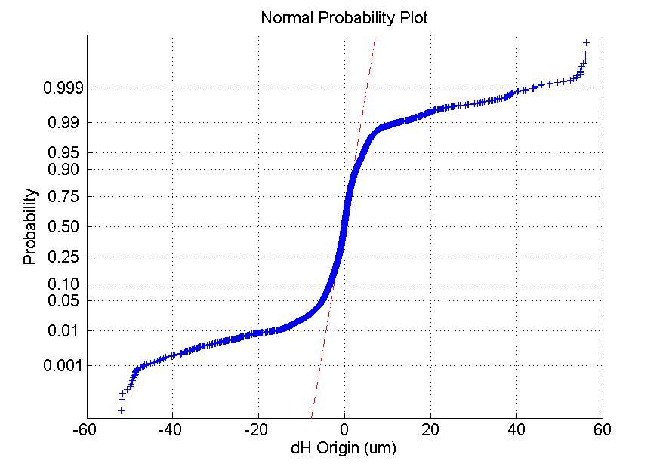
Sampling
σ=1.4 um
one point on graph

Slide 18
Long Beamline Translation Movements
For 250 m long beamline movement after 30 minutes is estimated between 1.1 um and 5 um
2¼ days
2100 nm
27 days
270 nm
x = dH / Distance y = x / min(x)
y = 1.00 1.11 1.26 2.67
Recall - tolerance 15 um over 30 minutes

Slide 19
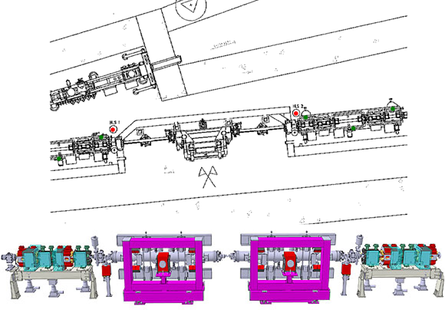
SR Straight Section Rotation

Slide 20
SR Straight Section Rotation
Recall - tolerance 100 nrad over 30 minutes

Slide 21
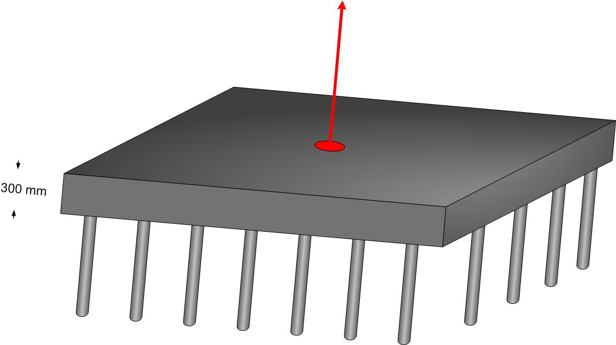
Slab Rocking

Slide 22
Slab Rocking
5½ hrs
8 hrs
Recall - tolerance 100 nrad over 30 minutes

Slide 23
Slab Curling

Slide 24
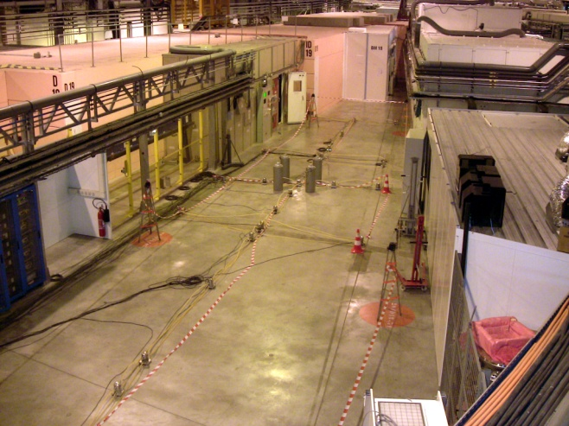
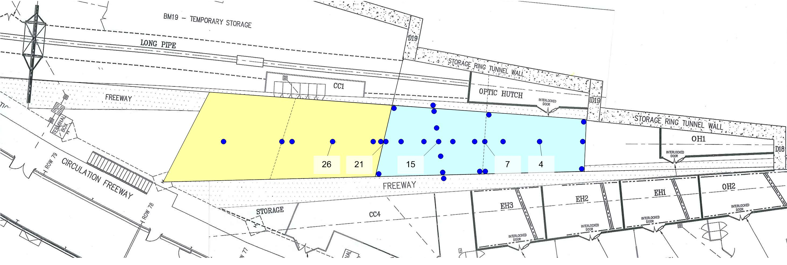
Slab Curling
15
26

Slide 25
Slab Curling

Slide 26
Slab Curling

Slide 27
Slab Curling

Slide 28
Slab Curling

Slide 29
Slab Curling
1100 nrad 3m from slab centre
370 nrad 1m from slab centre
Recall - tolerance 100 nrad over 30 minutes

Slide 30
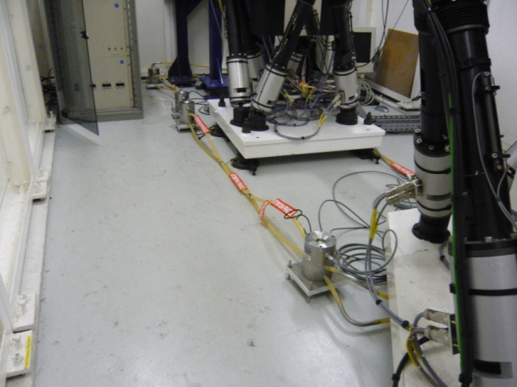
Beamline Mirror Rotation Movements

Slide 31
Beamline Mirror Rotation Movements

Slide 32
Summary- What can we say?
Translational stability of 15 µm over 30 minutes appears to be easily achievable,
Rotational stability of 100 nrad over 30 minutes is a challenge,
Observations and simulations have shown that slab curling due to temperature variations is the limiting design case in the new experimental hall slab for the ESRF Upgrade program.

