Slide 1
Long-term Variation of the Magnet Alignment In SPring-8 Storage Ring
Chao ZHANG, Sakuo Matsui
JASRI / SPring-8
Main events of magnet alignment
Long-term monitoring
Variation of magnet alignment

Slide 2
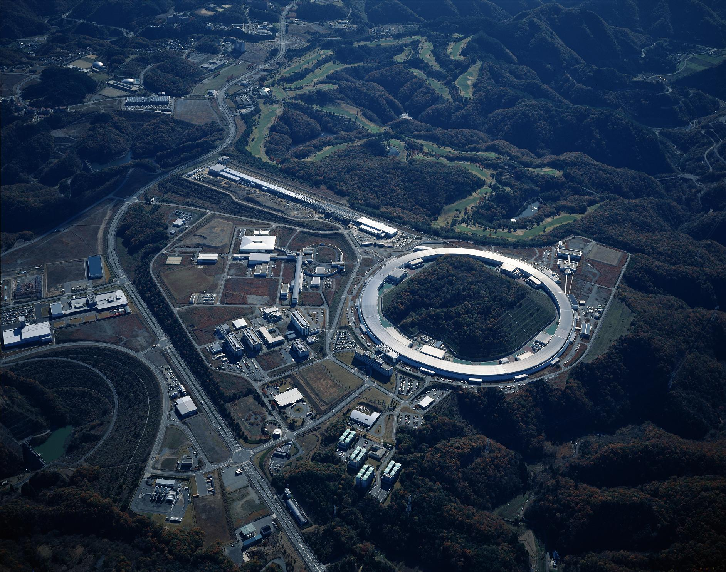
SPring-8 Site
8GeV Booster
1GeV Linac
８GeV Storage ring
2

Slide 3
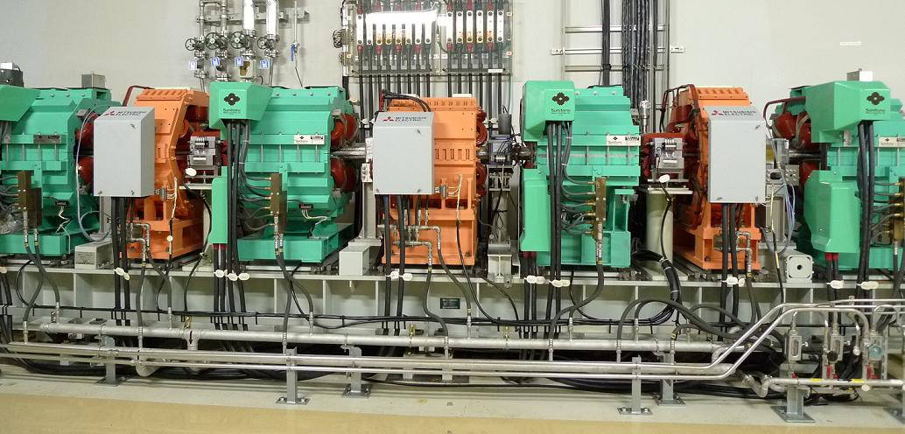
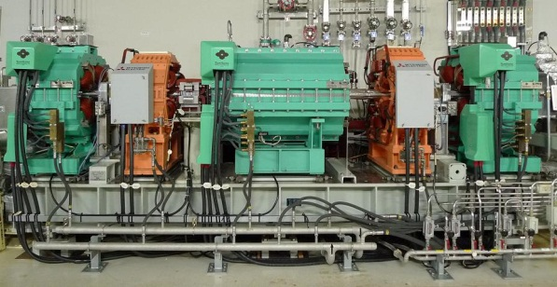
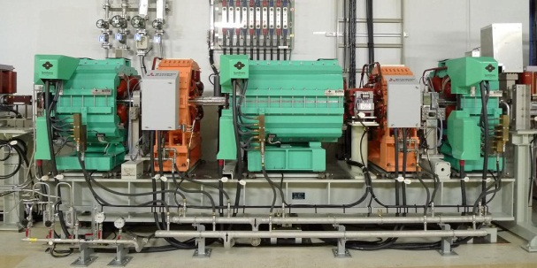
SPring-8 Storage Ring Magnets
Chasman-Green lattice of 48 cells :
Bending : 2
Multipole : 17 on three girders
Survey Monument (2)
Reference point (6 one cell, total of 288)
Magnet alignment tolerances :
Girder unit : 0.2 mm
Within girder : 50μm

Slide 4
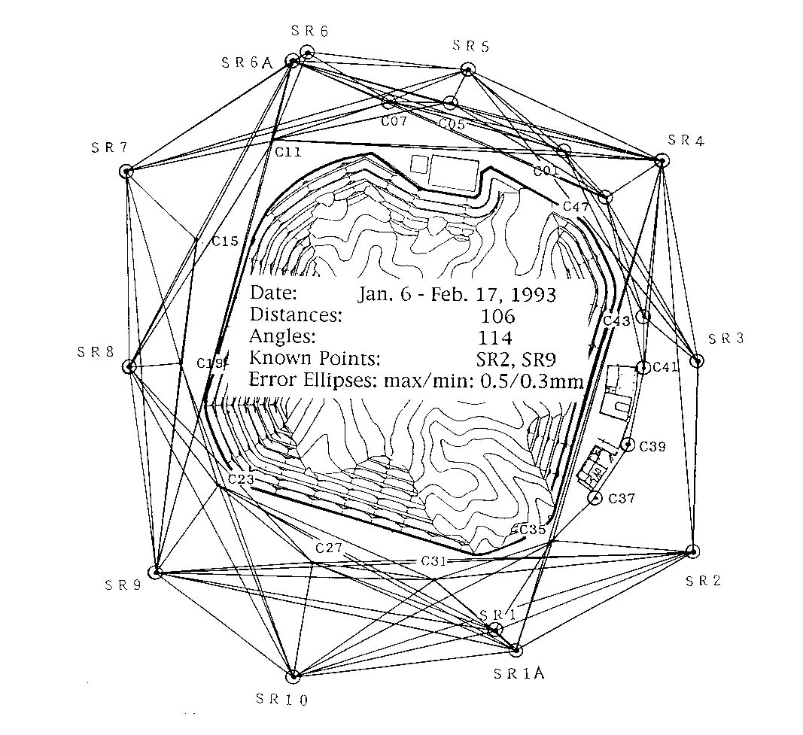
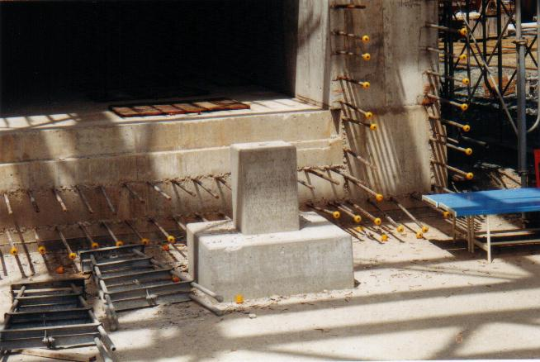
Main Events of Alignment -Monument survey
Main events of magnet alignment
1993/1 First time monuments survey
1994/11 Monument survey inside tunnel
1995/4-1996/3 Ring magnet installation
1996/4 Level survey for whole ring
1996/10 Horizontal survey for whole ring
1997/1 120 angles measured in horizontal
2000/7 Digital level introduced to level survey
2000/7-8 Magnet in long straight sections
were rearranged
Hydrostatic level system were setup in three places
2005/ 44 angles are added to horizontal survey
First time monuments survey

Slide 5
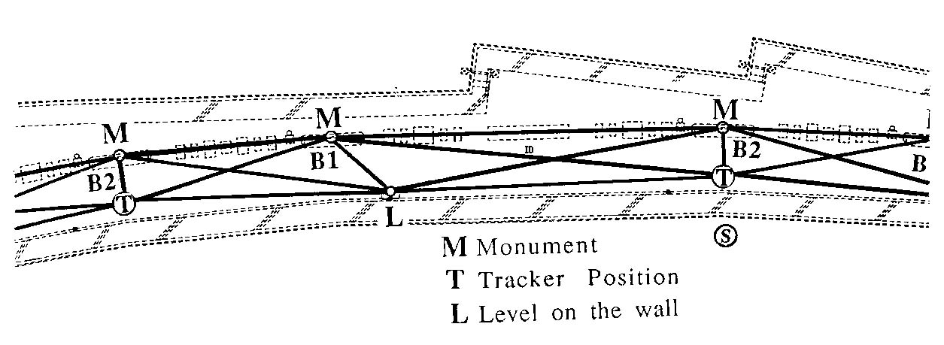
Main Events of Alignment -Monument survey
Main events of magnet alignment
1993/1 First time monuments survey
1994/11 Monument survey inside tunnel
1995/4-1996/3 Ring magnet installation
1996/4 Level survey for whole ring
1996/10 Horizontal survey for whole ring
1997/1 120 angles measured in horizontal
2000/7 Digital level introduced to level survey
2000/7-8 Magnet in long straight sections
were rearranged
Hydrostatic level system were setup in three places
2005/ 44 angles are added to horizontal survey
Monument survey in the tunnel
Total points: 192
Distances: 480+24
Angles: 24
Error ellipses: 0.64/0.30

Slide 6
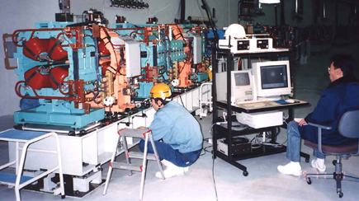
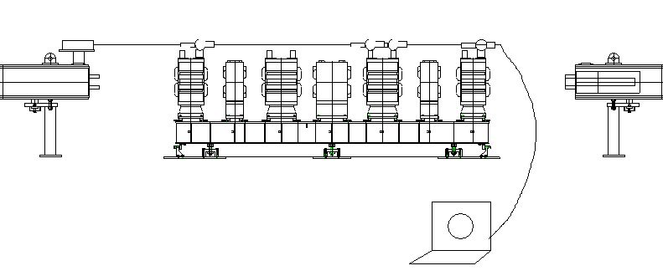
Main Events of Alignment –Magnet installation
Main events of magnet alignment
1993/1 First time monuments survey
1994/11 Monument survey inside tunnel
1995/4-1996/3 Ring magnet installation
1996/4 Level survey for whole ring
1996/10 Horizontal survey for whole ring
1997/1 120 angles measured in horizontal
2000/7 Digital level introduced to level survey
2000/7-8 Magnet in long straight sections
were rearranged
Hydrostatic level system were setup in three places
2005/ 44 angles are added to horizontal survey
Total of
88 bendings
816 multipoles on 144 girders

Slide 7
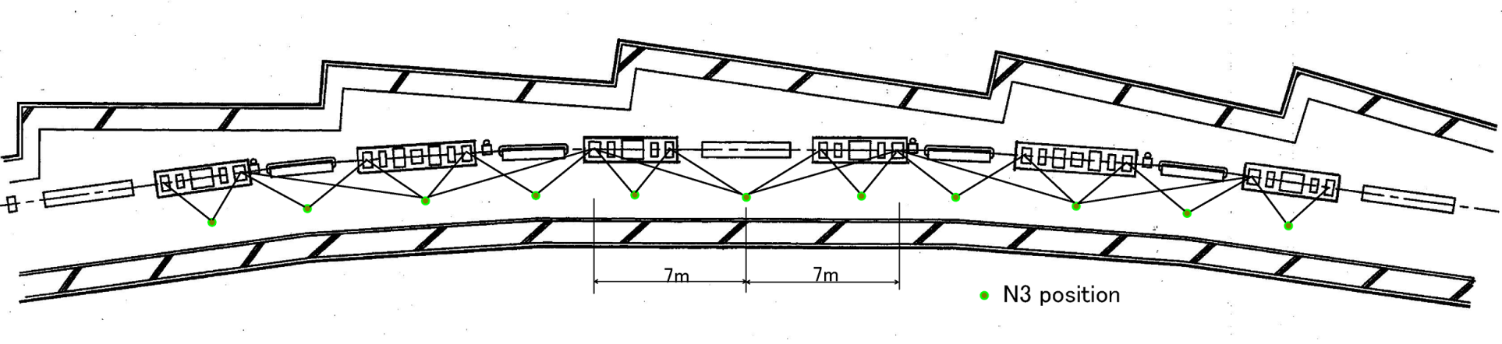
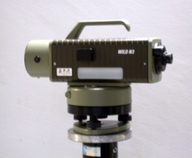
Main Events of Alignment –Level survey
Main events of magnet alignment
1993/1 First time monuments survey
1994/11 Monument survey inside tunnel
1995/4-1996/3 Ring magnet installation
1996/4 Level survey for whole ring
1996/10 Horizontal survey for whole ring
1997/1 120 angles measured in horizontal
2000/7 Digital level introduced to level survey
2000/7-8 Magnet in long straight sections
were rearranged
Hydrostatic level system were setup in three places
2005/ 44 angles are added to horizontal survey
Wild N3
std: 0.2mm/1km
Dot: Wild N3; Line: Sight of seeing
Std. (Between units): ± 0.02mm
Error rms (For 1.5km ring): ± 0.2mm

Slide 8
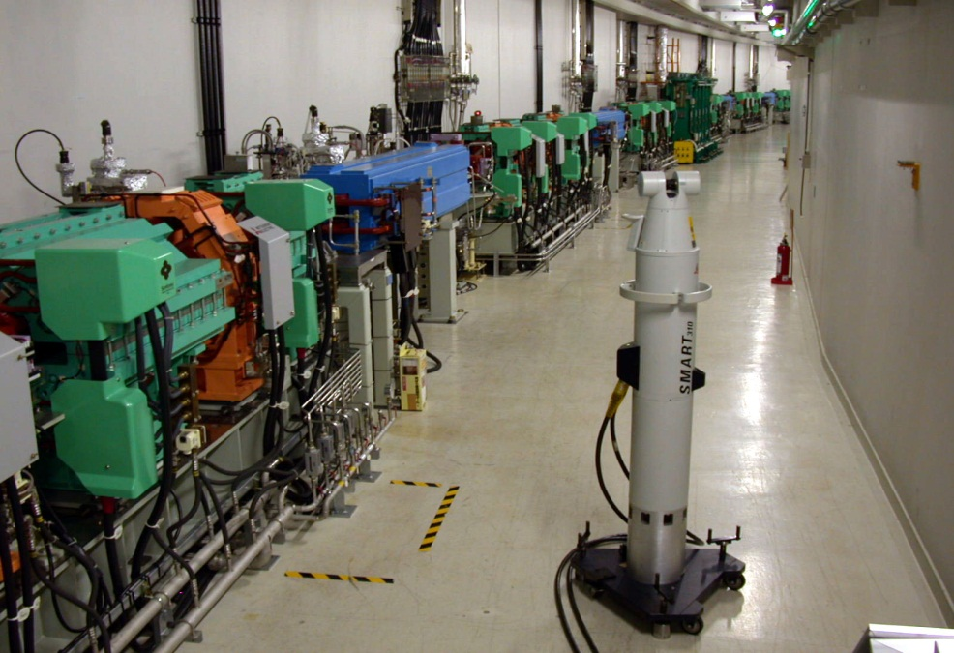
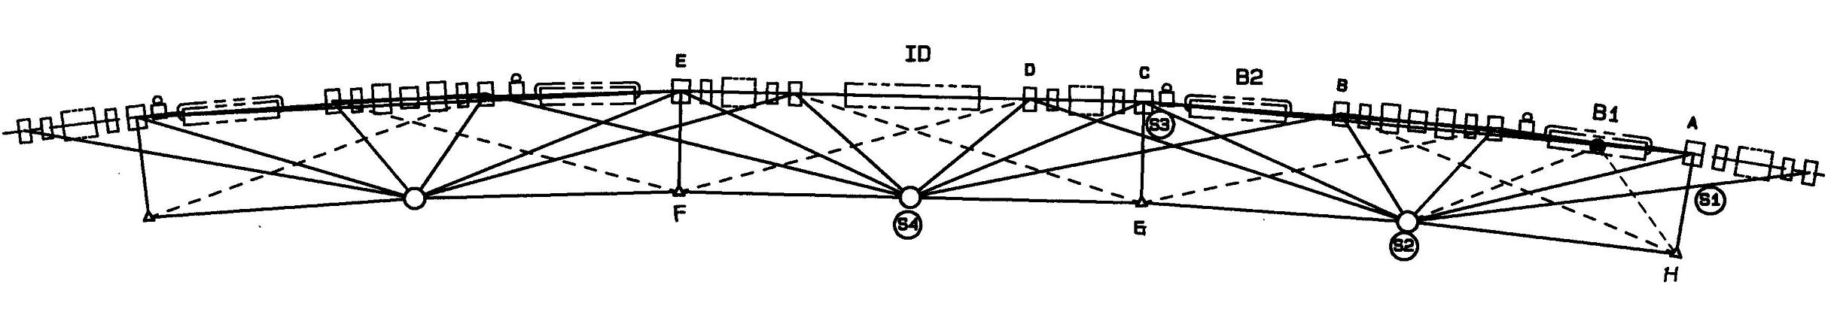
Main Events of Alignment –Horizontal survey
Main events of magnet alignment
1993/1 First time monuments survey
1994/11 Monument survey inside tunnel
1995/4-1996/3 Ring magnet installation
1996/4 Level survey for whole ring
1996/10 Horizontal survey for whole ring
1997/1 120 angles measured in horizontal
2000/7 Digital level introduced to level survey
2000/7-8 Magnet in long straight sections
were rearranged
Hydrostatic level system were setup in three places
2005/ 44 angles are added to horizontal survey
Line: distance measurement; Circle: station of LT set up.
Std. (Between units): ±0.05mm
Error rms (For 1.5km ring): ±0.5mm
Horizontal survey for whole ring

Slide 9
Main Events of Alignment –Horizontal survey
Main events of magnet alignment
1993/1 First time monuments survey
1994/11 Monument survey inside tunnel
1995/4-1996/3 Ring magnet installation
1996/4 Level survey for whole ring
1996/10 Horizontal survey for whole ring
1997/1 120 angles measured in horizontal
2000/7 Digital level introduced to level survey
2000/7-8 Magnet in long straight sections
were rearranged
Hydrostatic level system were setup in three places
2005/ 44 angles are added to horizontal survey
Line: distance measurement; Circle: station of LT set up.
Std. (Between units): ±0.04mm
Error rms (For 1.5km ring): ±0.4mm
Horizontal survey for whole ring

Slide 10
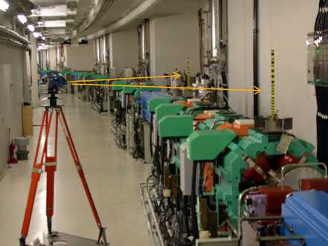
Main Events of Alignment –Level survey
Main events of magnet alignment
1993/1 First time monuments survey
1994/11 Monument survey inside tunnel
1995/4-1996/3 Ring magnet installation
1996/4 Level survey for whole ring
1996/10 Horizontal survey for whole ring
1997/1 120 angles measured in horizontal
2000/7 Introduce digital level to level survey
2000/7-8 Magnet in long straight sections
were rearranged
Hydrostatic level system were setup in three places
2005/ 44 angles are added to horizontal survey
Zeiss DiNi11
std: 0.3mm/1km

Slide 11
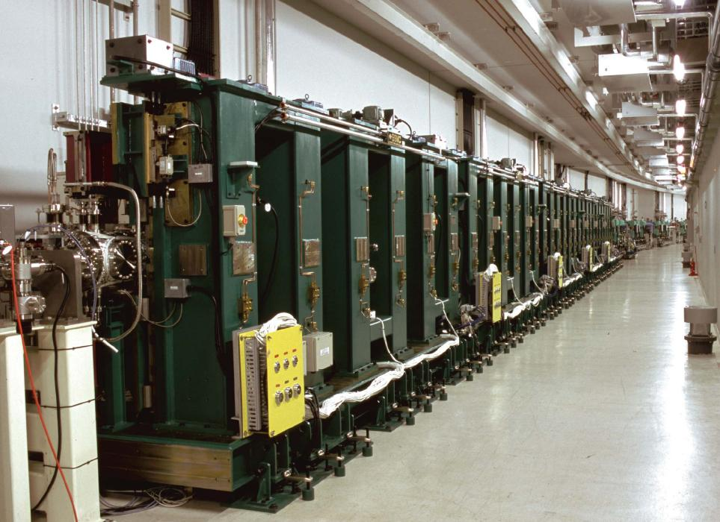
Main Events of Alignment –LSS rearrangement
Main events of magnet alignment
1993/1 First time monuments survey
1994/11 Monument survey inside tunnel
1995/4-1996/3 Ring magnet installation
1996/4 Level survey for whole ring
1996/10 Horizontal survey for whole ring
1997/1 120 angles measured in horizontal
2000/7 Introduce digital level to level survey
2000/7-8 Magnets in long straight sections
were rearranged
Hydrostatic level system were setup in three places
2005/ 44 angles are added to horizontal survey
Network point
2.4m
ID19: 27m-long undulator
Storage ring

Slide 12
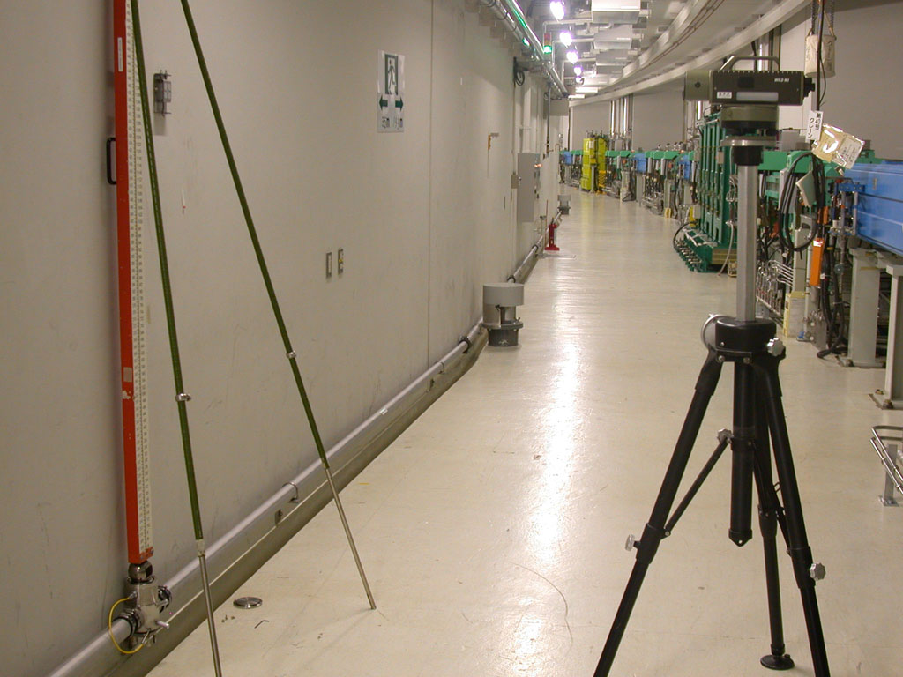
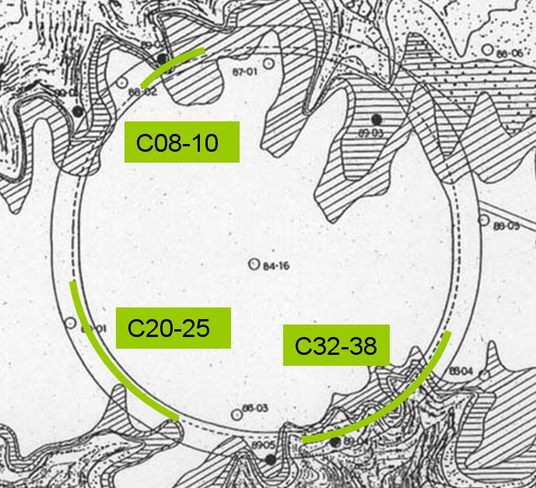
Main Events of Alignment –HLS system
Main events of magnet alignment
1993/1 First time monuments survey
1994/11 Monument survey inside tunnel
1995/4-1996/3 Ring magnet installation
1996/4 Level survey for whole ring
1996/10 Horizontal survey for whole ring
1997/1 120 angles measured in horizontal
2000/7 Introduce digital level to level survey
2000/7-8 Magnets in long straight sections
were rearranged
2003/8-2005/3 Hydrostatic level system
were set up at 3 places of the tunnel
2005/ 44 angles are added to horizontal survey
Hydrostatic level system
C08-10 : 50 m
C20-25 : 180 m
C32-38 : 180 m
Irregular noise level: 0.1 μm
( ∼2 e-10 radian resolution)

Slide 13
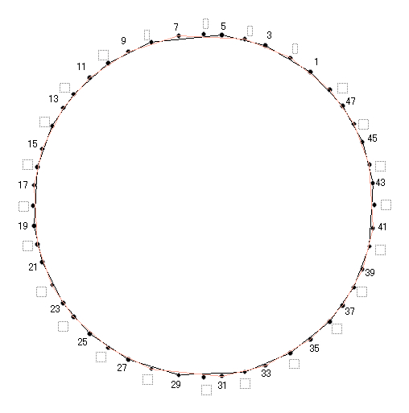
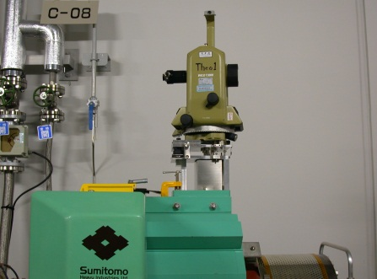
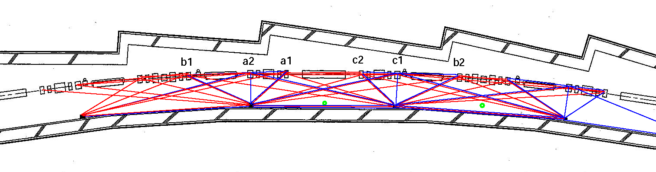
Main Events of Alignment –Horizontal survey
Main events of magnet alignment
1993/1 First time monuments survey
1994/11 Monument survey inside tunnel
1995/4-1996/3 Ring magnet installation
1996/4 Level survey for whole ring
1996/10 Horizontal survey for whole ring
1997/1 120 angles measured in horizontal
2000/7 Introduce digital level to level survey
2000/7-8 Magnets in long straight sections
were rearranged
2003/8-2005/3 Hydrostatic level system
were set up at 3 places of the tunnel
2005/4 44 angles added to horizontal survey
44 angles with T3000
Accuracy: 0.5”~1”
Ref. Points 385
Distances: 2852

Slide 14
Long-Term Monitoring –Survey result of horizontal

Slide 15
Long-Term Monitoring –Variance of relative movement
We calculate variance function between surveys:
v: variance of point’s relative movement, averaging over all points in the ring
τ: time delay in year
And, examine the dependence of rms relative movement σ ( ) on time interval τ
time interval count
(year)
1 5
2 7
3 4
4 5
5 3
6 4
7 3
8 4
9 3
10 3
11 2
12 1
13 1
15

Slide 16
Long-Term Monitoring –Linear weighted moving average
The center of gravity of the magnets is considered a good reference and linear weighted moving average is used.
Here, we take the weight:
i: current point
m: 2m is averaging length, total number in average around current point
That is, current point has maximum weight of m+1. the weight of a point that goes away from current is linear diminished.
The value of average depends on averaging length.
16

Slide 17
Long-Term Monitoring –Linear weighted moving average
17

Slide 18
Long-Term Monitoring –Variation of magnet alignment

Slide 19
Long-Term Monitoring –Linear weighted moving average
19

Slide 20
Long-Term Monitoring –Variance of relative movement
20

Slide 21
Long-Term Monitoring –Variance of relative movement
Displacement vs. Time interval:
σ = (0.005+1.9e-5L)×T
offset
factor
21

Slide 22
Long-Term Monitoring –Variation of magnet alignment
22

Slide 23
Long-Term Monitoring –Survey result of the level
23

Slide 24
Long-Term Monitoring –Variance of displacement
24

Slide 25
Long-Term Monitoring –Variance of displacement
Displacement vs. Time interval:
σ = (0.02+6.05e-6L)×T
25

Slide 26
Long-Term Monitoring –Variation of magnet’s level
26

Slide 27
Long-Term Monitoring –Variation of magnet alignment
27

Slide 28
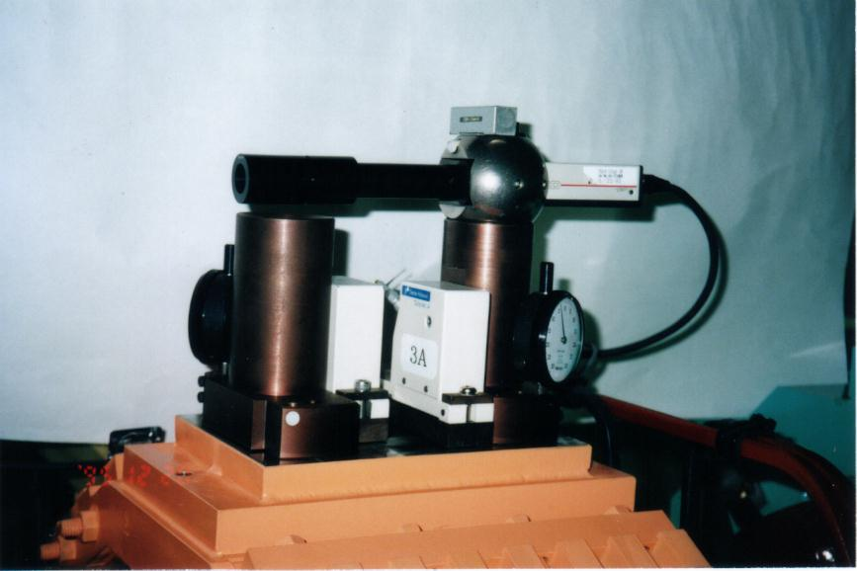
Long-Term Monitoring –Variation of magnet tilt
7 years
Δφ : 41 μrad
6 years
NO change !
28

Slide 29
Long-Term Monitoring–Linearity of magnet within girder
7 years:
Δx: 7 μm
Δy: 13 μm
6 years:
Δx: 1 μm
Δy: 13 μm
29

Slide 30
CONCLUSION
• linear weighted moving average is used as reference for extracting magnet displacement, And mean relative movement of magnets could be approximately modeled as
σ = (A₁+A₂L) T
A₁ represents constant factor, and A₂ is the factor of length dependence.
• In horizontal plane,
Deterioration rate is 0.014mm/year
RMS relative displacement varies 0.05 - 0.12 mm, for an inspection range of 60 meters.
In vertical plane,
Deterioration rate is 0.024mm/year
RMS relative displacement varies from 0.08 - 0.24mm for the range of 180 meters.
• Rolling of magnets are changed from 27 - 68 μrad (rms) in first 7 years, but following 6 years had no variance.
• Linearity of magnets within girder varied from 8 μm in vertical , While there is almost no change in horizontal after 2003, By contrast vertical seems making a constant progress of 2 μm/year.
Because the variation of magnet alignment is very small, we didn’t adjust any magnet for thirteen years.
30

