Slide 1
Experience Report with the Alignment Diagnostic System
Georg Gassner
September 17th 2010

Slide 2
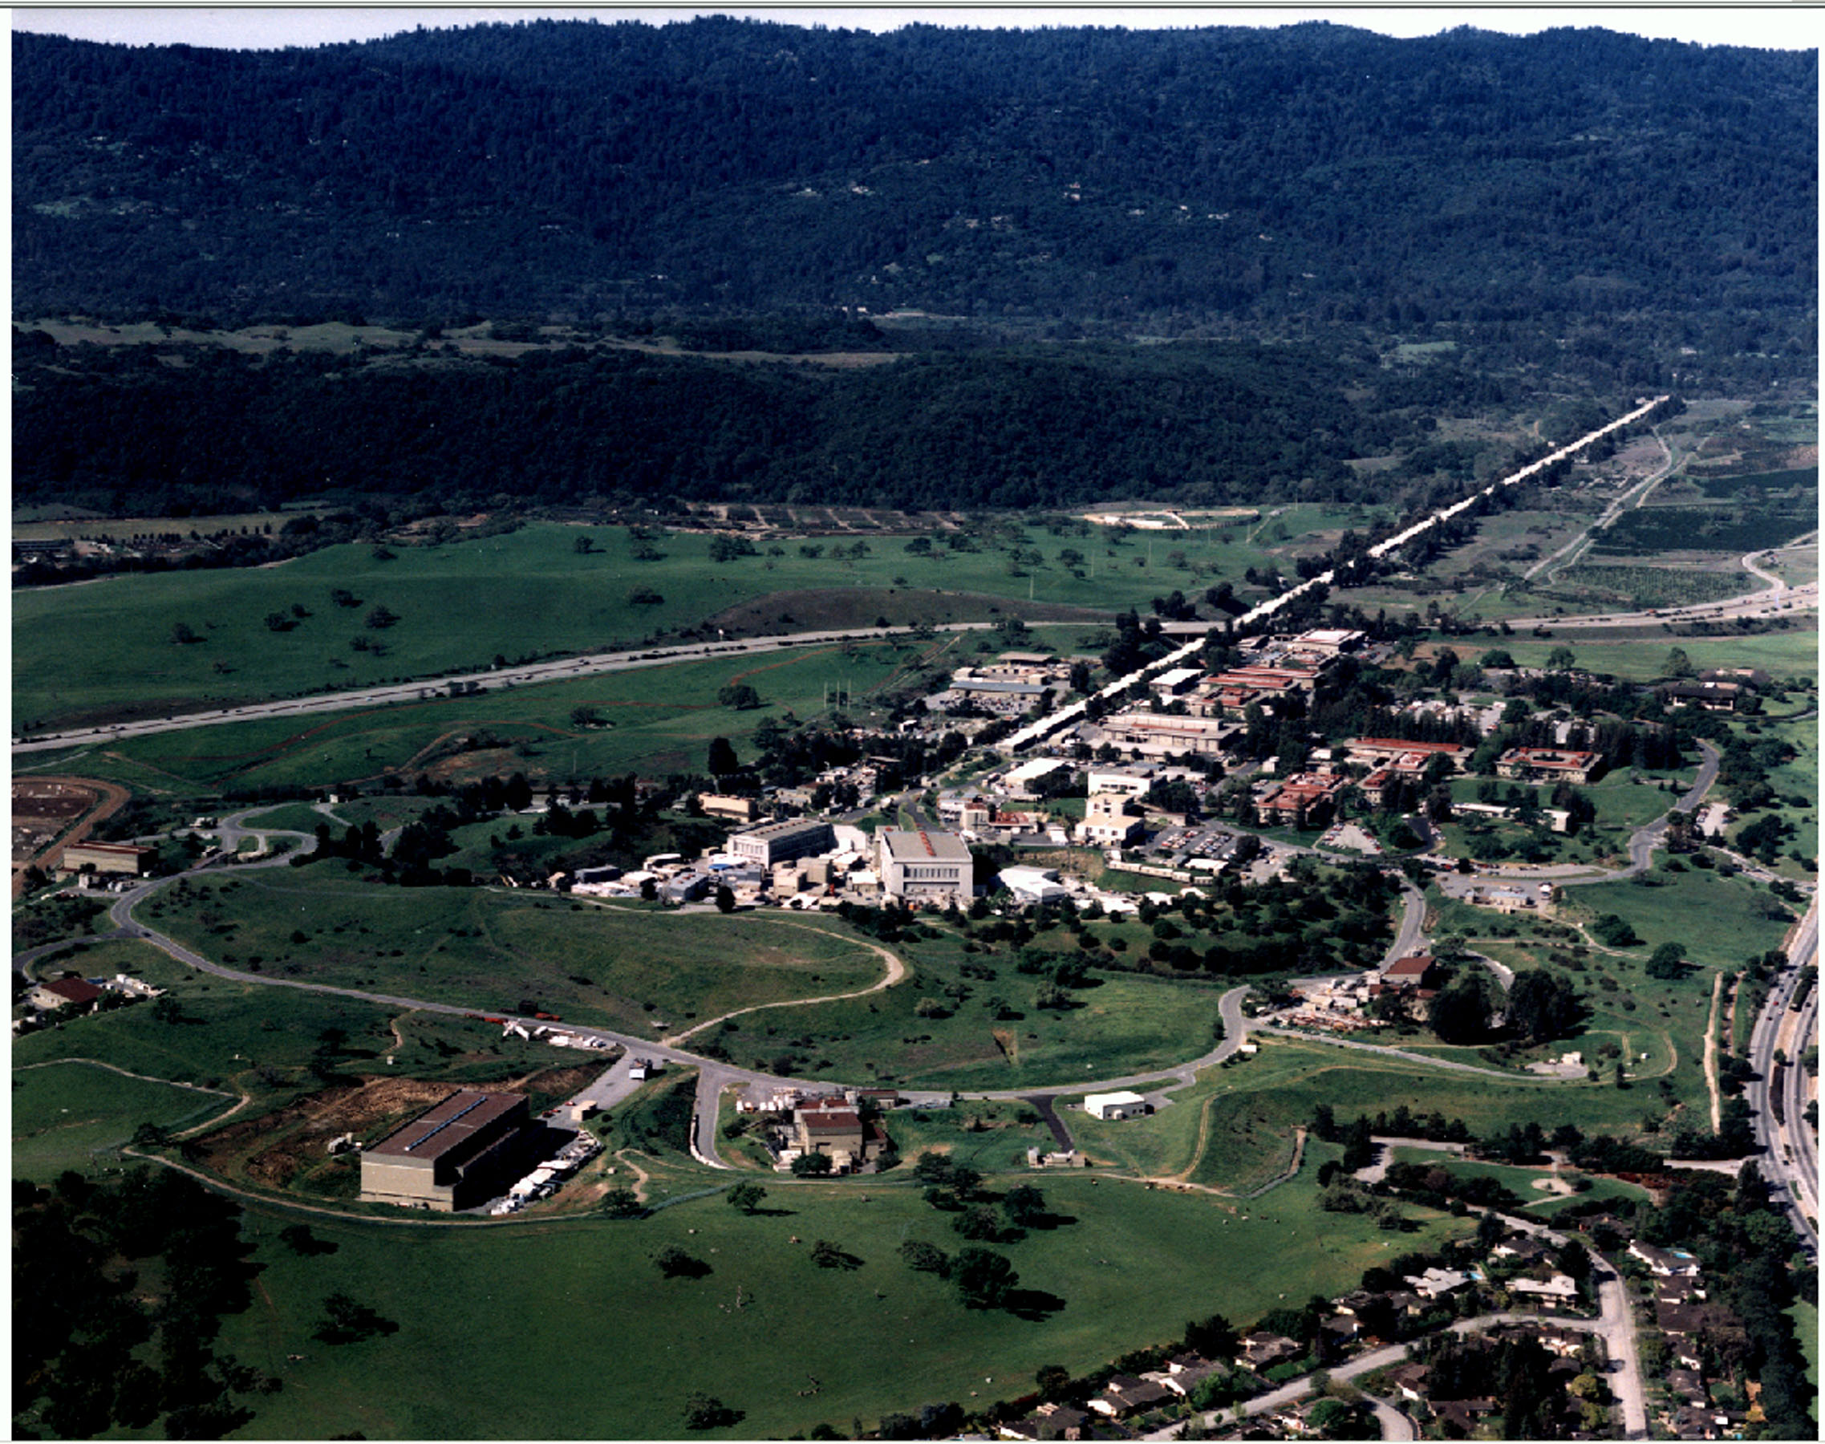
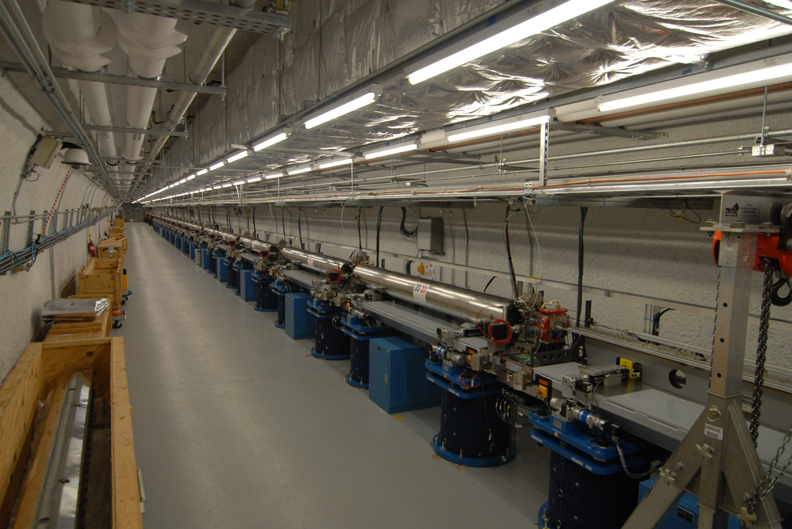




Linac Coherent Light Source at SLAC
X-FEL based on last 1-km of existing 3-km linac
1.5-15 Å
(14-4.3 GeV)
Injector (35º)
at 2-km point
Existing 1/3 Linac (1 km)
(with modifications)
New e⁻ Transfer Line (340 m)
X-ray Transport Line (200 m)
Undulator (130 m)
Near Experiment Hall
UCLA
Far Experiment
Hall

Slide 3
Undulator System
3.4m undulator magnet
Quadrupole
Wire Position
Monitor
X-translation
(in/out)
Hydrostatic
Leveling Sensor
CAM based 5 DOF
Motion control
Sand-filled
Thermally Isolated
Supports

Slide 4
Goal of the Alignment Diagnostic System
Question: Do we know how stable the LCLS tunnel and the
Undulator will be?
Answer: No, we don’t!
Advice: Install a girder position monitoring system…..
Undulator: 33 Girder, 132 m
1
2
i
Y-pos
33
X-pos
... and track each girder relative to the Least Square Fit of all girders!
Resolution: < One Micrometer
Measurement duration: > Weeks, no drifts
Building Blocks: Hydrostatic Leveling System (HLS) for Y - direction. Experience: Used @ SLAC
Wire Position Monitors (WPM) for the X & Y direction.* Experience: FFTB @ SLAC
* Original design from DESY as contribution to the FFTB experiment at SLAC, 1991

Slide 5
Alignment Diagnostics System
WPM and HLS operates as one system, called
Alignment Diagnostic System, ADS
WPM measures:
X and Y- positions relative to two stretched wires
HLS measures:
Y - Positions relative to the water surface level
Common Task:
X & Y Positon monitoring of undulator segments
Resolution: < micrometer
Data rate: every minute
Operation: continous
1400 mm

Slide 6
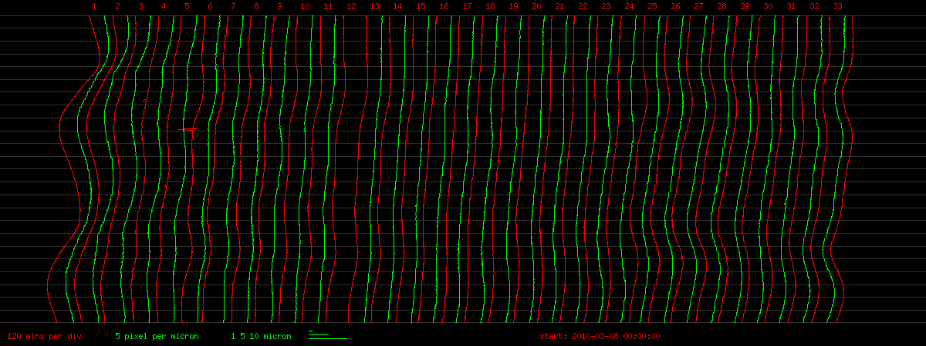
Results: Two days of tracking– no cam or stage movement
Hydrostatic leveling sensor readings - vertical
2010/3/10 0:00
2010/3/9 0:00
2010/3/8 0:00
10 µm

Slide 7
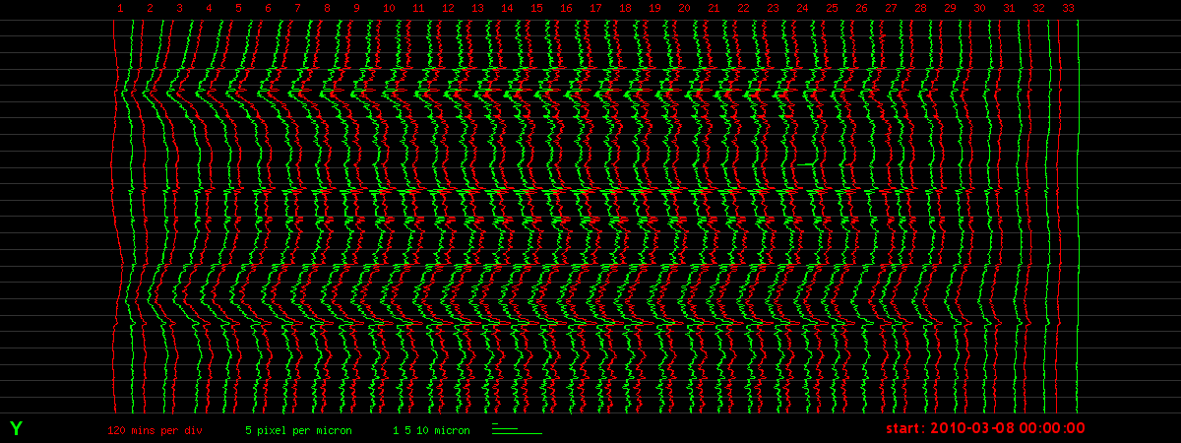
Results: Two days of tracking– no cam or stage movement
Wire position sensor readings - vertical
2010/3/10 0:00
2010/3/9 0:00
2010/3/8 0:00
10 µm

Slide 8
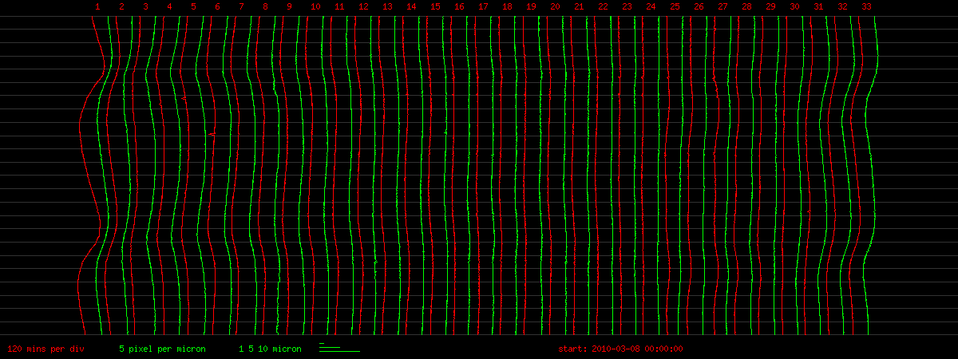
Results: Two days of tracking– no cam or stage movement
ADS response - vertical
2010/3/10 0:00
2010/3/9 0:00
2010/3/8 0:00
10 µm
Undulator hall below ground
Stretched wire

Slide 9
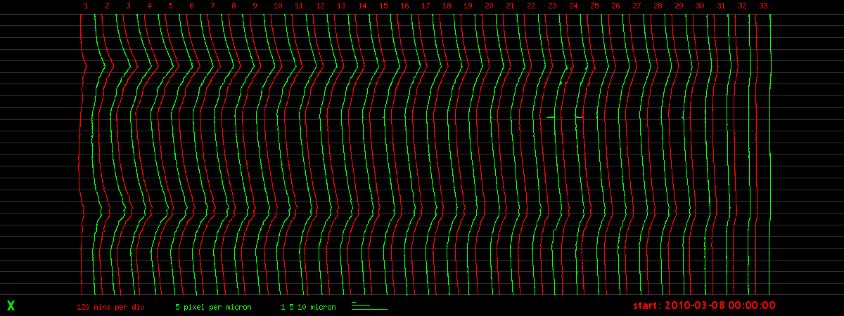
Results: Two days of tracking– no cam or stage movement
Wire position sensor readings - horizontal
2010/3/10 0:00
2010/3/9 0:00
2010/3/8 0:00
10 µm

Slide 10
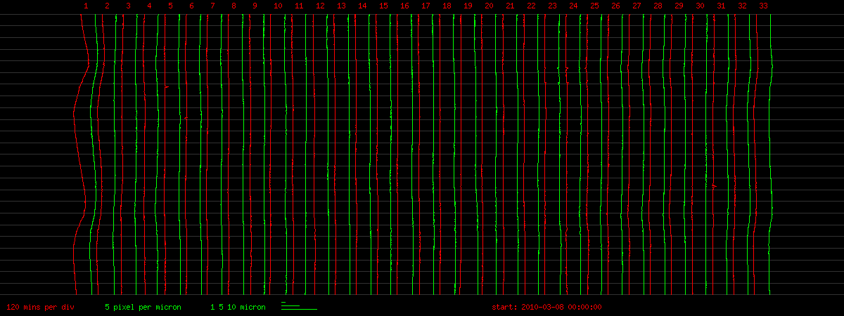
Results: Two days of tracking– no cam or stage movement
ADS response - horizontal
2010/3/10 0:00
2010/3/9 0:00
2010/3/8 0:00
10 µm

Slide 11
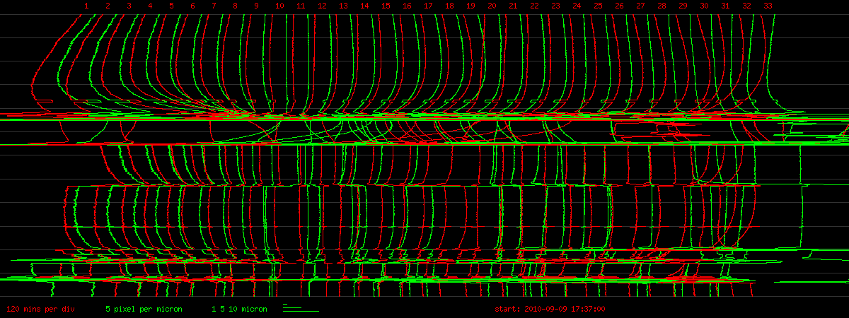
Results: normal operation – moving girders
ADS response - vertical
2010/9/9 17:37
2010/9/8 17:37
10 µm

Slide 12
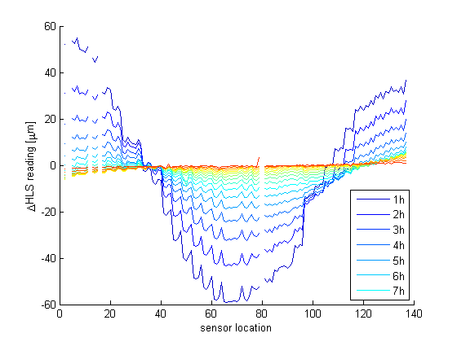
Problem (1): HLS time delay
Water takes several hours to settle if movement is big enough to require water to redistribute
Our pipes are mounted to the girder, if a girder moves all the water in the 4m pipe section has to redistribute

Slide 13
Problem (2): Best fit solution
Positions are given in respect to reference line which is the best fit solution.
If one girder is moved deliberately this would change the reference line and indicate that all girders have moved.
Reference line
Girder positions

Slide 14
Problem (2): Best fit solution
Positions are given in respect to reference line which is the best fit solution.
If one girder is moved deliberately this would change the reference line and indicate that all girders have moved.
Reference line
Girder positions

Slide 15
Problem (2): Best fit solution
Positions are given in respect to reference line which is the best fit solution.
If one girder is moved deliberately this would change the reference line and indicate that all girders have moved.
Girder motions are communicated to the ADS system and taken into account in the adjustment
Reference line
Girder positions

Slide 16
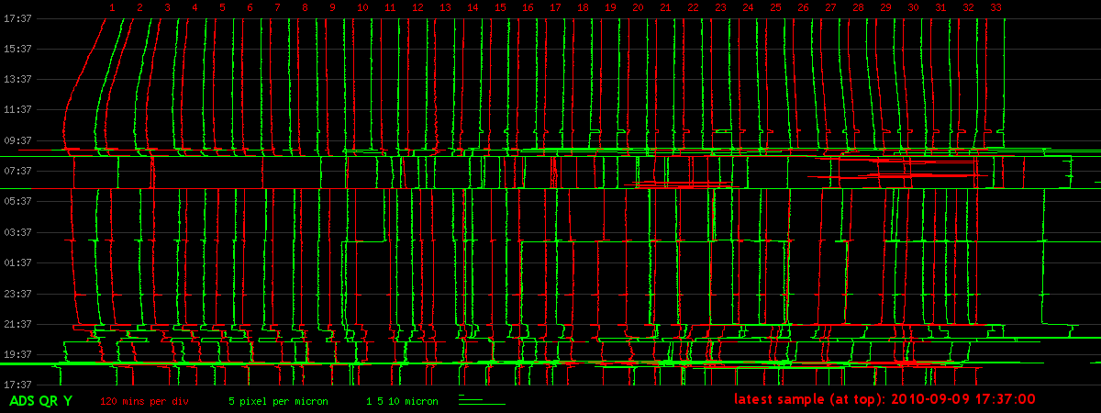
Results: normal operation – moving girders
Quick response mode
ADS response - vertical
2010/9/9 17:37
2010/9/8 17:37
10 µm

Slide 17
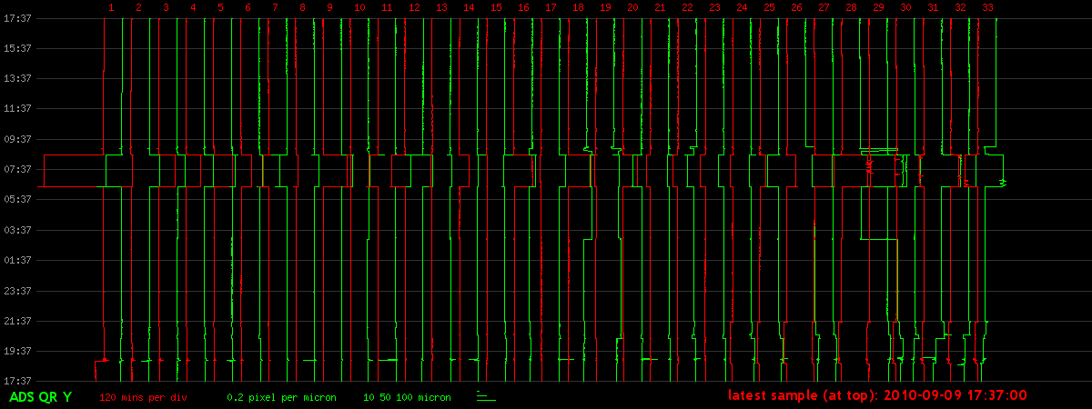
Results: normal operation – moving girders
Quick response mode
ADS response - vertical
2010/9/9 17:37
2010/9/8 17:37
200 µm

Slide 18
Summary
ADS achieved original goal of monitoring quadrupole position to the micrometer level
Add-ons:
  Cam/stage system motion is taken into account for reference line fit.
  Since girders are moved by tens of µm, a “quick response” algorithm to monitor the girder position short term had to be added.

Slide 19
The End

Slide 20
Introduction
Text goes here.
  Since 2009 an Alignment Diagnostic System (ADS) has been operating at the undulator of the new Linac Coherent Light Source at SLAC National Laboratory. The undulator spans a distance of 132 meters and is structured into 33 segments. Each segment is equipped with four hydrostatic leveling sensors and three wire position monitors. This report describes the set up and reflects long time experience gained with ADS.

Slide 21
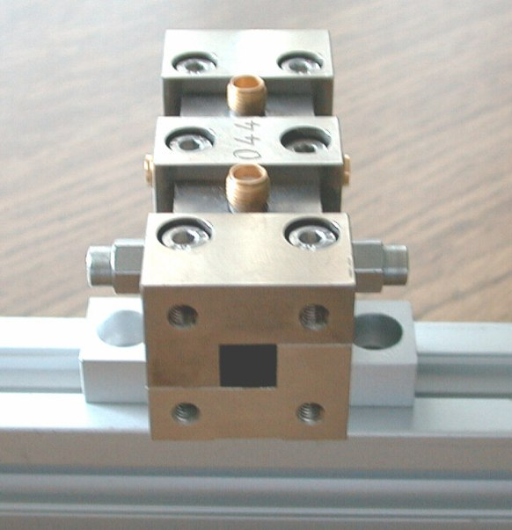
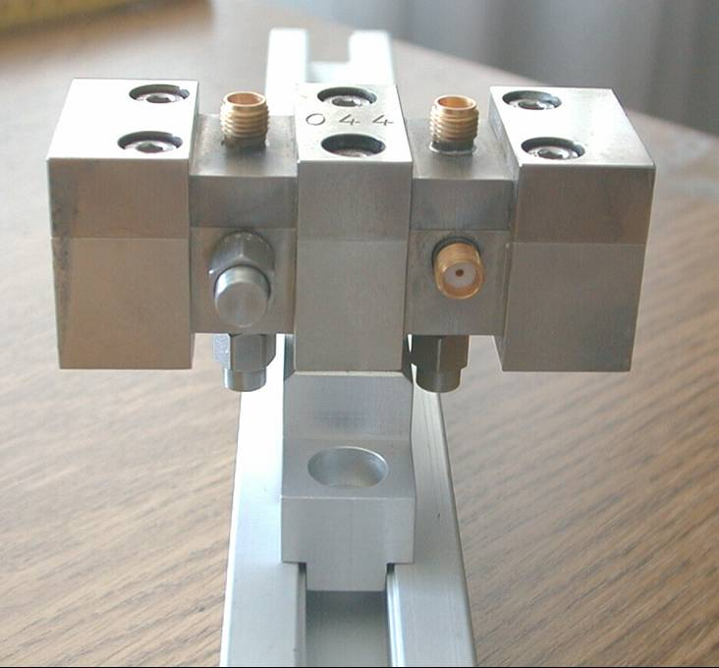
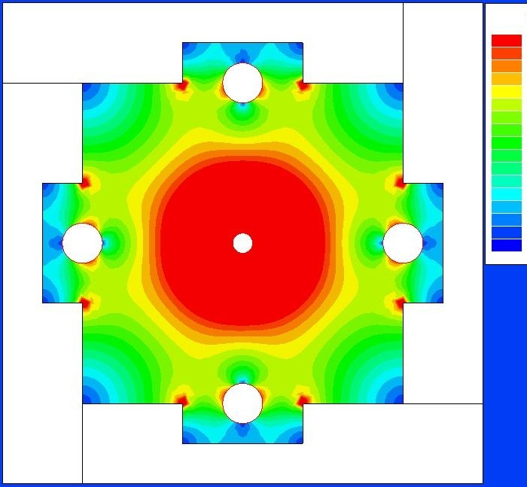
Wire Position Monitor *
Monitor Length 74 Millimeter
Monitor GAP 8 Millimeter Square
* Original design from DESY as contribution to the FFTB experiment at SLAC, 1991

Slide 22
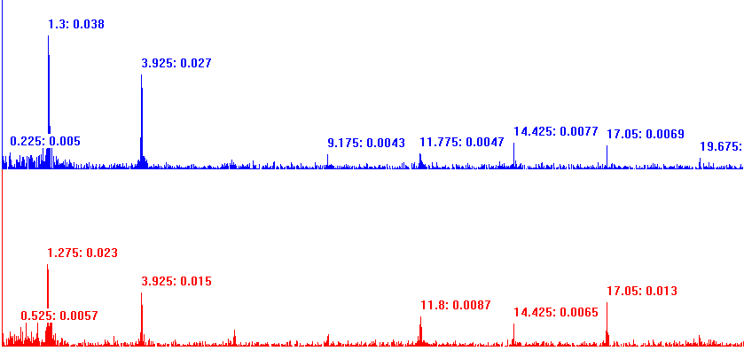
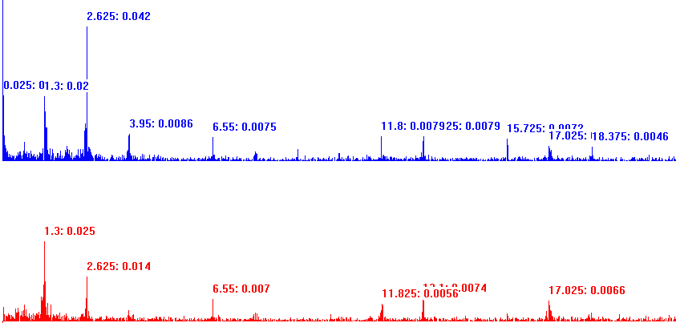
LCLS - WPM system sensitivity – e.g. response on social noise -
Frequency analysis of the 140 m stretched wire. - 40 seconds of data acquisition -
Monitor at the middle of the 140 m wire
X
3.925 Hz: 0.027 µm
2nd and higher even harmonics missing
Y
Monitor outside the middle of the 140 m wire
X
2nd and higher even harmonics visible
3.95 Hz: 0.0086 µm
18.375Hz: 0.0046 µm
Y
1st
1.3Hz
2nd
2.6Hz
3rd
3.9Hz
4th
5.2Hz
5th
6.5Hz
6th
7.8Hz
7th
9.1Hz
8th
10.4Hz
9th
11.8Hz
10th
13.1Hz
11th
14.4Hz
12th
15.7Hz
13th
17.0Hz
14th
18.3Hz
15th
19.6Hz

Slide 23
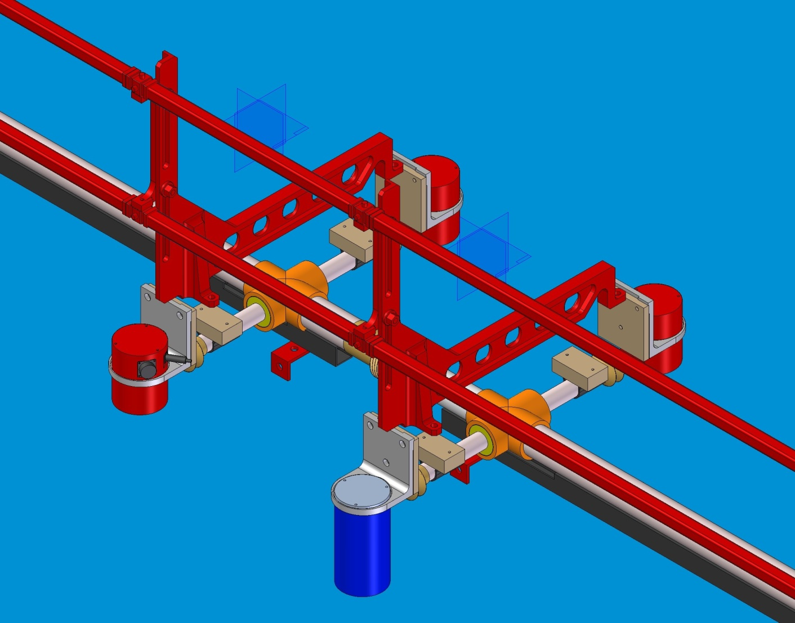
Integration of ADS to girder: Artist view
WPM
Capacitive
WPM
Capacitive
Capacitive
Ultra sonic
Drawing: Courtesy by Scott Doran, ANL

