Slide 1
Hydrostatic Level Systems at Fermilab and DUSEL
J Volk, V Shiltsev
Fermilab USA
A Chuprya, M Kondaurov, S Singatulin
Budker Institute of Nuclear Physicis Russia
L Stetler, J Van Beek
South Dakota School of Mines and Technology USA

Slide 2
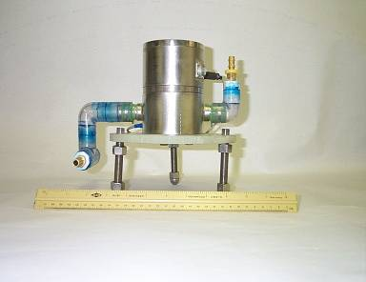
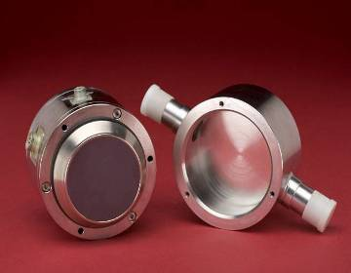
Hydro static water Level Systems HLS
BUDKER sensor
Capacitive pickup
Accuracy 1 micrometer
Cost $1200 per channel
Air line
Capacitive sensor
Water pool
Water line
On stand with water and
Air line connections

Slide 3
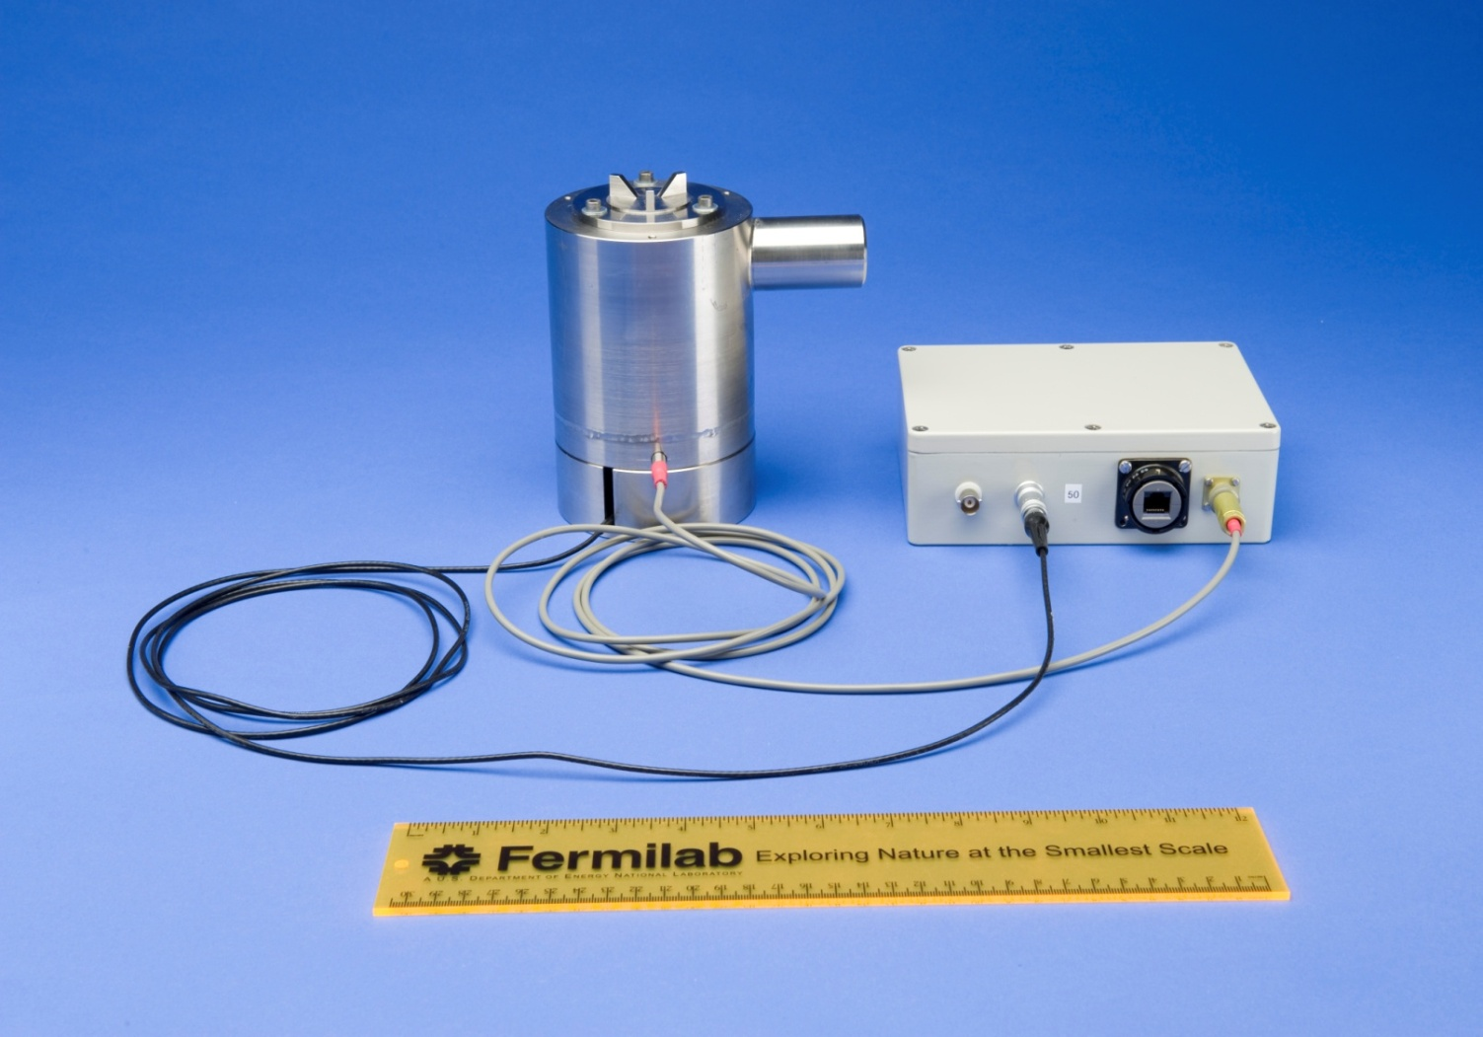
Ultra Sonic Sensor and Electronics
Separate electronics
Water pool and sensor
Ultra sonic sensor better than 1 micrometer resolution $4000 per channel

Slide 4
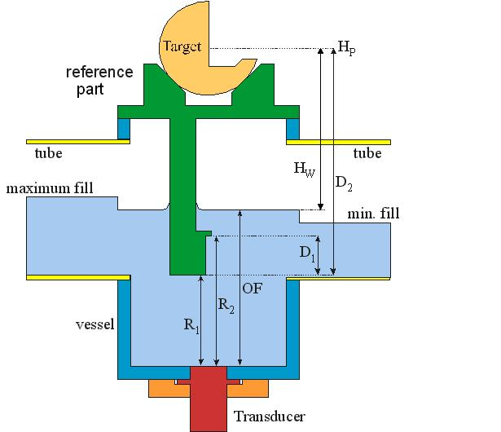
Schematic of Ultra Sonic Sensor
R1 and R2 are
Fixed distances
used for calibration
OF is water level
Target at top is
for alignment

Slide 5
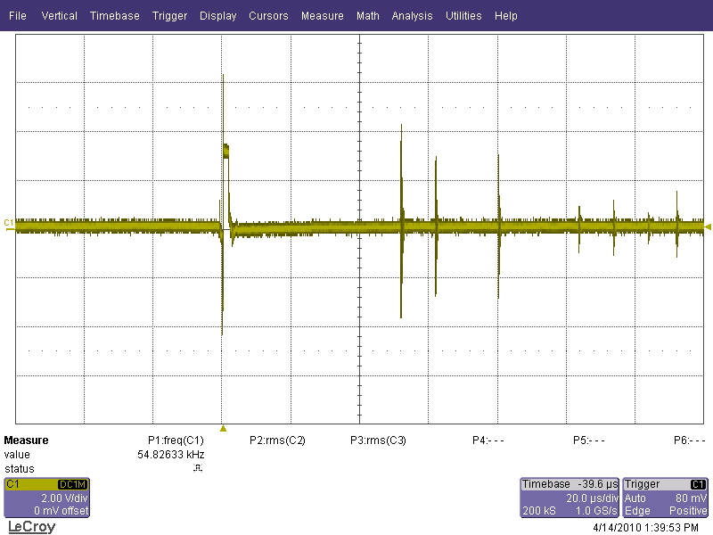
Ultra Sound Pulses
2 volts per division
20 μs per division
Description | Min | Actual | Max | units
Echo pulse duration | 0.2 | 0.8 | 2 | μs
Test Frequency | 5 | 6.9 | 10 | MHz
Bandwidth at 6 db | 15 | 25.9 | 50 | %
Pulse echo sensitivity | -48 | -42.2 | -38 | dB
GE H10KB5T

Slide 6
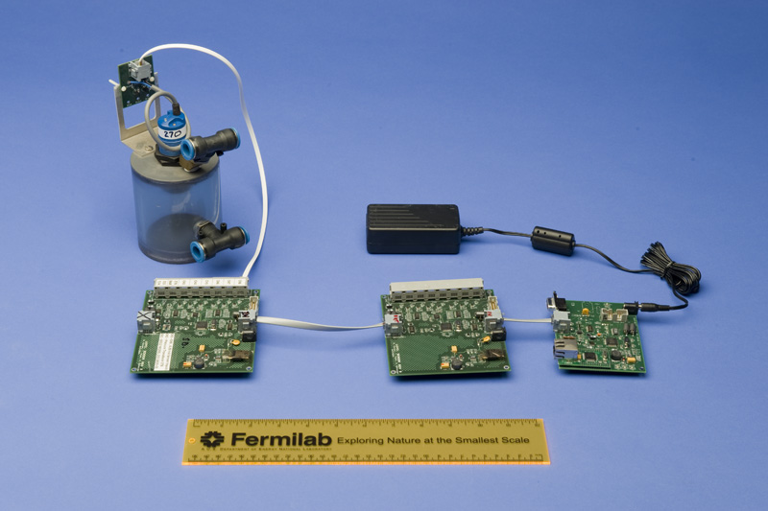
Fermilab design Tevatron style
Balluff sensor and pool
Power supply
RS232 port
8 channel readout card
Ether net interface
Paper in IWAA-08 J Volk

Slide 7
Sensors at Fermilab and DUSEL
Name | Location | Type of Sensor | Number of sensors | Software version | Operating system
Tev Sensors | Tevatron quadrupoles | Balluff | 204 |  | ACNET
B0 | Low beta quads B0 interaction region | SAS | 9 | 19_Mar-09 | Windows XP
D0 | Low beta quads D0 interaction region | SAS | 9 | 19_Mar-09 | Windows XP
HLS-Minos-2 | MINOS Hall | SAS-E | 7 | 04-Mar-10 | Windows XP
ADAPS90581 | LaFarge Mine North Aurora Il | SAS | 5 | 19_Mar-09 | Windows XP
Array A | 2000-ft level Homestake Gold mine, Lead SD | TEV | 6 |  | Windows XP
Array B | 2000-ft level Homestake Gold mine, Lead SD | TEV | 6 |  | Windows XP
Array C | 2000 ft level Homestake Gold mine Lead SD | SAS-E | 6 | 04-Mar-10 | Windows XP
DUSEL-1 | MP8 tunnel Fermilab | SAS-E | 12 | 04-Mar-10 | Windows XP
HLS-MP8-1 | MP7 tunnel Fermilab | ULSE | 3 | 04-Mar-10 | Windows XP
HLS-MP8-2 | MP8 tunnel Fermilab | ULSE | 12 | 04-Mar-10 | Windows XP
BDPHY14 | MP8 tunnel Fermilab |  | Test and calibration | 04-Mar-10 | Windows 7
Hot Spares | MP8 tunnel Fermilab | SAS-E | 4 | 04-Mar-10 | Windows 7
PK 50 | Porta Kamp 50 Fermilab |  | Test and calibration | 04-Mar-10 | Windows XP

Slide 8
Tevatron HLS sensors during quench

Slide 9
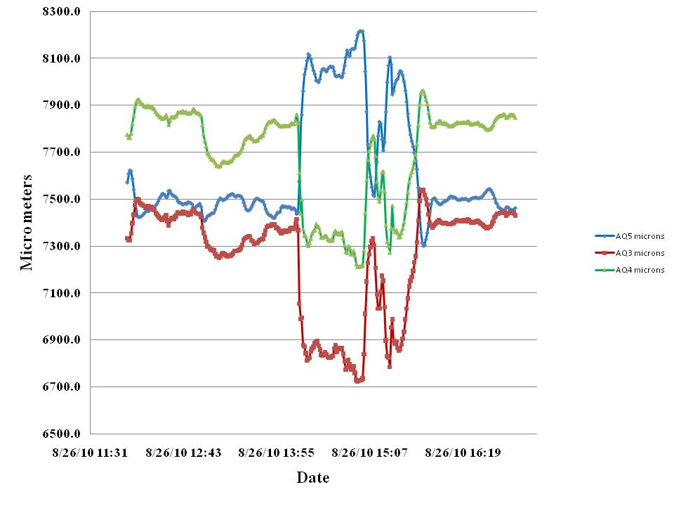
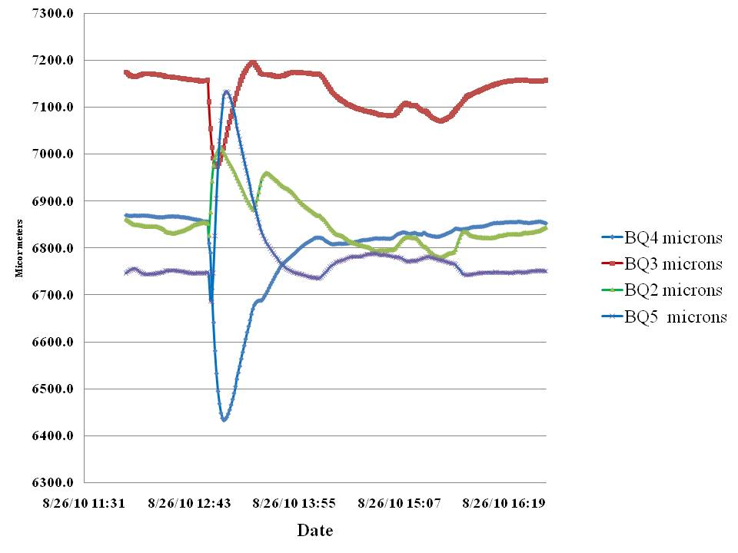
Quench Low Beta Quads B0 Interaction Region
B side response to quench
A side where quench occurred

Slide 10
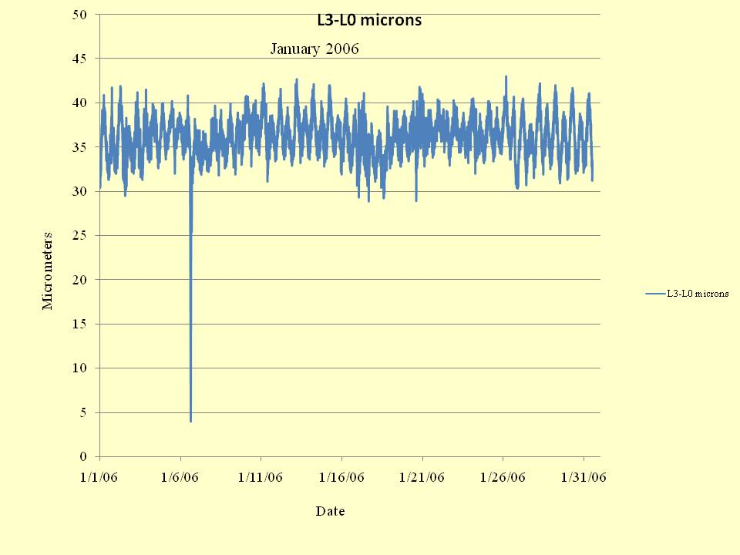
One Month MINOS Data

Slide 11
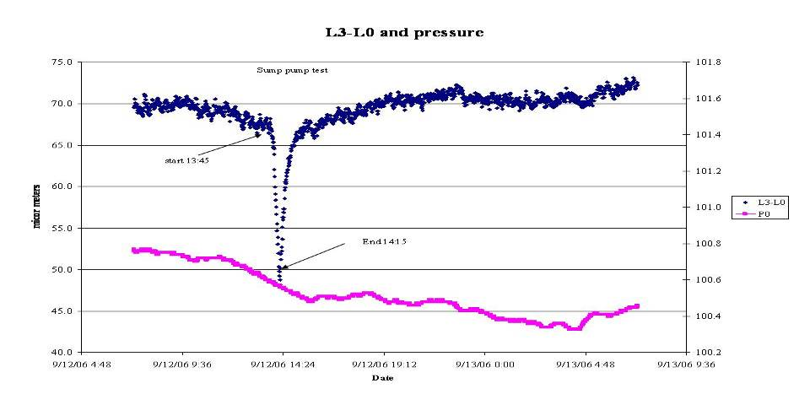
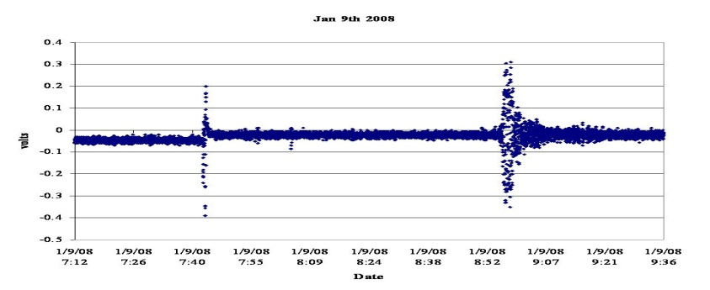
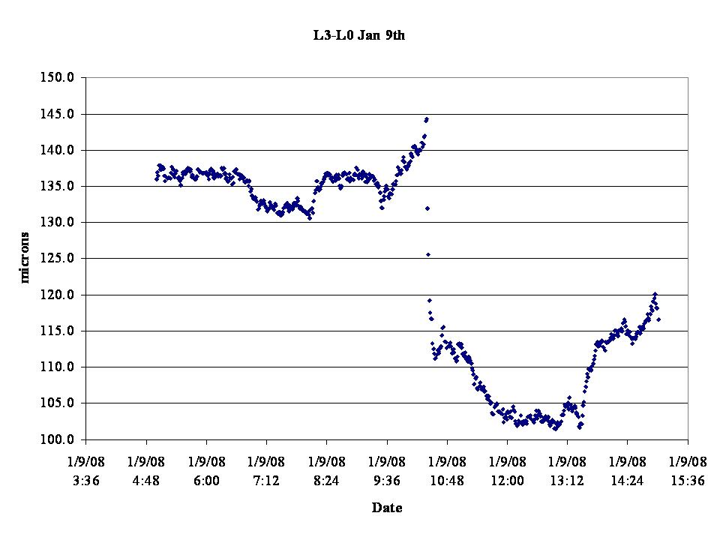
Other types of Ground Motion
Subsidence caused by earth quakes
Floor tilting caused
by movement of
water
Primary
Secondary

Slide 12
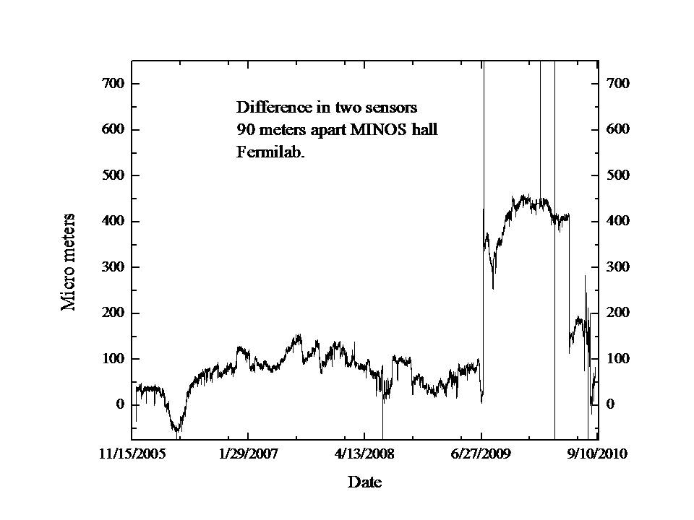
Five Years of MINOS data

Slide 13
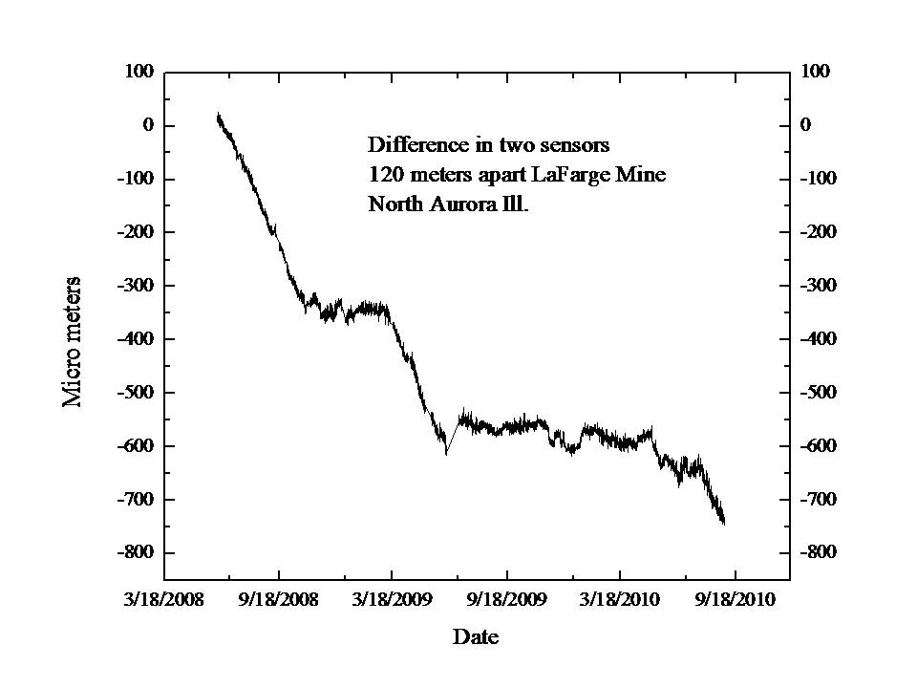
Two Years of Data From LaFarge Mine

Slide 14
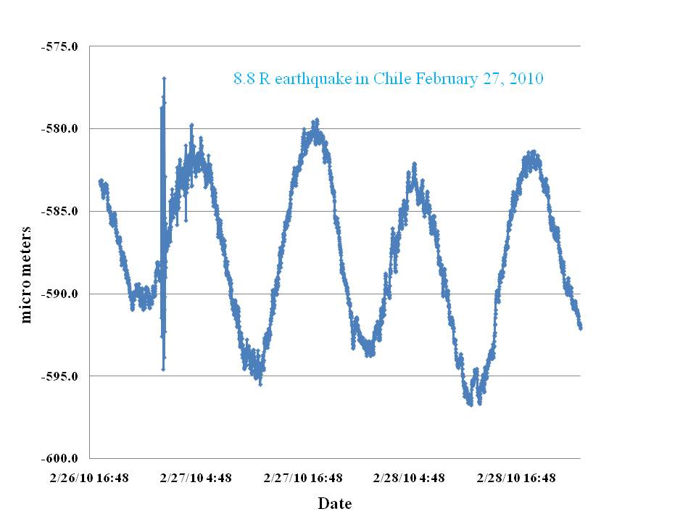
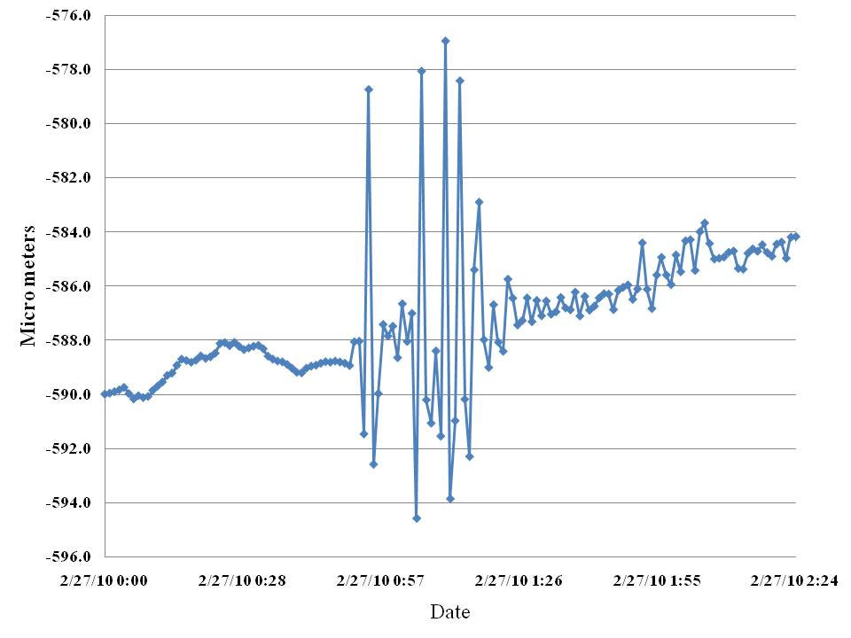
Chilean Earth Quake of February 27, 2010
Secondary wave tilted floor
For 25 minutes
16 μm
Spacing 120 m
0.13 μradian
8.8 magnitude earthquake as seen
By the LaFarge mine HLS

Slide 15
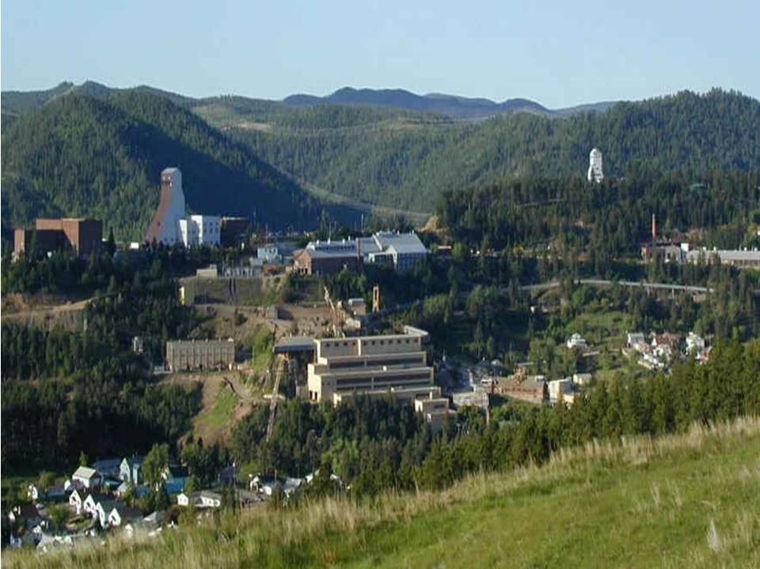
DUSEL Lead South Dakota
Cross section of Homestake gold mine
Yates Shaft
Ross shaft
1.2 km
Homestake gold mine

Slide 16
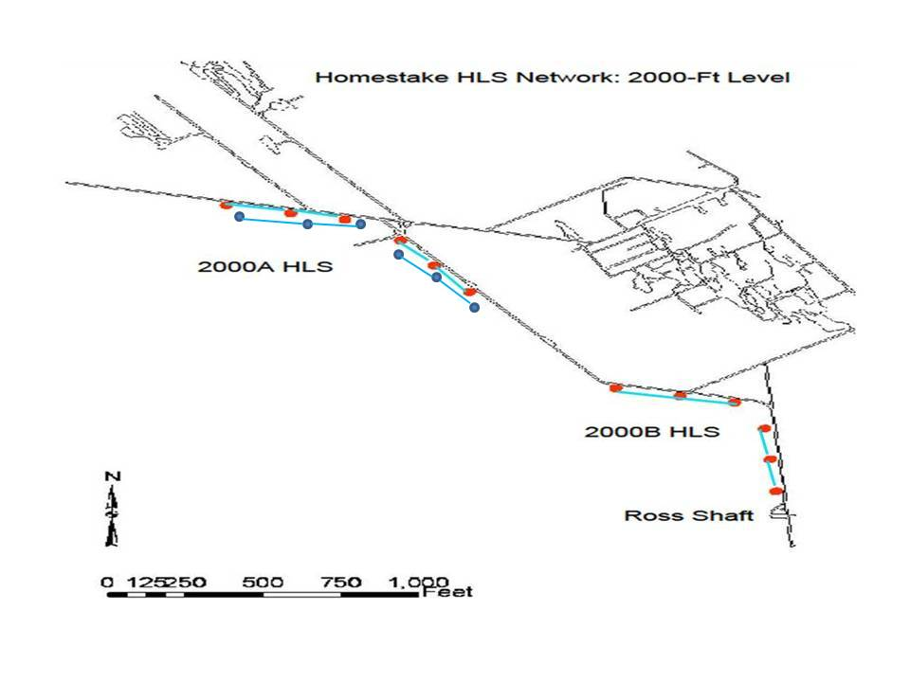
HLS in 2000 ft Level Homestake Gold Mine DUSEL/Sandford lab

Slide 17
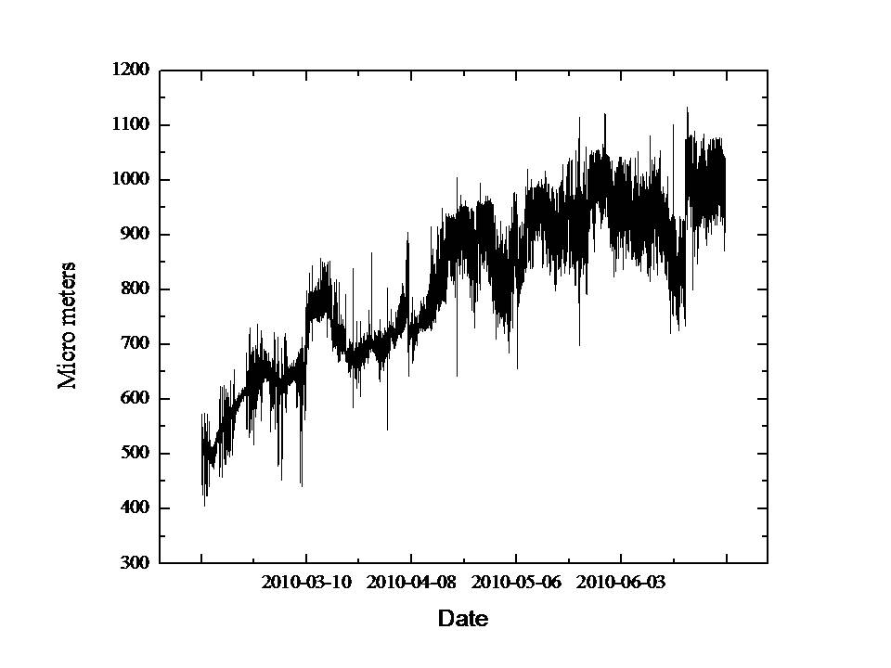
Array C Budker Sensors 2000 ft level Homestake Gold mine
Difference in two sensors 2000 ft level

Slide 18
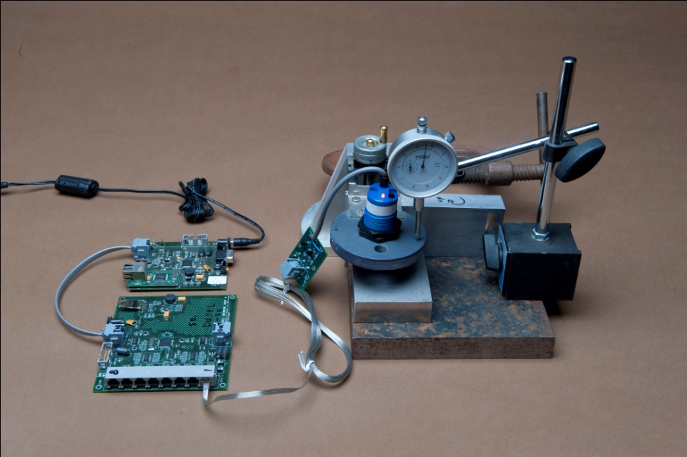
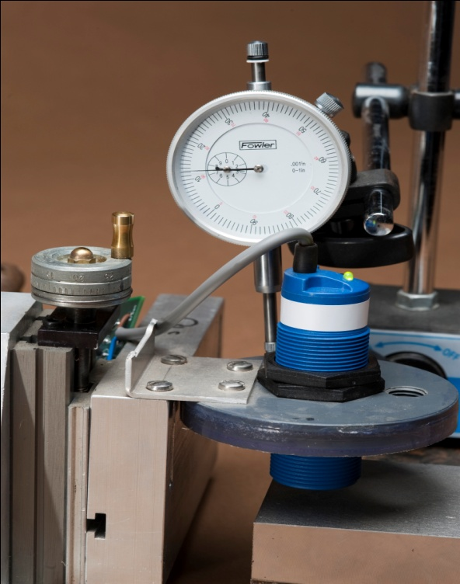
Calibration Stand for Balluff sensors
Adjustable stage
and micrometer
Calibration of a Balluff sensor

Slide 19
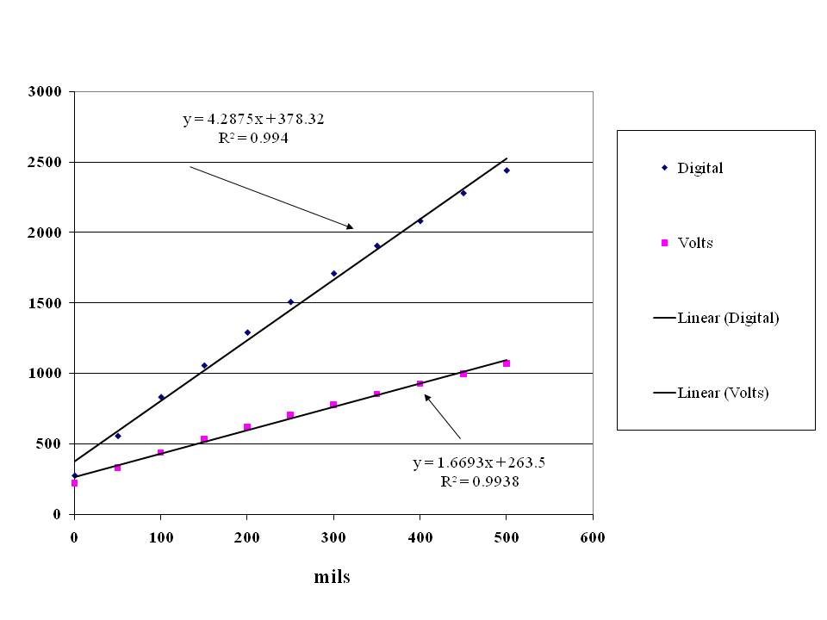
Balluff Sensor Calibration Data

Slide 20
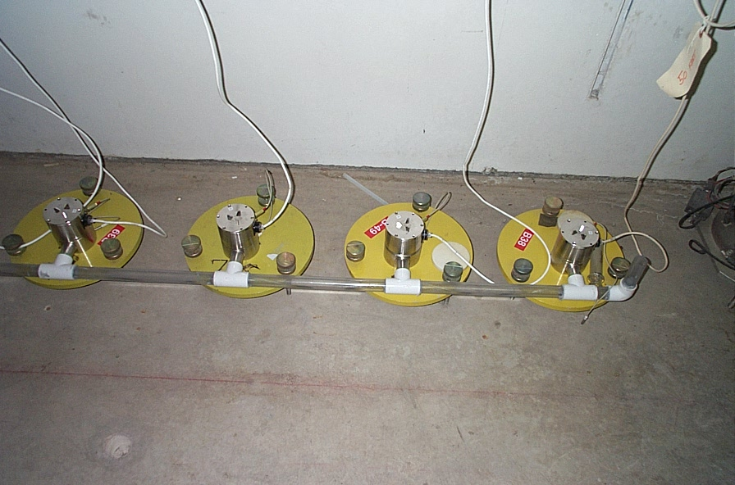
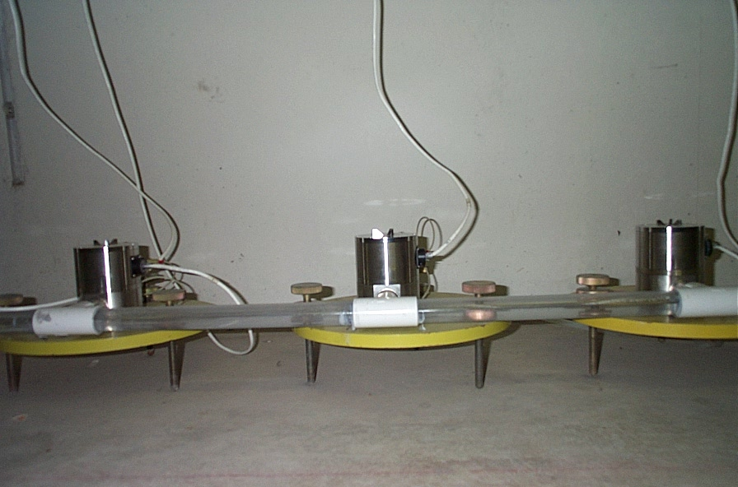
View of SAS-E Test Stand
Single pipe half filled system
Pipe diameter 25.4 mm

Slide 21
Two sensors on same system 4 m apart 2 weeks of data

Slide 22
Adding 50 CC of water to system

Slide 23
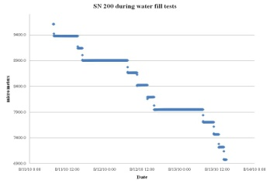
Adding 50 cc of water to SAS-E system
 | SN 188 | SN 189 | SN 190 | SN 191 | SN 193 | SN 194 | SN 195 | SN 196 | SN 197 | SN 198 | SN 199 | SN 200 | Average | Std Dev
Fill number | microns | microns | microns | microns | microns | microns | microns | microns | microns | microns | microns | microns | microns | microns
1 | 232.7 | 232.4 | 232.4 | 232.3 | 232.3 | 232.3 | 232.2 | 232.0 | 232.1 | 232.1 | 231.7 | 232.0 | 232.2 | 0.3
2 | 236.5 | 236.6 | 236.2 | 236.4 | 236.6 | 236.8 | 236.6 | 236.4 | 236.5 | 236.2 | 235.4 | 236.0 | 236.3 | 0.4
3 | 238.7 | 238.7 | 238.6 | 238.5 | 238.6 | 238.8 | 238.7 | 238.6 | 238.6 | 238.5 | 237.8 | 238.1 | 238.5 | 0.3
4 | 239.5 | 239.4 | 239.3 | 239.1 | 239.2 | 239.4 | 239.1 | 239.2 | 239.2 | 239.1 | 238.2 | 238.7 | 239.1 | 0.3
5 | 241.3 | 241.2 | 241.0 | 240.7 | 241.0 | 241.1 | 241.0 | 241.0 | 241.0 | 240.5 | 240.3 | 240.5 | 240.9 | 0.3
6 | 233.8 | 233.6 | 233.6 | 233.6 | 233.6 | 233.6 | 233.6 | 233.7 | 233.7 | 233.6 | 232.9 | 233.3 | 233.6 | 0.2
7 | 243.9 | 243.9 | 243.7 | 243.6 | 243.6 | 243.8 | 243.8 | 244.0 | 243.8 | 243.6 | 243.0 | 243.3 | 243.7 | 0.3
8 | 246.6 | 246.3 | 246.4 | 246.2 | 246.3 | 246.1 | 246.3 | 246.4 | 246.4 | 246.3 | 245.5 | 245.9 | 246.2 | 0.3
9 | 237.9 | 237.4 | 237.6 | 237.4 | 237.6 | 237.5 | 237.7 | 237.7 | 237.7 | 237.4 | 236.8 | 237.0 | 237.5 | 0.3
10 | 247.0 | 246.7 | 246.9 | 246.8 | 246.8 | 246.8 | 246.9 | 247.0 | 246.9 | 246.8 | 246.4 | 246.4 | 246.8 | 0.2
11 | 243.7 | 243.3 | 243.3 | 243.2 | 243.3 | 243.2 | 243.4 | 243.3 | 243.1 | 242.8 | 242.5 | 242.5 | 243.1 | 0.4
12 | 245.2 | 244.9 | 245.1 | 245.1 | 245.0 | 244.9 | 245.1 | 245.2 | 245.1 | 245.1 | 244.8 | 245.0 | 245.0 | 0.1
13 | 222.1 | 222.0 | 222.1 | 222.2 | 221.9 | 221.9 | 222.0 | 222.0 | 221.9 | 222.0 | 221.5 | 221.7 | 222.0 | 0.2
14 | 223.7 | 223.5 | 223.6 | 223.6 | 223.4 | 223.4 | 223.4 | 223.6 | 223.3 | 223.3 | 222.6 | 222.9 | 223.4 | 0.3
15 | 213.6 | 213.6 | 213.7 | 213.9 | 213.6 | 213.7 | 213.9 | 213.9 | 213.7 | 213.8 | 213.3 | 213.5 | 213.7 | 0.2
16 | 226.5 | 226.5 | 226.6 | 226.8 | 226.6 | 226.6 | 226.7 | 226.8 | 226.6 | 226.6 | 226.2 | 226.2 | 226.6 | 0.2
17 | 215.4 | 215.0 | 215.1 | 215.4 | 215.1 | 215.3 | 215.8 | 216.1 | 216.1 | 216.4 | 216.2 | 216.5 | 215.7 | 0.5
18 | 226.8 | 226.7 | 226.7 | 227.0 | 226.6 | 226.7 | 226.9 | 227.0 | 226.8 | 227.2 | 227.0 | 227.1 | 226.9 | 0.2
19 | 229.3 | 229.0 | 229.0 | 229.4 | 228.8 | 229.0 | 229.0 | 229.1 | 228.6 | 228.8 | 228.3 | 228.1 | 228.9 | 0.4

Slide 24
Adding 50 cc of Water to ULSE Sensors
Fill number | SN 53 | SN 57 | SN 64 | SN 56 | SN 63 | SN 62 | SN 54 | SN 55 | SN 61 | SN 59 | SN 58 | SN 60 | average | std dev
1 | 231.5 | 228.9 | 227.2 | 228.1 | 229.7 | 227.8 | 225.2 | 226.7 | 225.3 | 220.2 | 222.4 | 211.4 | 225.4 | 5.4
2 | 213.8 | 218.7 | 214.7 | 216.7 | 217.2 | 216.7 | 217.5 | 218.8 | 216.5 | 216.5 | 214.2 | 214.1 | 216.3 | 1.7
3 | 221.2 | 221.4 | 222.7 | 223.3 | 221.1 | 220.7 | 222.4 | 223.6 | 221.6 | 220.6 | 218.6 | 218.7 | 221.3 | 1.6
4 | 239.5 | 216.4 | 213.4 | 213.4 | 211.2 | 209.5 | 210.6 | 212.8 | 211.6 | 219.3 | 209.0 | 227.7 | 216.2 | 9.0
5 | 226.8 | 219.6 | 217.1 | 216.2 | 213.8 | 211.9 | 214.0 | 214.9 | 213.4 | 217.4 | 211.5 | 220.9 | 216.5 | 4.4
6 | 228.3 | 228.3 | 226.4 | 228.6 | 227.8 | 226.4 | 228.3 | 229.3 | 228.0 | 226.8 | 225.1 | 227.7 | 227.6 | 1.2
7 | 229.4 | 231.5 | 229.9 | 232.0 | 230.7 | 229.2 | 231.3 | 232.1 | 230.7 | 230.6 | 227.5 | 232.2 | 230.6 | 1.4
8 | 232.0 | 229.9 | 228.7 | 230.1 | 228.9 | 227.0 | 229.0 | 229.7 | 228.1 | 228.8 | 225.1 | 229.7 | 228.9 | 1.7
9 | 239.7 | 240.9 | 238.9 | 240.9 | 239.1 | 237.5 | 239.5 | 240.5 | 239.3 | 240.0 | 236.7 | 240.1 | 239.4 | 1.3
10 | 228.0 | 227.7 | 224.9 | 227.2 | 226.0 | 224.9 | 226.7 | 227.3 | 226.1 | 226.5 | 223.5 | 226.1 | 226.2 | 1.3
11 | 244.4 | 244.4 | 242.4 | 244.5 | 242.8 | 241.6 | 243.6 | 244.6 | 243.7 | 244.4 | 241.4 | 244.4 | 243.5 | 1.2
12 | 247.4 | 246.6 | 244.0 | 245.6 | 243.4 | 242.1 | 244.0 | 245.1 | 244.6 | 244.8 | 242.9 | 245.8 | 244.7 | 1.5
13 | 244.8 | 243.3 | 241.0 | 243.2 | 241.6 | 240.8 | 242.5 | 243.7 | 242.8 | 242.1 | 240.8 | 243.3 | 242.5 | 1.3
14 | 233.5 | 236.8 | 234.9 | 236.9 | 235.1 | 234.4 | 235.9 | 237.0 | 236.1 | 241.9 | 247.1 | 237.2 | 237.2 | 3.7

Slide 25
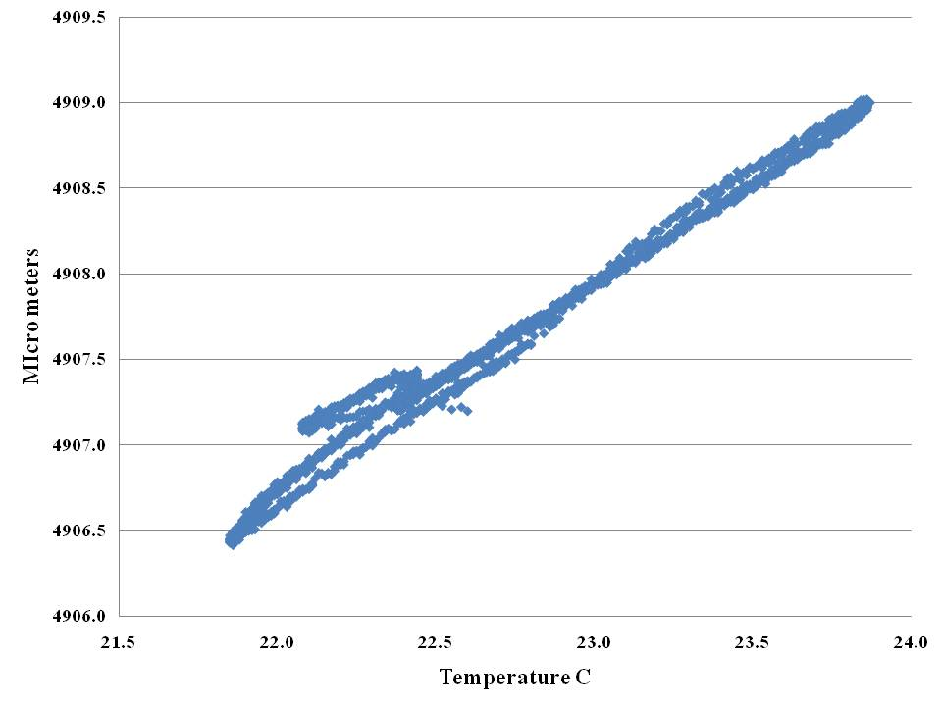
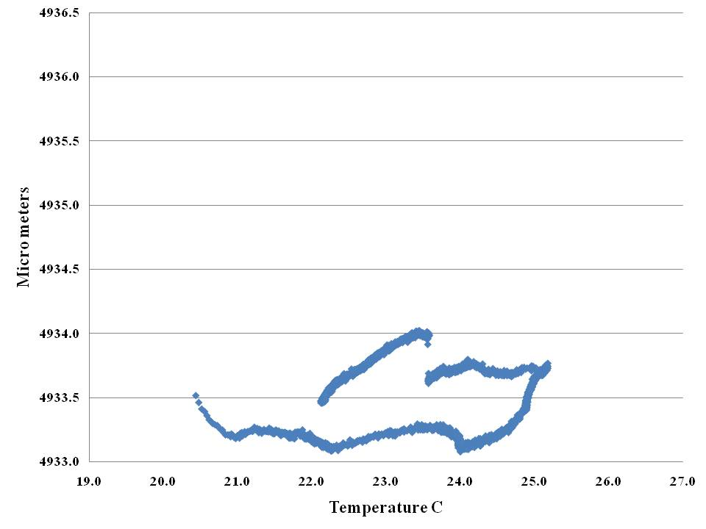
Heating of Budker Capacitive Sensors with fixed disk in pool
SN 198
SN 188
0.5 micro meter per division

Slide 26
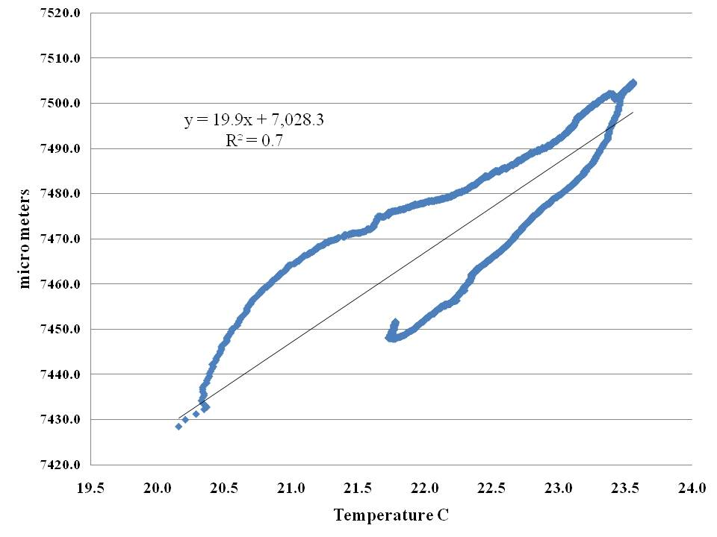
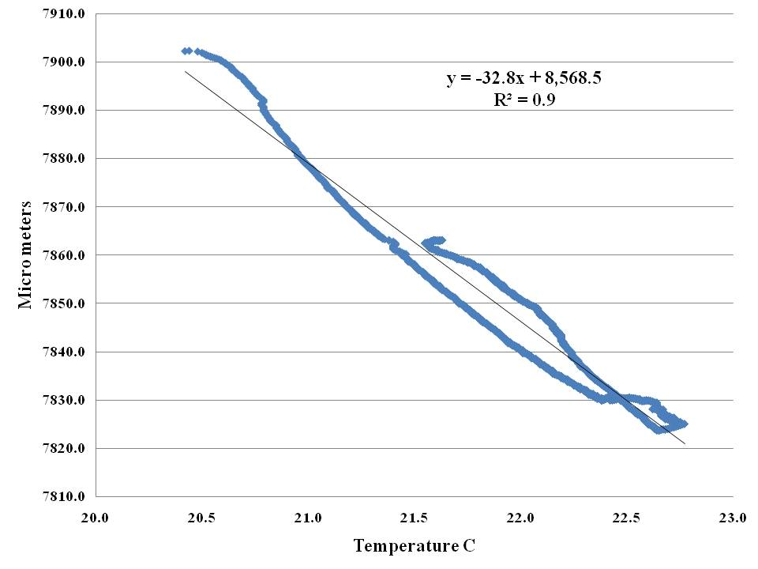
Heating of Budker Ultra Sonic sensors
Sensor 53
Sensor 60
Same scale 1 micro meter per division

Slide 27
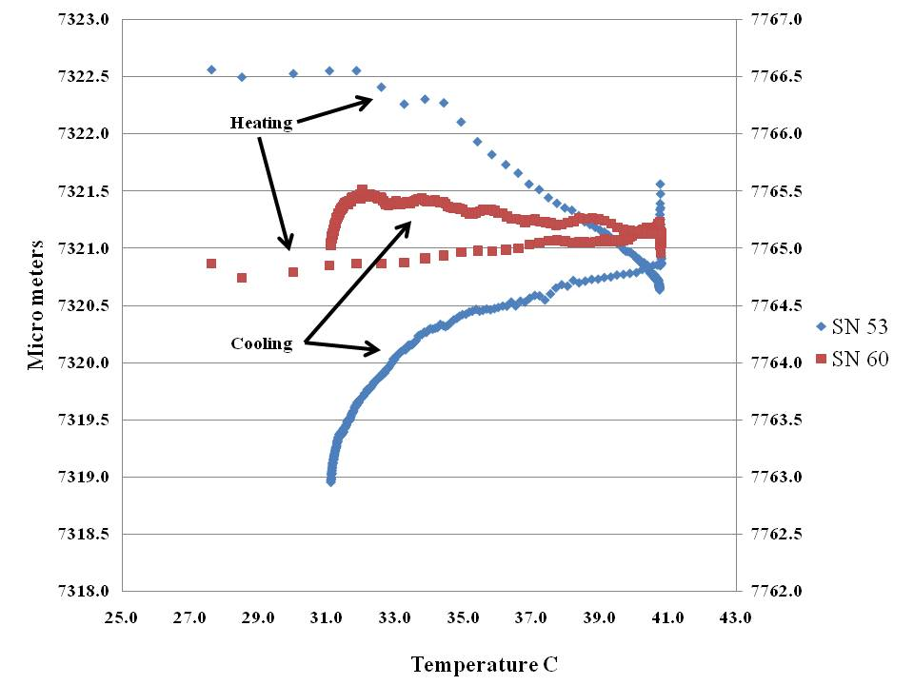
Heating of electronics only for Budker Ultrasonic sensor
0.5 micro meter per division

Slide 28
Findings From Calibration Studies
The capacitive sensors calibration is good to 0.5 micro meters as determined by water filling tests.
The temperature dependence of the capacitive sensors has a hysteresis and varies from sensor to sensor.
This could be an electronic effect and will need more testing.
Need to split analog and digital parts test separately.
The ultrasonic sensors have a larger temperature dependence than the capacitive sensors.
The electronics for the ultrasonic sensors is very stable as measured by separate tests.
Change in water level can not be totally accounted for by water expansion.
Need to test transponders to fully understand temperature effects.

Slide 29
Conclusions
HLS can provide useful information for accelerator operations.
Resolutions of less than 1 micro meter are possible.
Stability test of systems needs more work.
Temperature dependence of electronics needs to be studied.
There is a need to cross calibrate different systems

Slide 30
Danke schön!
Thank You
For you attention
I can be reached at volk@fnal.gov

