Slide 1
Latest Results from the CLIC Geodetic Studies
Mark Jones, CERN
Sébastien Guillaume, ETH Zurich / CERN
Julien Boerez, Université de Strasbourg / CERN

Slide 2
Outline
Introduction
Determination of a Precision Geoid
Modelling the Tidal and other Time Variable Effects on HLS Measurements
Conclusions

Slide 3
Geodetic Studies
Feasibility Study for CLIC
Pre-Alignment tolerance
± 10 [μm] over 200 [m] (3σ)
Knowledge of gravity field essential
High precision geoid model
Tidal and other periodic or non-periodic effects
Particularly important for HLS
CLIC Metrology Reference Network
Two doctoral research projects in progress
Sebastien Guillaume and Julien Boerez

Slide 4
CLIC Geodetic Requirements
Instantaneous equipotential surface at level of HLS & Instantaneous shape of the Earth along the surface where the HLS / Accelerator is installed
In Euclidean space
As a function of time
With a relative precision of a few microns over 200 m
Earth’s gravity potential modelled by applying Newton’s Universal Law of Gravitation and his Second Law of Motion for a point P(x, y, z), considering
Earth’s mass distribution
Earth’s motion within our quasi-inertial solar system

Slide 5
Earth’s Instantaneous Gravity Potential
Time independent elements define quasi-static part of the Earth’s gravity potential
Time independent
Time dependent
r = distance from P(x,y,z) to dV
ρ = density of dV
dV = differential volume element
ω = Earth’s rotation angular velocity
R = Earth’s radius
ϕ = latitude of P(x,y,z)

Slide 6
Disturbing Potential
Can reformulate
To give
Term U(x, y, z) is a known, perfect, mathematical potential field
Term T(x, y, z) is a disturbing potential
Potential field induced by non-modelled density anomalies
Disturbing potential cannot be modelled accurately
Elements of derivatives can be observed
Only astronomical levelling could meet CLIC tolerance
Integrate Earth’s surface deflections of the vertical, ε
Geometrical variations of the disturbing potential at level H_{tnl}
Orthometric correction
(gravity measurements)

Slide 7
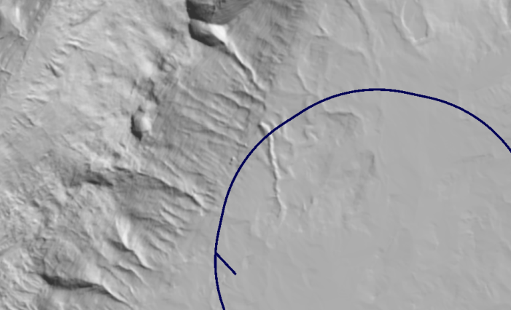
Measurement Campaign
TZ32 tunnel
~850 long, ~80 m underground
Gravity Measurements
Relative Gravimeter Scintrex CG-5
Absolute Gravimeter FG-5
Swiss Federal Office of Metrology (METAS)
Profiles at Surface (every 10 m) and in Tunnel (every 5 m)
Deflection of the Vertical Measurements
DIADEM (ETHZ)
AURIGA software (University of Hannover)
Measurement every 10 m
N
Jura mountains
LHC
TZ32

Slide 8
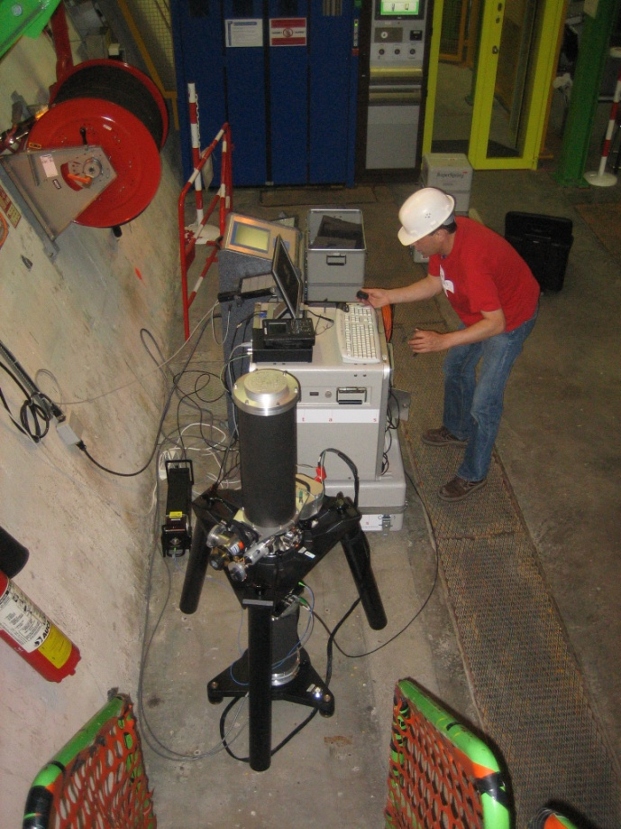
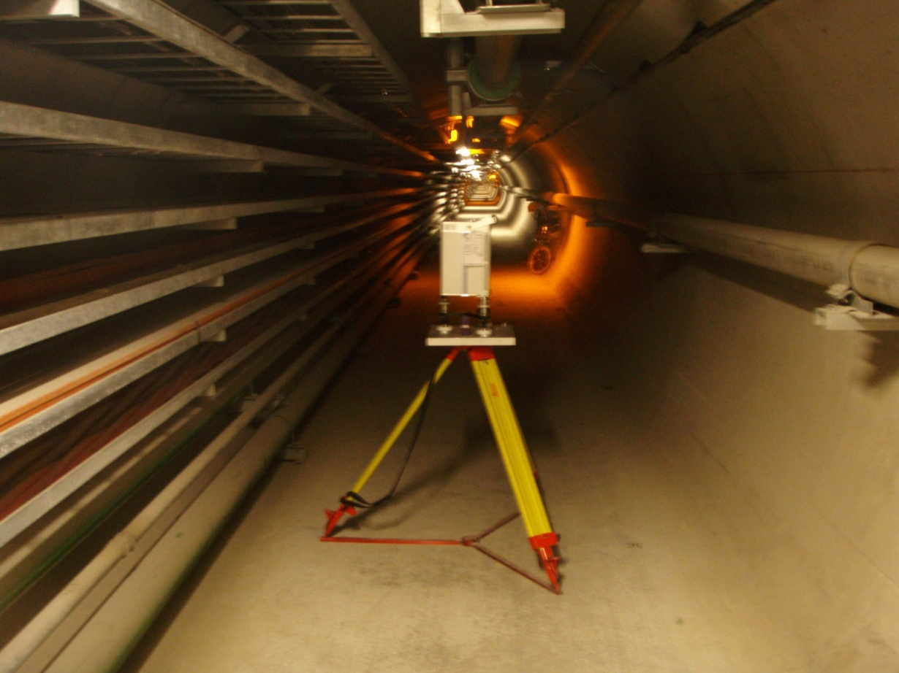
Gravity Measurements
Absolute
FG-5
Relative
Scintrex CG-5

Slide 9
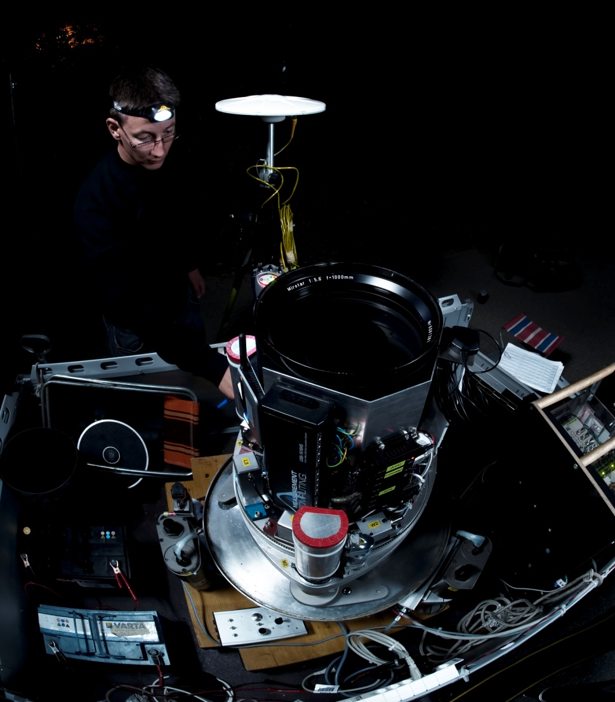
Astro-Geodetic Measurements
DIADEM
Component | # type | Characteristic
Optic | 1x Mirotar | f=1020 mm D=200 mm
CCD camera | 1x Apogee Alta | 2184x1472 pixel, 6.8x6.8 microns, 16 bits
GPS timing | 1x ublox | precision: < 0.1 milisecond
Tiltmeters | 2x Wyler Zerotronics | range: +/- 3600'', precision: 0.15''
 | 4x Lippmann | range: +/- 200'', precision: <0.05''
Digital Focuser | 1x FLI PDF | range: 0-8.9 mm, resolution: 1.3 microns
Automation | 3x eletric cylinders
 | 5x servo motors
DAQ and Control | 2x computers

Slide 10
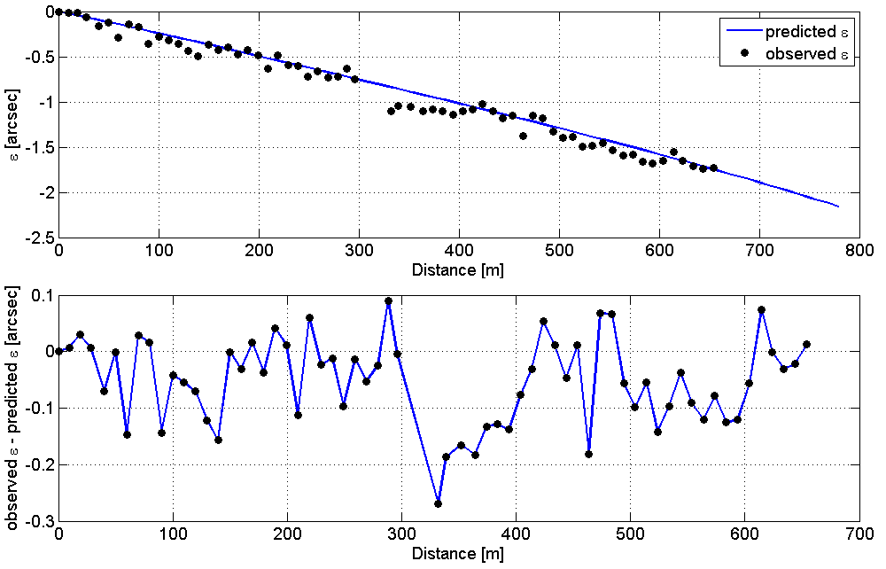
Deflections of the Vertical

Slide 11
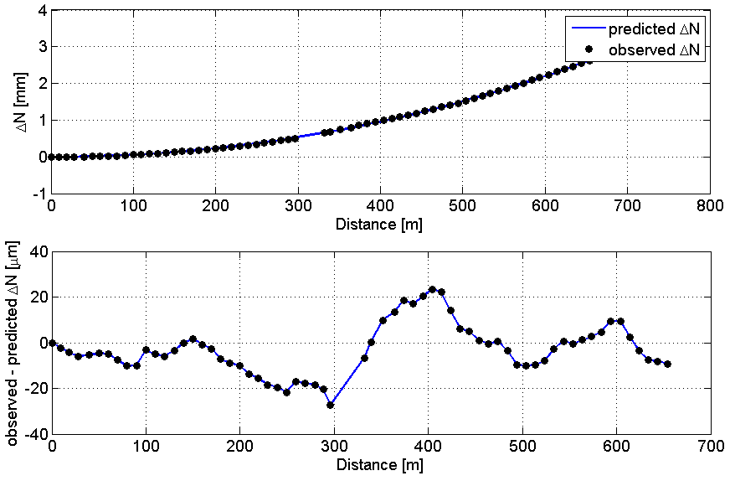
Variation of the Disturbing Potential

Slide 12
Next Steps
Confirm and improve measurement results
Complementary astro-geodetic measurements
Deeper analysis of gravimetric measurements
Try to show what we should expect to find in the real gravity signal
Improved mass models taking into account local geological and hydrological information
Stochastic simulations of the gravity field

Slide 13
Tide Potential
Gravity potential equation
Let us now consider the Tidal Potential
Caused by relative motions of different bodies in our solar system (mainly Sun and Moon)
Different effect on different instruments
Each type of instrument is modelled by specific Love numbers
Time independent
Time dependent

Slide 14
Perturbing Phenomena
Love numbers define the tidal effects for a perfect mathematical model of the Earth
Model perturbed at different scales by various phenomena
geological structure of ground, topography
With a sufficient number of continuous measurements small corrections to the mathematical model can be calculated
These corrections probably only apply to the installed HLS providing the measurement signal
There are other perturbing phenomena for an HLS too
E.g. oceanic load, hydrological load, cavity effects

Slide 15
Hydrostatic Levelling System
An HLS (a tiltmeter) is affected by the change in the Earth’s crust and the measured water surface
Love number combination, γ = 1 + k – h
HLS_1
Equipotential Surface
HLS_2
H-Air_1
Δ1
H-Air_2
H-Water_1
H-Water_2
dH
Earth’s Crust
Δ2
dH = H-Air_1 – H-Air_2 – Δ1 – Δ2

Slide 16
Tilts and Deformations
In the context of accelerator alignment the difference between a tilt and a deformation is very important
The goal is to separate out the two from the raw measurement signal

Slide 17
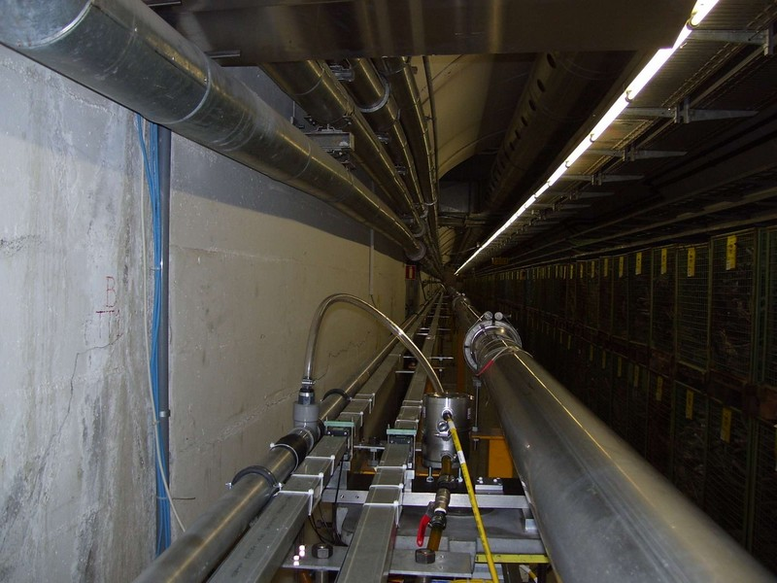
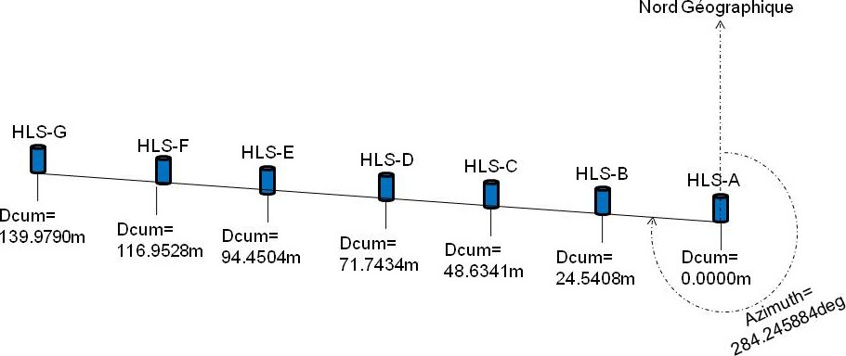
Raw HLS Measurement Signal
TT1 Tunnel

Slide 18
Eterna Package
Major tool for analysis and prediction of tidal effects
Developed by Prof.Dr.-Ing H.-G. Wenzel in the 1990’s
Different tidal potential catalogues available
Many programs included in the Eterna 3.30 Package
ANALYZE program – for analysis of earth tide observations
Compares raw measurements against theoretical tide models
Determines modified tide parameters
New amplitude and phase shift parameters to predict future measurements
PREDICT program – computation of synthetic model tides
Standard model, or results from ANALYZE
Main tool used for our research

Slide 19
HLS Network Analysis
Standard processing technique using Eterna
Analysis of 2.5 month dataset
Analysis values used to predict tides for later 3 week period
Predicted tides and some load signals* removed from raw HLS signal
But we cannot distinguish between periodic signals in raw measurements
We need to separate some of them!
* Kindly provided by J.P. Boy, NASA GSFC

Slide 20
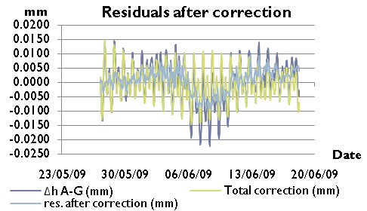
Analysis Results

Slide 21
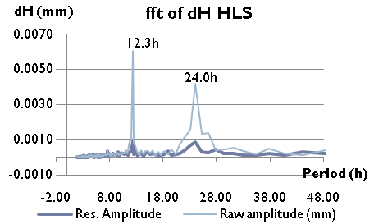
Analysis Results

Slide 22
Analytical Prediction
PREDICT program used to determine theoretical HLS tide signal
Predicted tides and all other known signals removed from raw HLS signal
This gives us an isolated ground deformation signal
We don’t know if he residual signal gives only local deformations!

Slide 23
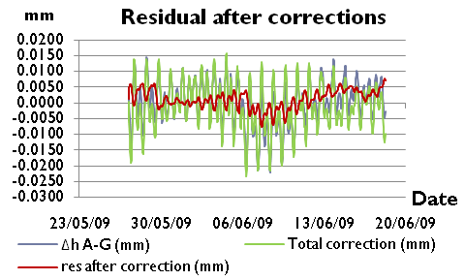
Prediction Results

Slide 24
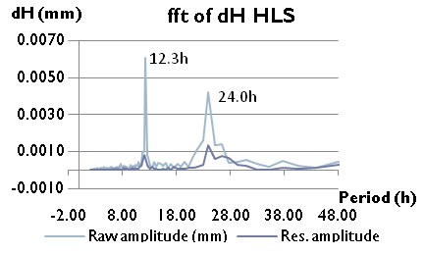
Prediction Results

Slide 25
Next Steps
Need a different approach to meet specific needs of accelerator alignment
Isolate local tilt signal and local deformation signal
Another possibility using ANALYZE program
Need to determine models for as many phenomena as possible
Remove all modelled signals from raw measurement signal
Use sensor at one end of HLS and pair it up with each of the other sensors in turn
Use results from end point sensors as base signal
Remove signal from other analysed sensor pairs
Remaining signals should represent relative movements of intermediate sensors

Slide 26
Conclusions
Two research projects launched to address geoid and HLS issues from CLIC Feasibility Study and LHC installation
Both projects in final year
800 metre tunnel selected for Geoid Precision study
Campaigns of astro-geodetic and gravity measurements
Modifications to zenith camera (DIADEM) to improve precision
Initial results very promising
Further work required to confirm results
Improved precision of DIADEM confirmed in difficult field conditions

Slide 27
Conclusions
Two approaches tried to model tidal and other effects on HLS measurements
Disadvantanges to both methods
Need a new approach to meet the specific requirements of accelerator alignment
Multiple sensors on each network, looking to isolate local deformations and tilts
Analysis is now in progress
Still some phenomena to take into account
Need to apply results to LHC networks and implement corrections

Slide 28
Thank you for your attention

