Slide 1
Graphical and Numeric Measurement Station Uncertainty Characterization
Scott Sandwith
New River Kinematics
scott@kinematics.com

Slide 2
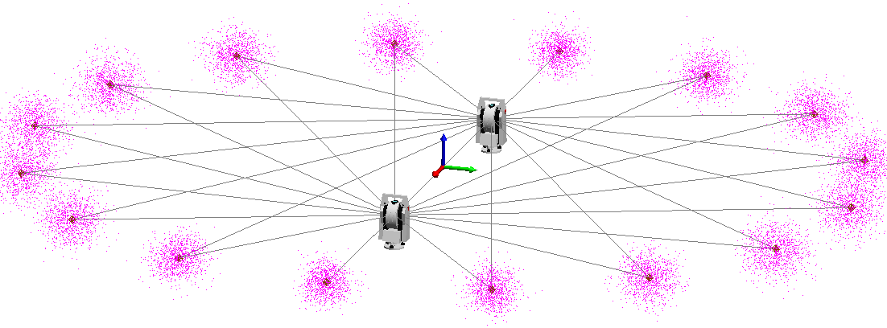
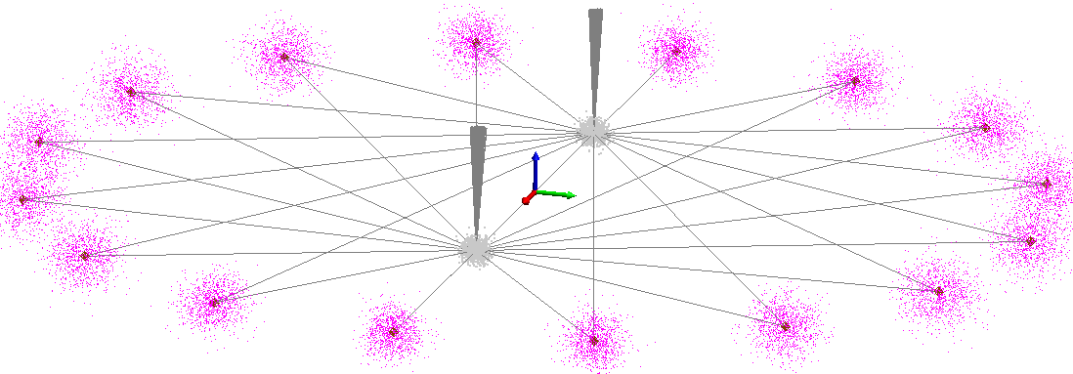
Introduction
Network Adjustment (Inputs v. Outputs)
Compute and report instrument (station) position variation during Monte Carlo
Save each station position during Monte Carlo computation
Compute std dev of each position/orientation parameter based on the samples
Report station variations
Instrument Position/Orientation Uncertainty Report
Conclusions

Slide 3
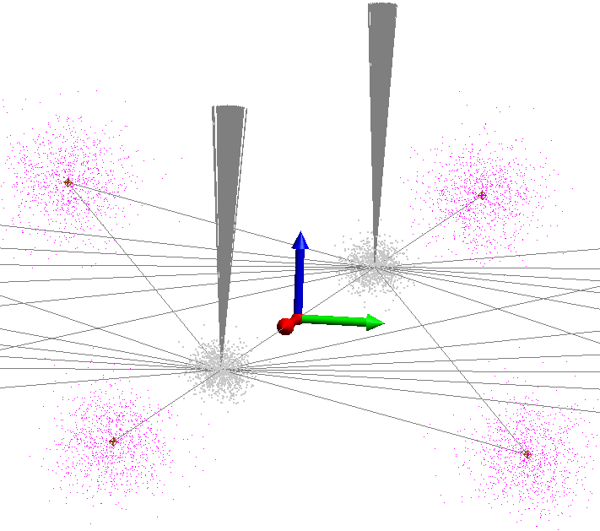
Communicating Uncertainty Estimates
Understanding and communicating reliable measurement uncertainty
In many cases measurement process uncertainty is difficult to control
Geometry constraints within facility
Methods to characterize and communicate specific influences and dependences are key tools for alignment teams

Slide 4
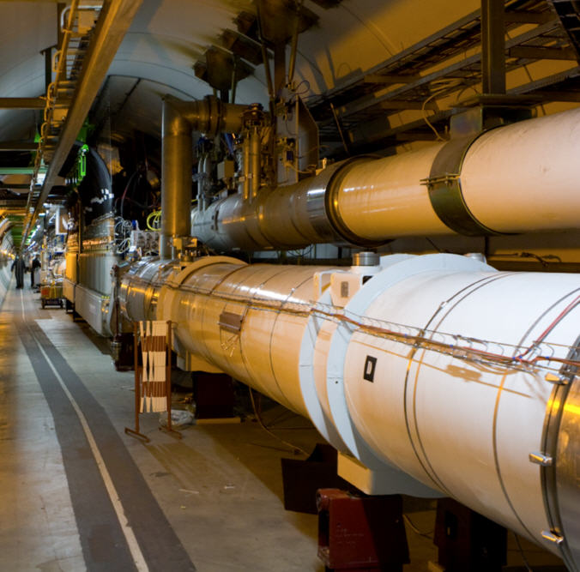
Accelerator Surveys
Inputs
Instruments (Types Stations, Performance, and Environment)
Control/Constraints (Instrument, Levels, Scale Bar(s) Distance)
Point/Observation Network
Reflector and Targeting Offsets, Errors (e.g., hidden pts, vector bars)
Outputs
Network Adjustment
Uncertainty Analysis – Study – Confidence
Points
Stations
Geometry

Slide 5
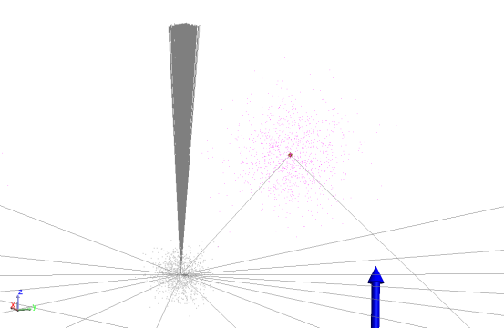
Why Instrument Uncertainties?
Point uncertainties are primary output of interest
To influence pt uncertainty understanding instrument/station uncertainty
Ux, Uy, Uz, URx, URy, URz, U_TA
is a key element to influence and control alignment network uncertainty

Slide 6
Objective Uncertainty Feedback
Objectively characterizing and visualizing each stations position and orientation uncertainty in context of network is helpful
Understanding influences and dependence that station position and precision plays enables alignment teams to make objective choices on effective optimize station performance and position(s).

Slide 7
Case Studies
Individual station uncertainty within network results are presented both graphically and numerically
Evaluation and graphical results show net differences in how measurement network from a station influences component alignment characterization
Outcome → Choices in which sensors are used and how their position(s) within network influence alignment fidelity

Slide 8
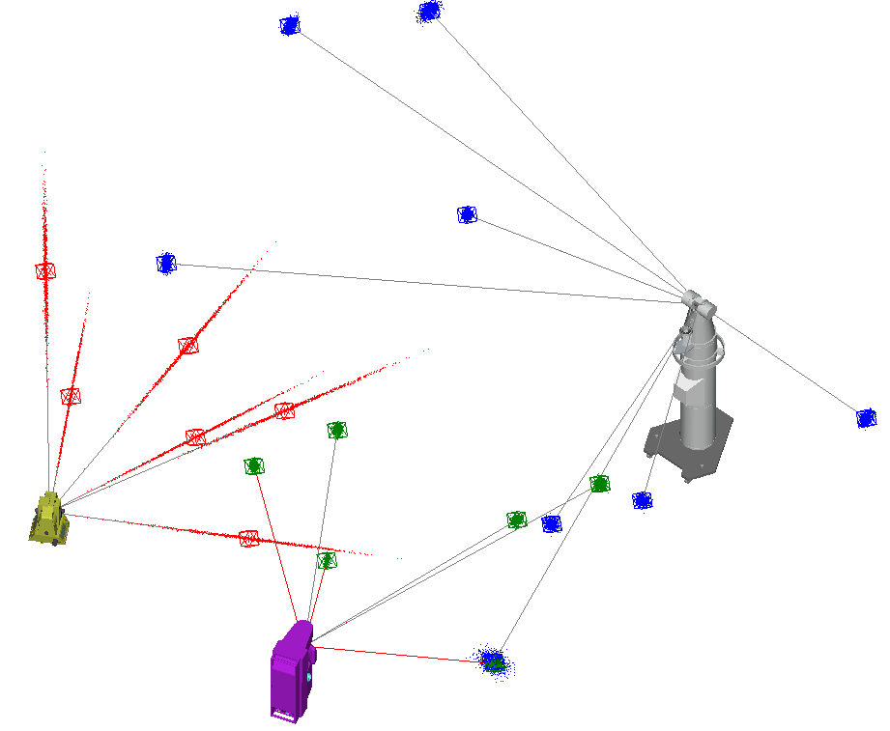
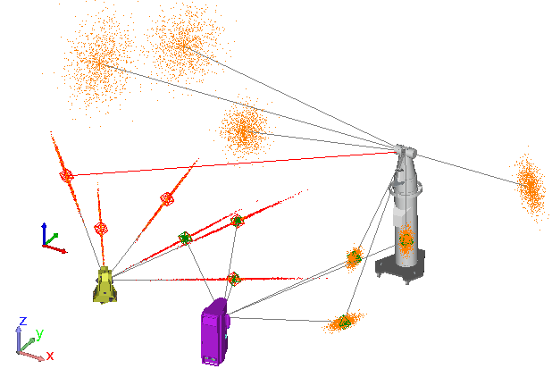
Simple Example

Slide 9
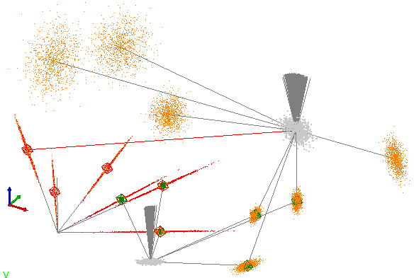
Open Network Effects

Slide 10
Uncertainty Comparison
Open Network Fixed Total Station
Closed Network Fixed Total Station
Closed Network Free Network Adjustment

Slide 11
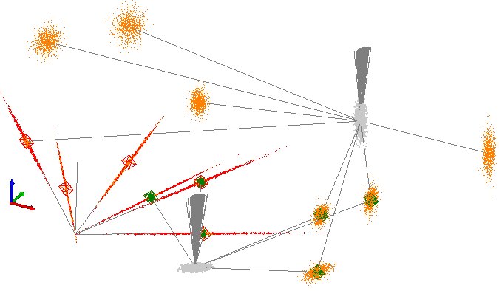
Compare: Open/Closed Survey

Slide 12
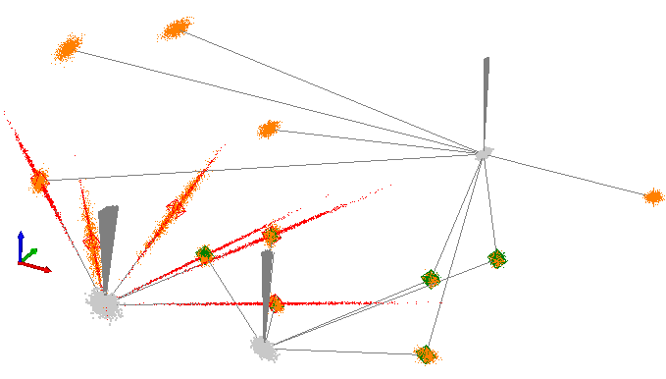
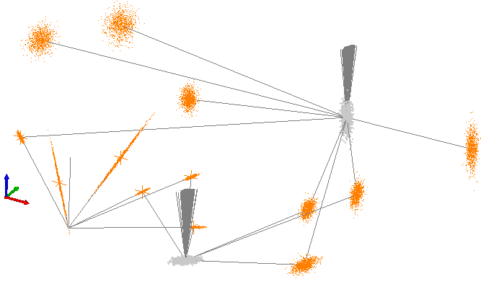
Closed Survey → FreeNet

Slide 13
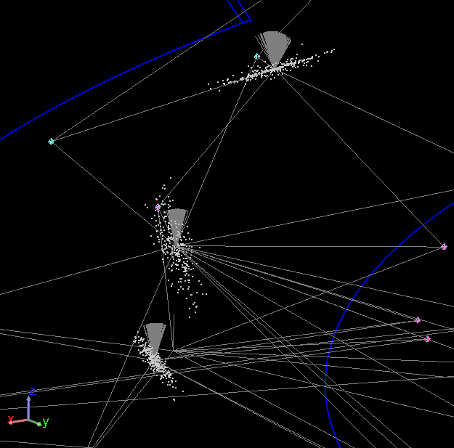
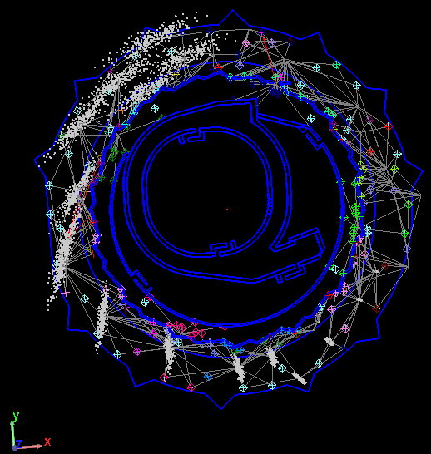
Accelerator Network

Slide 14
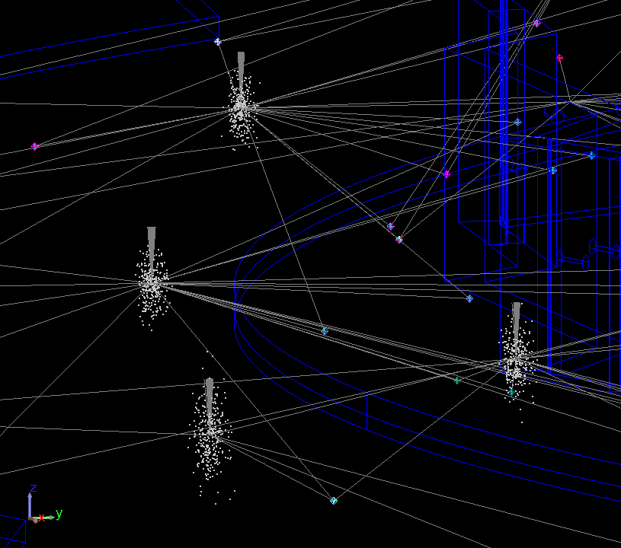
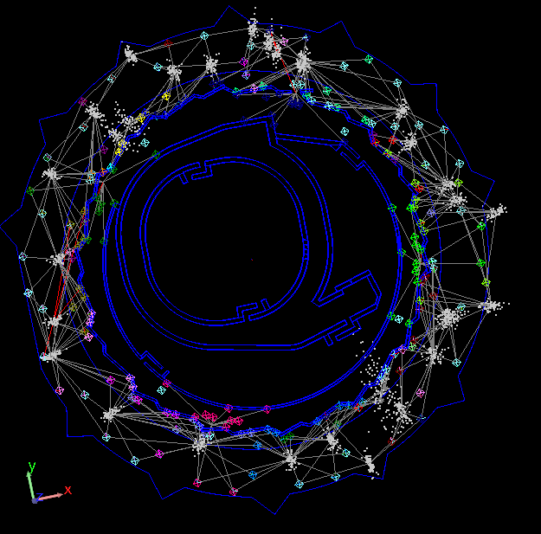
Free Network Instrument Uncertainty

Slide 15
Comparison between Fixed and Freenet

Slide 16
Instrument/Station Uncertainty Conclusions
Measure of how encompassing pt network is about each station
Larger instrument uncertainty results if the pt network is within a narrow field of view
When common pt network is uniformly distributed instrument uncertainty looks worse but will provide more conservative estimates of performance
Using variation of station position during Monte Carlo provides a reasonable measure of the rigor of the network

